Slide 1


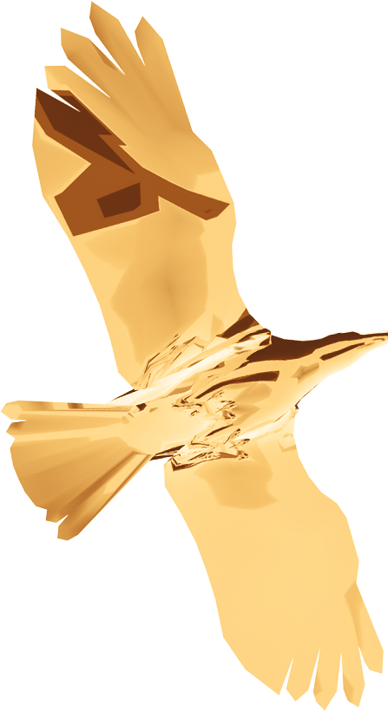
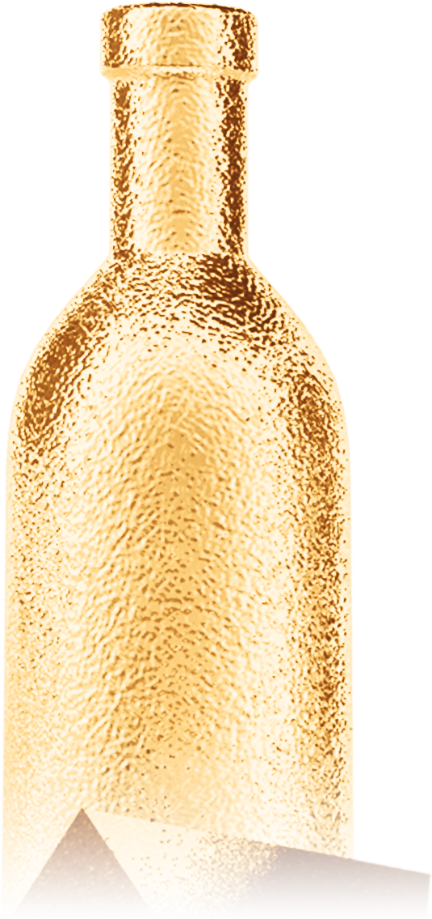


LIVE, HOT & FREE
31st DECEMBER 2025
2026
2026
NEW YEAR
NEW YEAR
T H E U L T I M A T E N E W Y E A R P A R T Y !
DRESS TO IMPRESS
Venue
NEAR BURGER-HOUSE | GLAMOURAVE 24 | 34954 FEELINGTOWN

