Slide 1
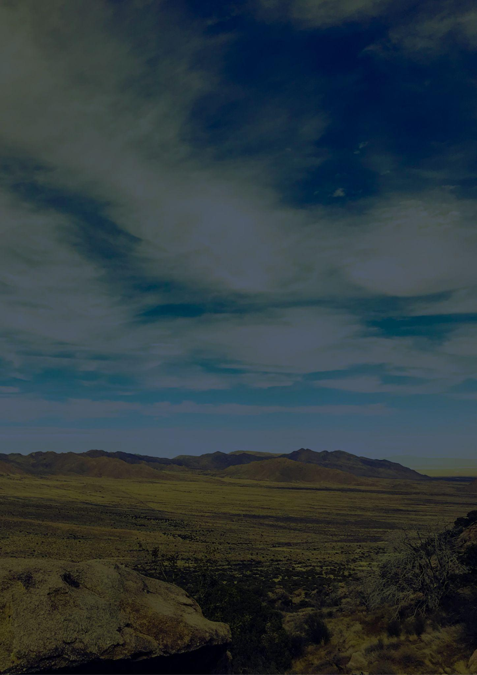
Travel bucket list
New Mexico
Carlsbad Caverns Park
Research Center
White Sands
Georgia O'Keeffe Museum
Balloon Fiesta
Carlsbad Caverns Park
Bandelier Monument
New Mexico Museum
Petroglyph Monument
Loretto Chapel
Taos Pueblo
Sandia Peak Ski
Gila Cliff Dwellings
Petroglyph Monument
Taos Ski Valley
Taos Pueblo
Pecos National Park
Santa Rosa Blue Hole
The Very Large Array
Billy the Kid Museum
Chaco Culture Park
Wheeler Peak Wilderness
Billy the Kid Museum
UFO Museum
Wheeler Peak Wilderness
ABQ BioPark
Cliff’s Amusement Park
Four Corners Monument

