Slide 1
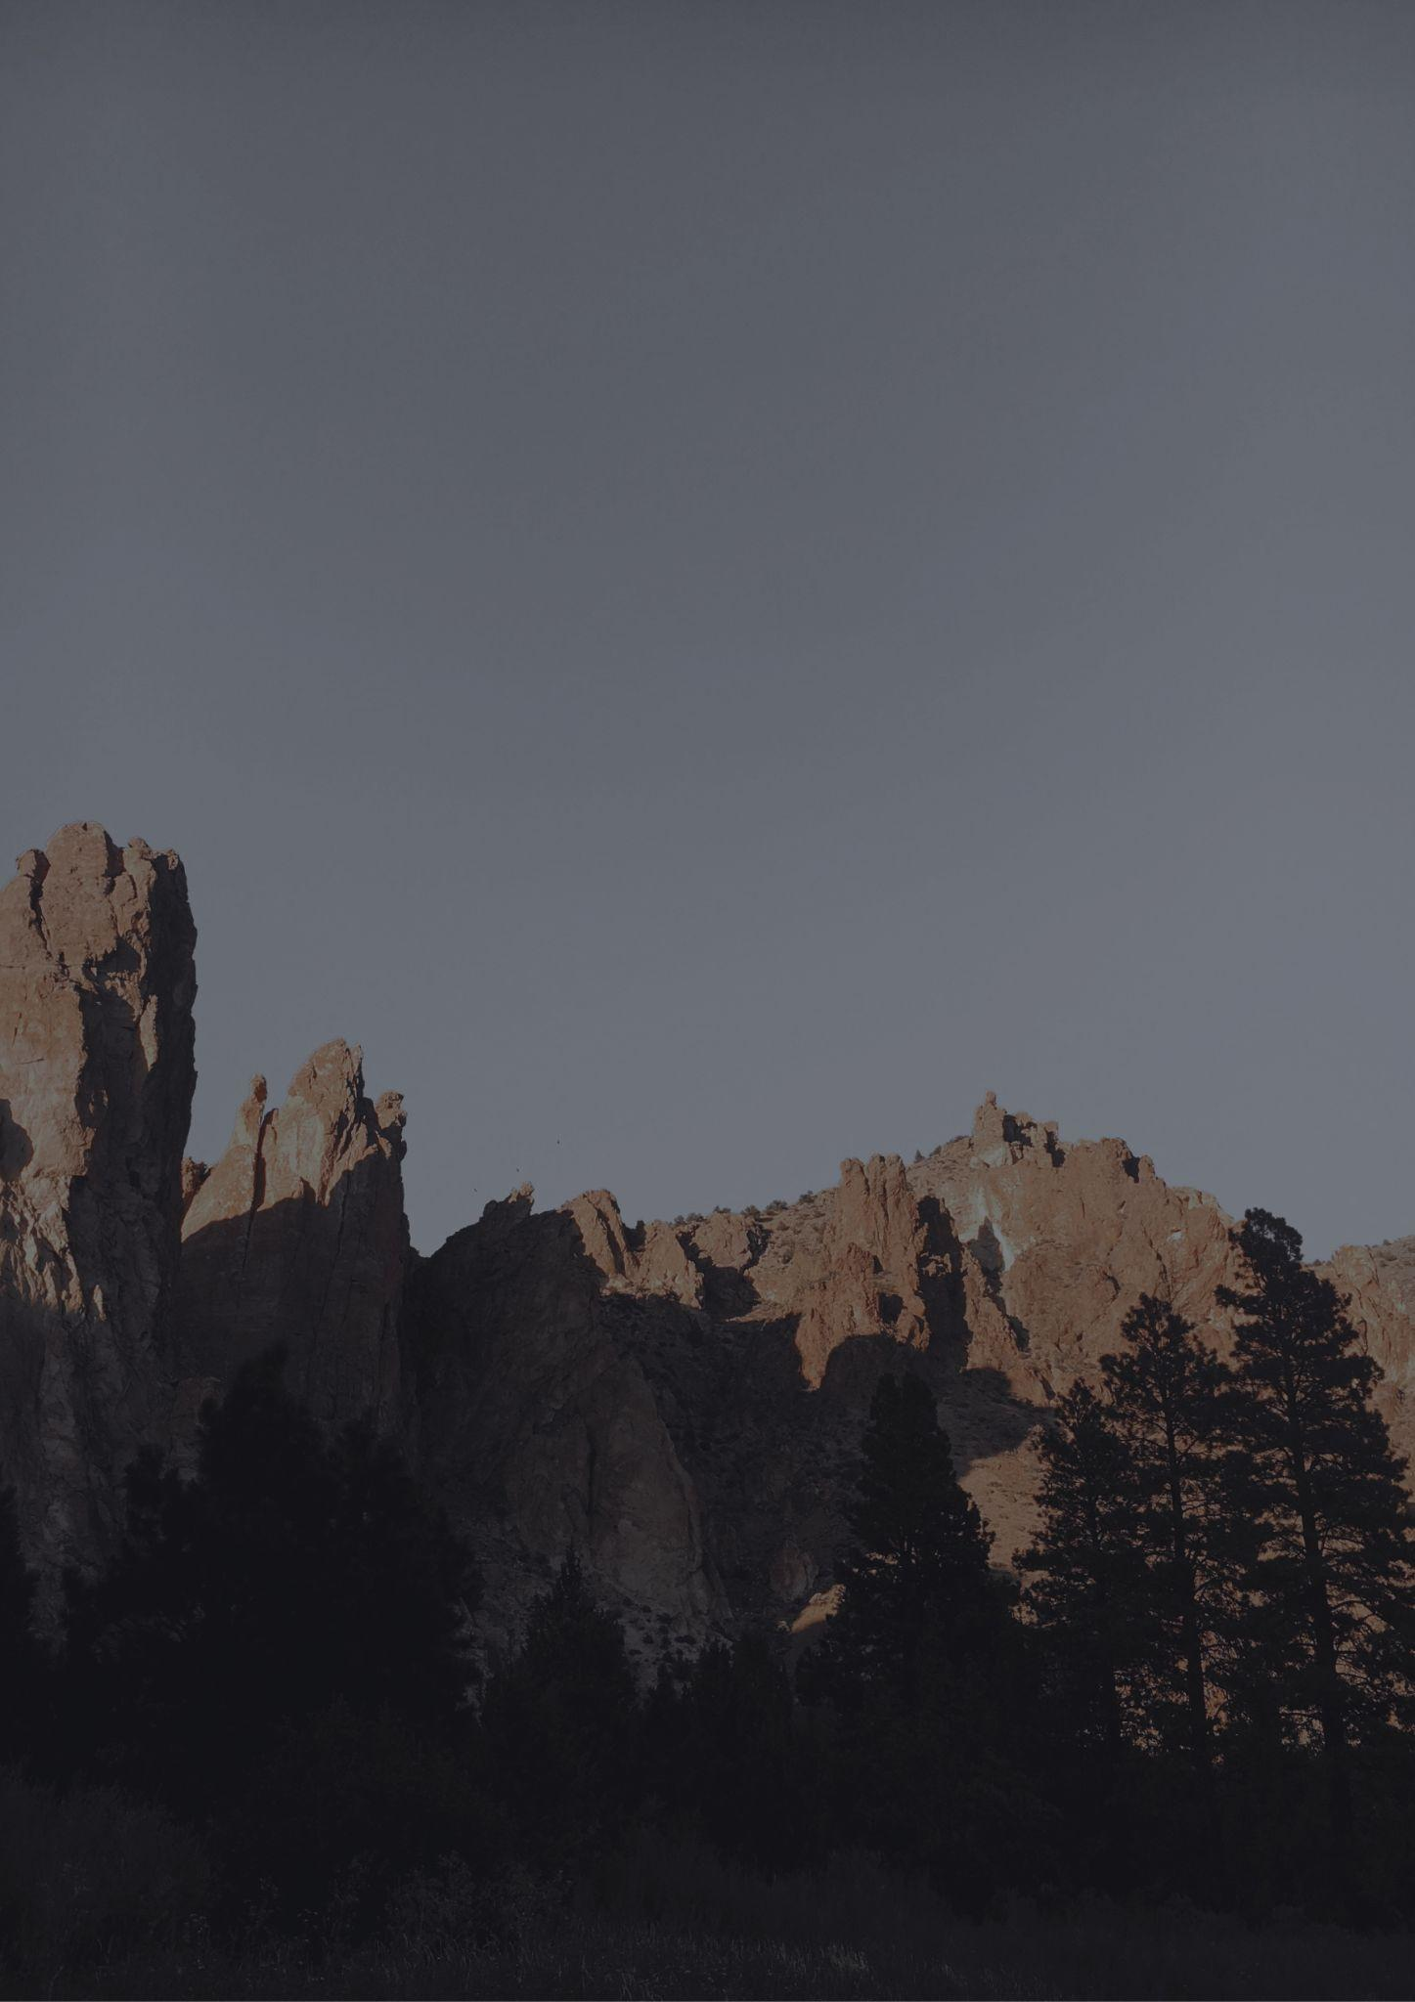
Travel bucket list
NEBRASKA
Omaha's Henry Doorly Zoo
Lake McConaughy
Strategic Air Command
Aerospace Museum
Chimney Rock
Chadron State Park
Ponca State Park
Cowboy Trail
Harold Warp Pioneer Village
Sunken Gardens
The Durham Museum
Nebraska State Capitol
Niobrara National River
Lincoln Children's Zoo
Lauritzen Gardens
Pioneer Courage Park
Joslyn Art Museum
Arbor Lodge State Park
Carhenge
Omaha Old Market
Buffalo Bill Ranch
Cody Park
Scotts Bluff Monument
World's Largest Stamp Ball
Golden Spike Tower
Homestead National Park
Indian Cave State Park
Toadstool Geological Park
The Archway
Joslyn Art Museum

