Slide 1
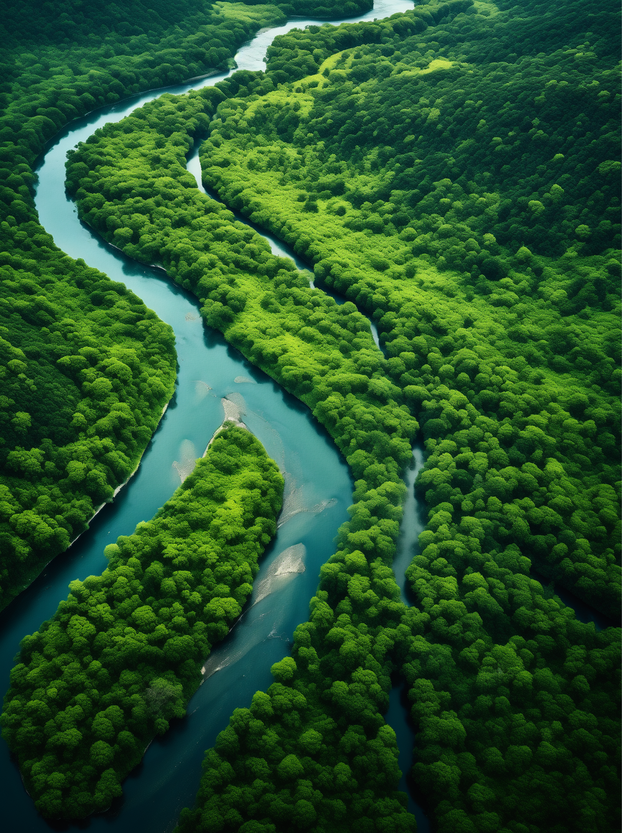
Destinations | Trends | Tips
Friday, October 1, 2025
THE GREEN HORIZON
The photographer, renowned ecologist Dr. Elena Martinez, documented this scene while researching the forest's biodiversity.
A JOURNAL OF ECOLOGY & CONSERVATION

Slide 2
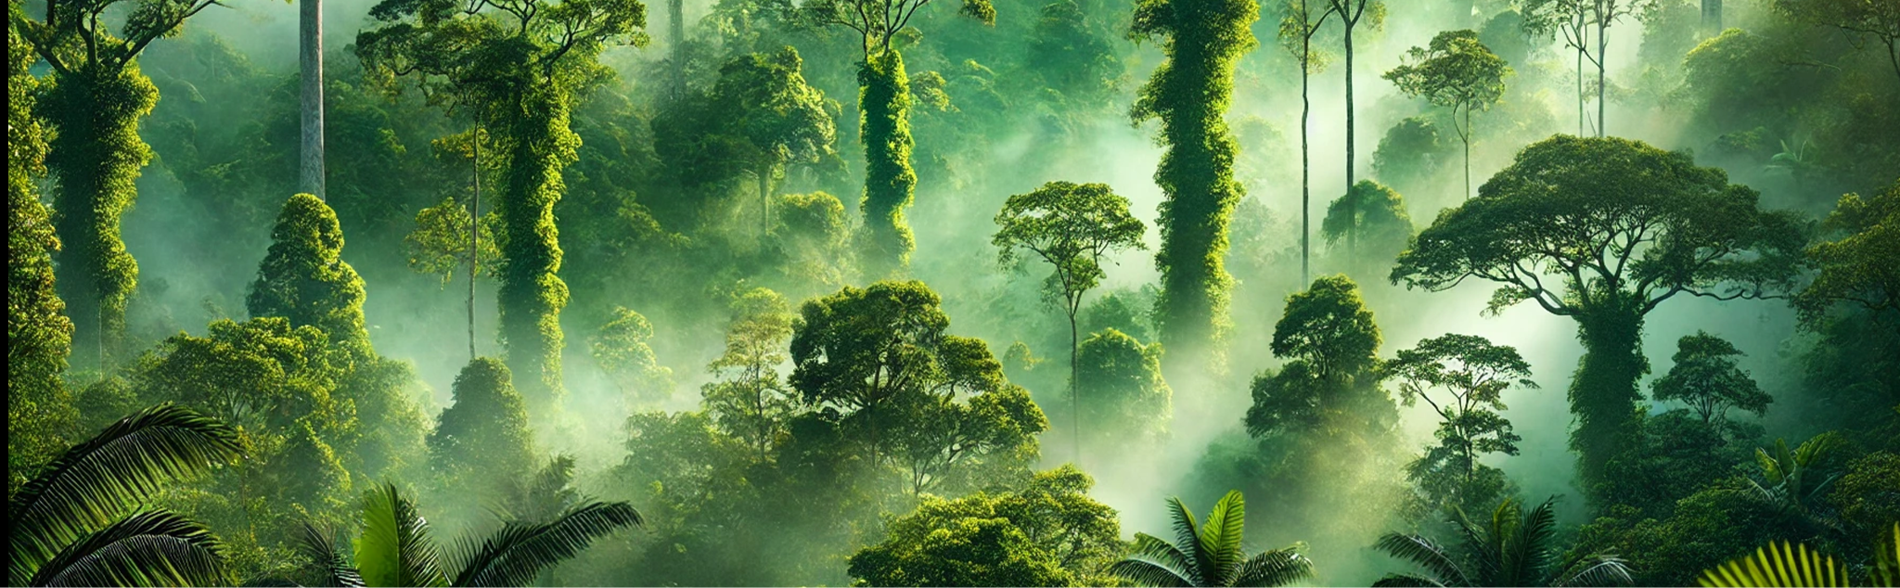
Destinations | Trends | Tips
Friday, October 1, 2025
This image, taken by environmental photographer Alexei Kozlov, captures the magic of untouched wilderness.
WHY PRESERVING
ANCIENT FORESTS
IS VITAL:
The preservation of ancient forests like the Amazon is more important now than ever. Conservationists argue that the remaining intact forests must be protected under international law, and local communities should be empowered to act as guardians of these ecosystems. The Amazon is home to over 400 billion individual trees representing 16,000 species, and it provides habitat for a vast range of wildlife, including jaguars, sloths, and harpy eagles. However, beyond its biodiversity, its ability to store carbon and produce oxygen is invaluable to the health of our planet.
Various initiatives are working to protect and restore the Amazon. Brazil, Peru, and Colombia have launched conservation programs aimed at protecting large tracts of forest from further development, and indigenous communities are playing a crucial role far-reaching, not only reducing the forest's ability to regulate.
The Lungs of the Earth
As deforestation continues to ravage some of the world’s most vital ecosystems, the Amazon Rainforest stands at the forefront of this battle. Often referred to as the “lungs of the Earth,” the Amazon plays a critical role in absorbing carbon dioxide from the atmosphere and releasing oxygen, making it one of the most essential ecosystems in combating climate change. Yet, it is also one of the most threatened.
According to recent studies, over 17% of the Amazon has been destroyed in the past five decades, primarily due to illegal logging, agricultural expansion, and infrastructure development. The consequences of this destruction are.

Slide 3
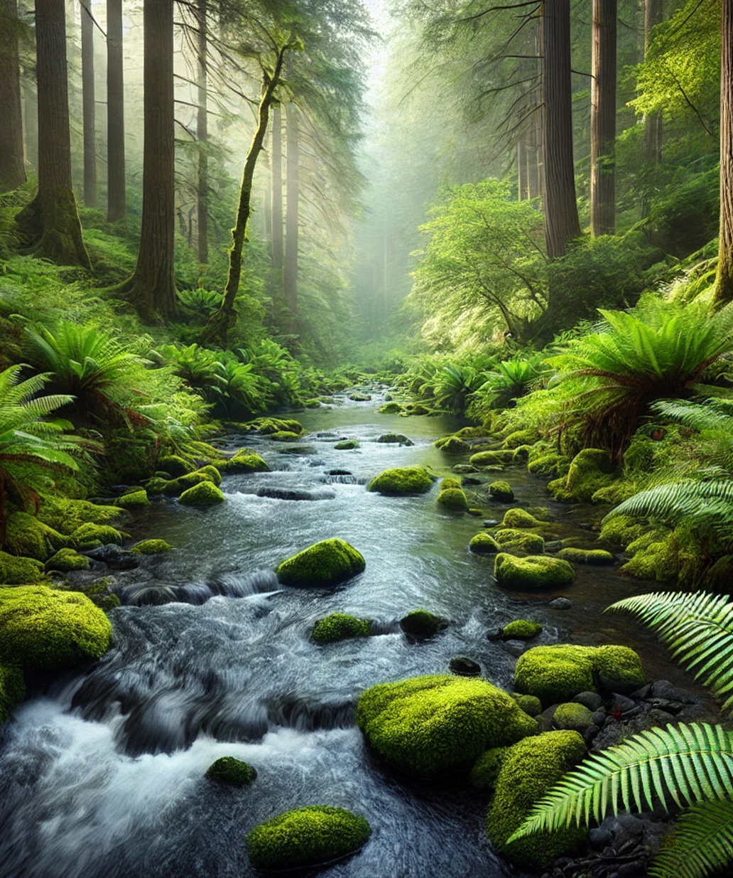
Friday, October 1, 2025
DISCOVERING THE
HIDDEN WORLD ABOVE:
The Magic of the Canopy
In the face of widespread deforestation, reforestation projects offer a glimmer of hope. Reforestation is not just about planting trees—it’s about restoring entire ecosystems, improving air quality, and rebuilding habitats for wildlife. A young sapling, like the one captured by Iryna Melnyk in Poland, represents the resilience of nature and the potential for recovery even in heavily degraded landscapes.
Global reforestation efforts have gained significant traction over the past few decades, with countries and organizations dedicating time and resources to plant millions of trees. Initiatives such as the United Nations.
RECONNECTING
WITH NATURE:
Forests are often referred to as “nature’s sanctuaries,” places where the stresses of modern life can be left behind and the healing power of nature can take over. Forest trails, in particular, offer a space where people can reconnect with the natural world, whether through quiet reflection, recreational hiking, or forest bathing, a practice that originated in Japan and has been embraced around the world.
In an increasingly urbanized world, spending time in forests is no longer as easy as it once was, as cities expand and natural spaces become more distant.
This image, taken by environmental photographer Alexei Kozlov, captures the magic of untouched wilderness.

Slide 4
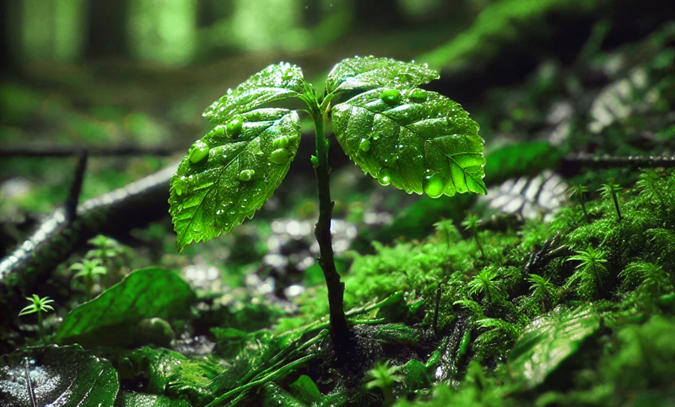
Destinations | Trends | Tips
Friday, October 1, 2025
PLANTING THE FUTURE:
The Power of Reforestation
the globe. These efforts are critical in reversing the damage caused by deforestation, particularly in regions that have experienced large-scale clearing for agriculture or urban development.
However, planting trees is just the first step. For reforestation to be successful, it requires careful planning, nurturing, and long-term maintenance. In many cases, reforestation projects have failed due to a lack of proper care for young trees or planting species that are not native to the area. Successful reforestation requires a deep understanding of the local ecosystem, ensuring that the species planted will thrive and benefit the surrounding wildlife.
In Poland, grassroots organizations have taken the lead in promoting sustainable.
In the face of widespread deforestation, reforestation projects offer a glimmer of hope. Reforestation is not just about planting trees—it’s about restoring entire ecosystems, improving air quality, and rebuilding habitats for wildlife. A young sapling, like the one captured by Iryna Melnyk in Poland, represents the resilience of nature and the potential for recovery even in heavily degraded landscapes.
Global reforestation efforts have gained significant traction over the past few decades, with countries and organizations dedicating time and resources to plant millions of trees. Initiatives such as the United Nations’ “Trillion Tree Campaign” aim to restore degraded land by planting
Photographed by eco-activist Iryna Melnyk in a protected national park in Poland, the image symbolizes hope for reforestation efforts worldwide.

