Slide 1
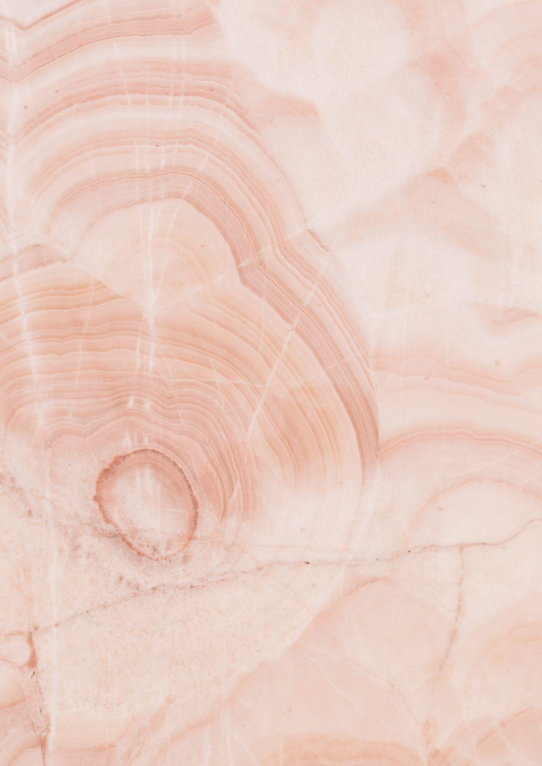
NAIL SALON
Price List
Manicure
Manicure (American)
$ 15.00
Express Manicure (Gel American)
$ 16.00
Manicure (French)
$ 17.50
Express Manicure (Normal French)
$ 12.00
Kids Manicure
$ 17.25
Luxury Manicure (Gel French)
$ 18.10
Pedicure
Classic Pedicure (Gel)
$ 15.00
Classic Pedicure (American)
$ 16.00
Kids Pedicure
$ 17.50
Luxury Slush Pedicure
$ 12.00
Dry Express Pedicure
$ 17.25
Nail Repair
Shellac / Gel Removal
$ 15.00
Nail Enhancements
$ 16.00
Repair Nail Enhancements (Per Nail)
$ 17.50

Slide 2
NAIL SALON
All About Nails
your social media
www.yourwebsite.com

