Slide 1
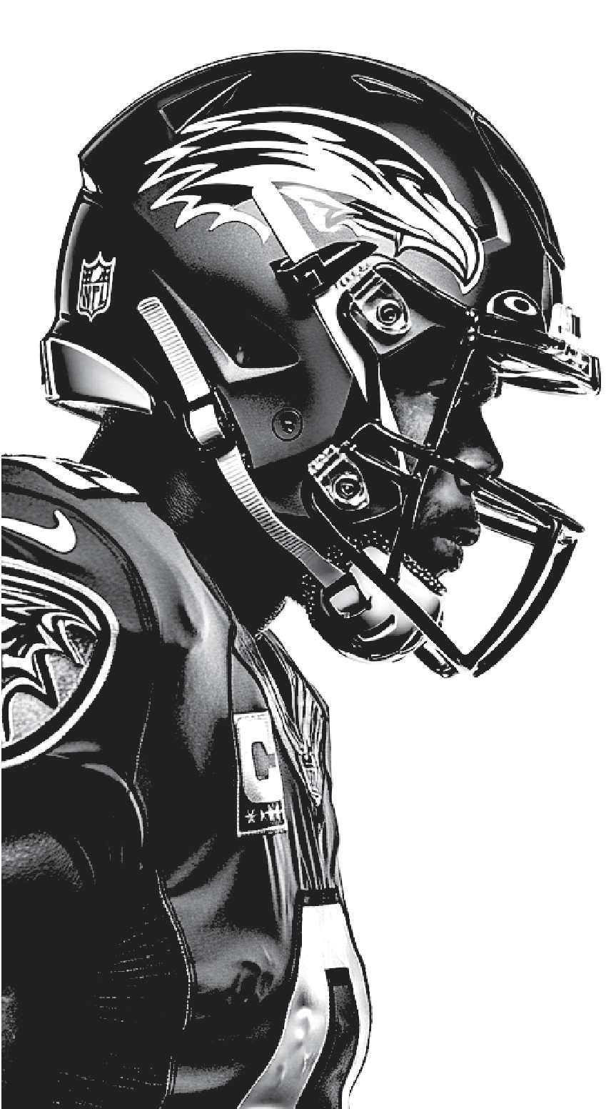
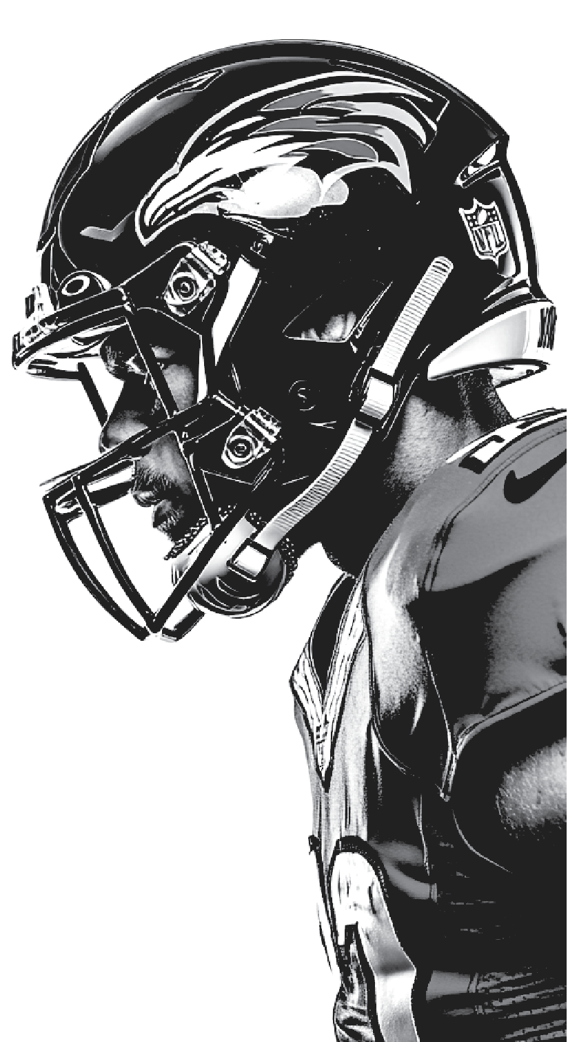

WILD CARD
DIVISIONAL
ROUND
CONFERENCE
CHAMPIONSHIP
CONFERENCE
CHAMPIONSHIP
DIVISIONAL
ROUND
WILD CARD
NFL
1
PLAYOFF BRACKET
1
4
4
5
5
3
3
6
6
2
2
7
7

