Slide 1



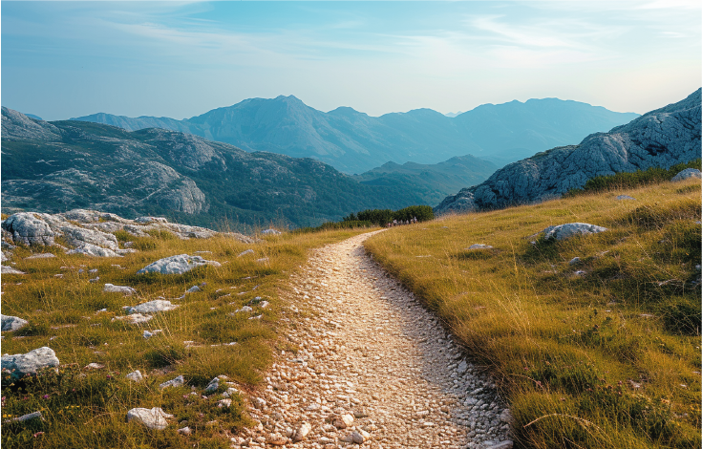
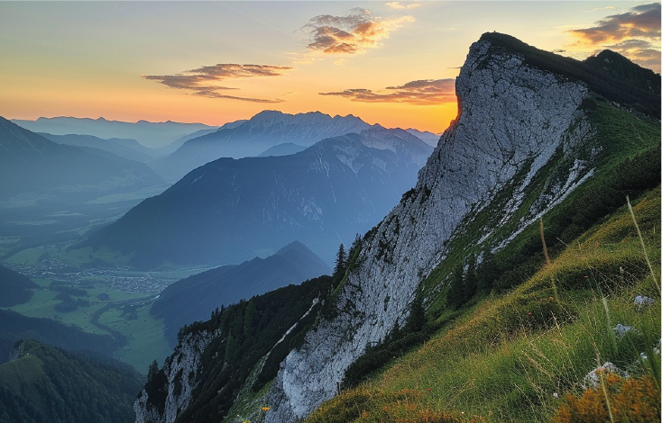
MOUNTAIN
HIKE
ITINERARY
Location: John Muir Trail, Sierra Nevada Mountains, California
Duration: 6 Days, 5 Nights
Difficulty Level: Moderate to Difficult
Total Distance: 60 miles (approximately 10 miles per day)
DAY 1:
Route:
06-21-2025
Trailhead: Happy Isles (Yosemite Valley)
Destination: Little Yosemite Valley Campground
Distance: 6 miles
Highlights: Start at Yosemite Valley, climb alongside Vernal and Nevada Falls, camp in the serene Little Yosemite Valley.
DAY 2:
Route:
06-22-2025
Starting Point: Little Yosemite Valley Campground
Destination: Sunrise Creek
Distance: 8 miles
Highlights: Sweeping vistas along the trail, which winds through thick forests
and expansive meadows.
DAY 3:
Route:
06-23-2025
Starting Point: Sunrise Creek
Destination: Cathedral Lakes
Distance: 10 miles
Highlights: Pass by the iconic Half Dome (with a potential side trip), stunning views of Cathedral Range, camp by the picturesque Cathedral Lakes.

Slide 2
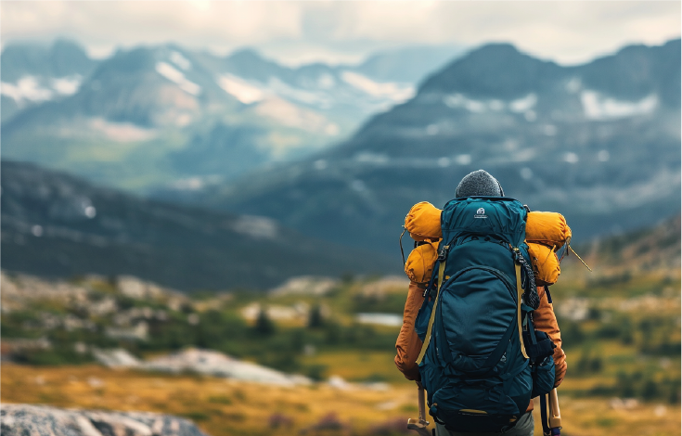
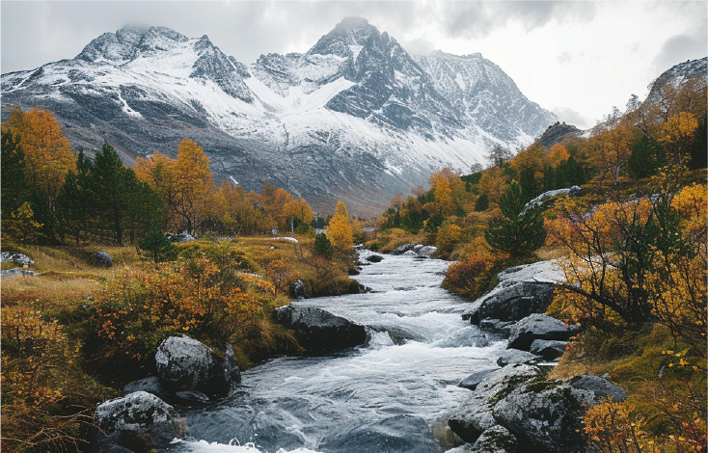
MOUNTAIN
HIKE
ITINERARY
Location: John Muir Trail, Sierra Nevada Mountains, California
Duration: 6 Days, 5 Nights
Difficulty Level: Moderate to Difficult
Total Distance: 60 miles (approximately 10 miles per day)
DAY 4:
Route:
06-24-2025
Starting Point: Cathedral Lakes
Destination: Tuolumne Meadows
Distance: 8 miles
Highlights: Scenic meadows, Tuolumne River, potential resupply at
Tuolumne Meadows.
DAY 5:
Route:
06-25-2025
Starting Point: Tuolumne Meadows
Destination: Lyell Canyon
Distance: 10 miles
Highlights: Gentle ascent through Lyell Canyon, views of Lyell Fork of the Tuolumne River, peaceful camping in the canyon.
DAY 6:
Route:
06-26-2025
Starting Point: Lyell Canyon
Destination: Donohue Pass
Distance: 10 miles
Highlights: Climb to Donohue Pass, stunning alpine views, entry into Ansel Adams Wilderness.

