Slide 1
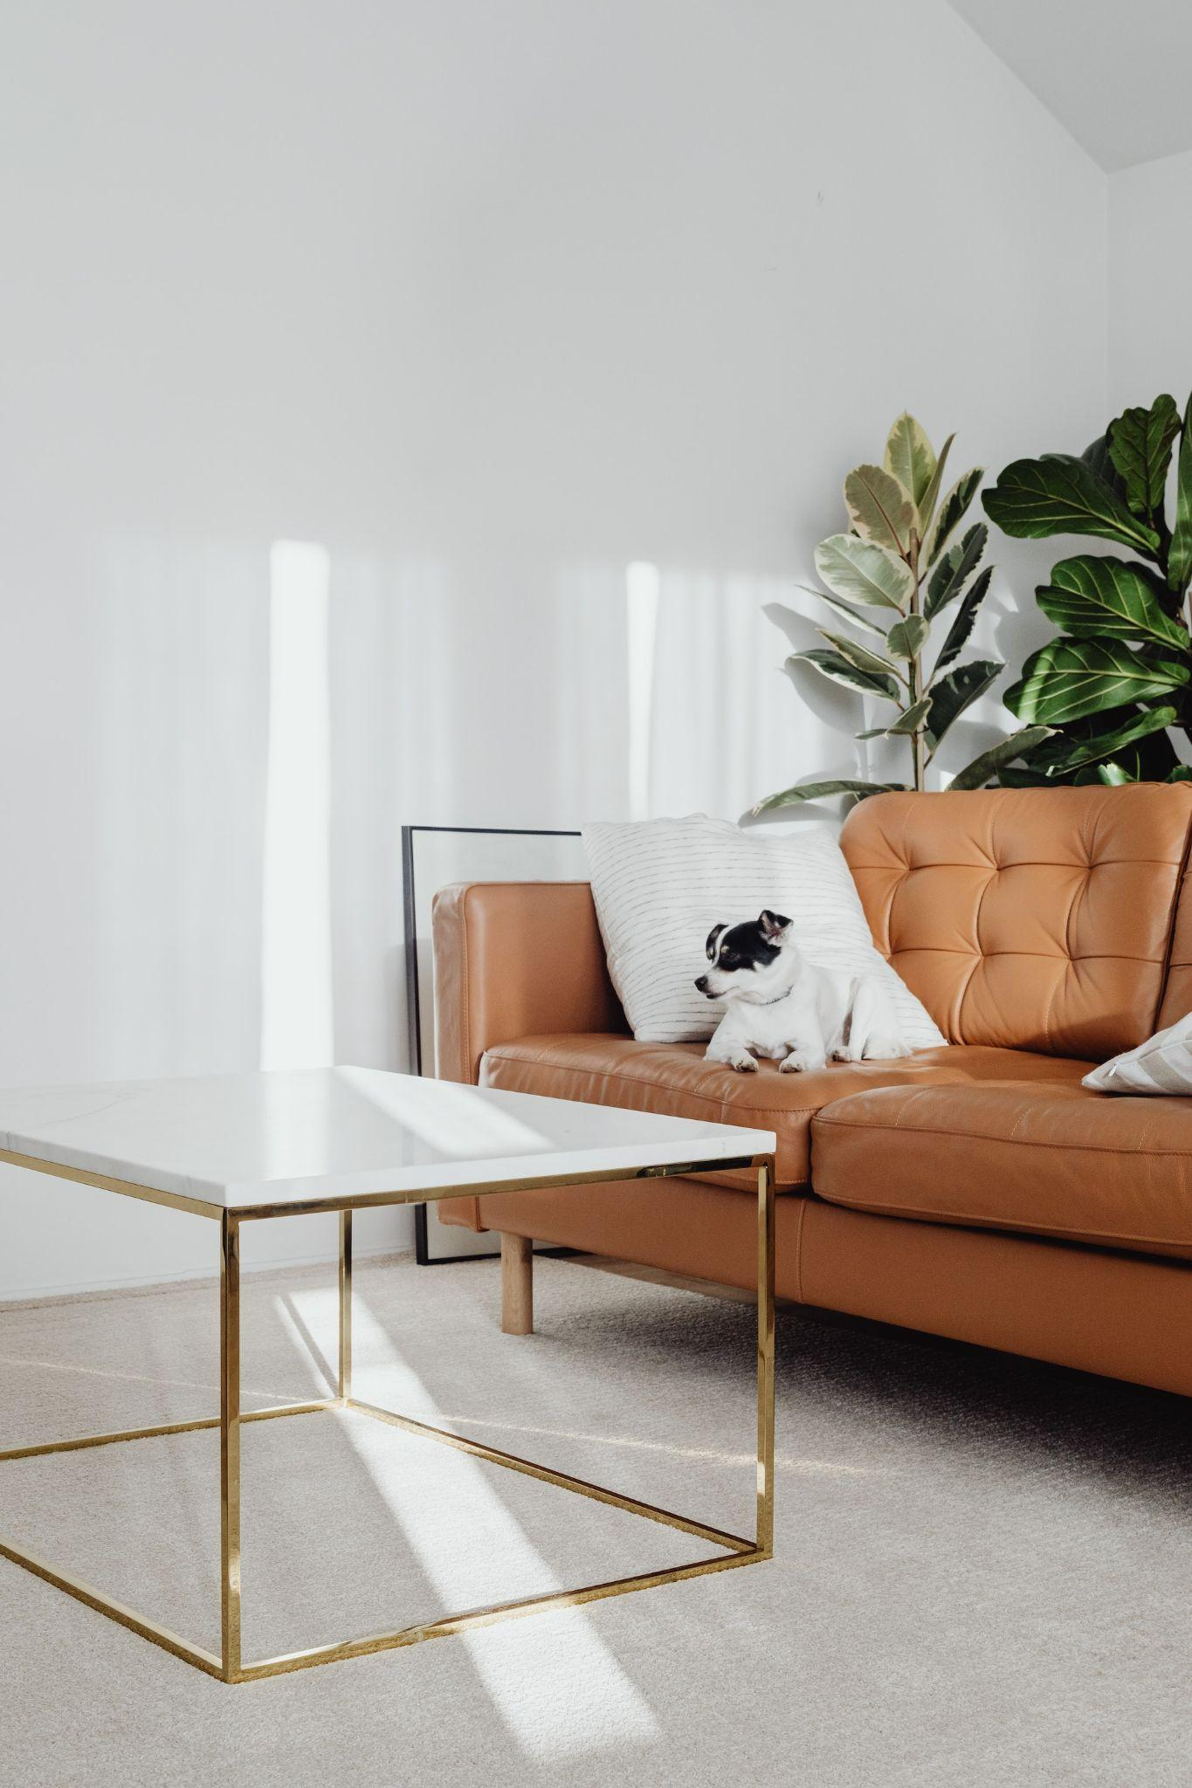

Monthly
Newsletter
DECORATING IDEAS
FOR SMALL HOMES
How to make use of small areas in your home
HOW TO SELL YOUR HOME FASTER
Four top tips on how you can be involved in the selling process
MARKET UPDATE
Look back at the last months
statistics
SELLING DURING THE HOLIDAYS
4 Tips to help get you home sold during the winter
months
DECORATING TO SELL
How to decorate your home
to sell in the seasonal holidays

Slide 2
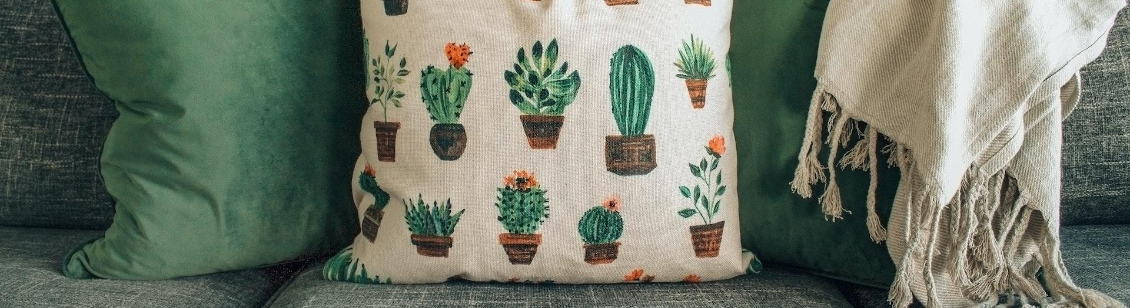
4 tips for Selling your
Home during the holidays
PRICE IT
ACCORDINGLY
WORK WITH A
RELIABLE AGENT
During the holidays, it is best to price in the evening using market data to avoid trading competition
You want to be working with an agent who isn't going to be MIA I can assure you that will always have
your back
FOCUS ON
OUTDOOR FEATURES
STAGE
IT ACCORDINGLY
The holidays can give you the chance to show off same of your exterior features that make it win-equipped for the winter weather
Deck the halls but not too much. Opt for neutral holiday decorations to not turn off potential buyers
Community Calendar
Aug. 4
Wine Tasting
Aug. 16
Strawberry Festival
Aug. 9
Farmer’s Market
Aug. 26
Comedy Tour

Slide 3
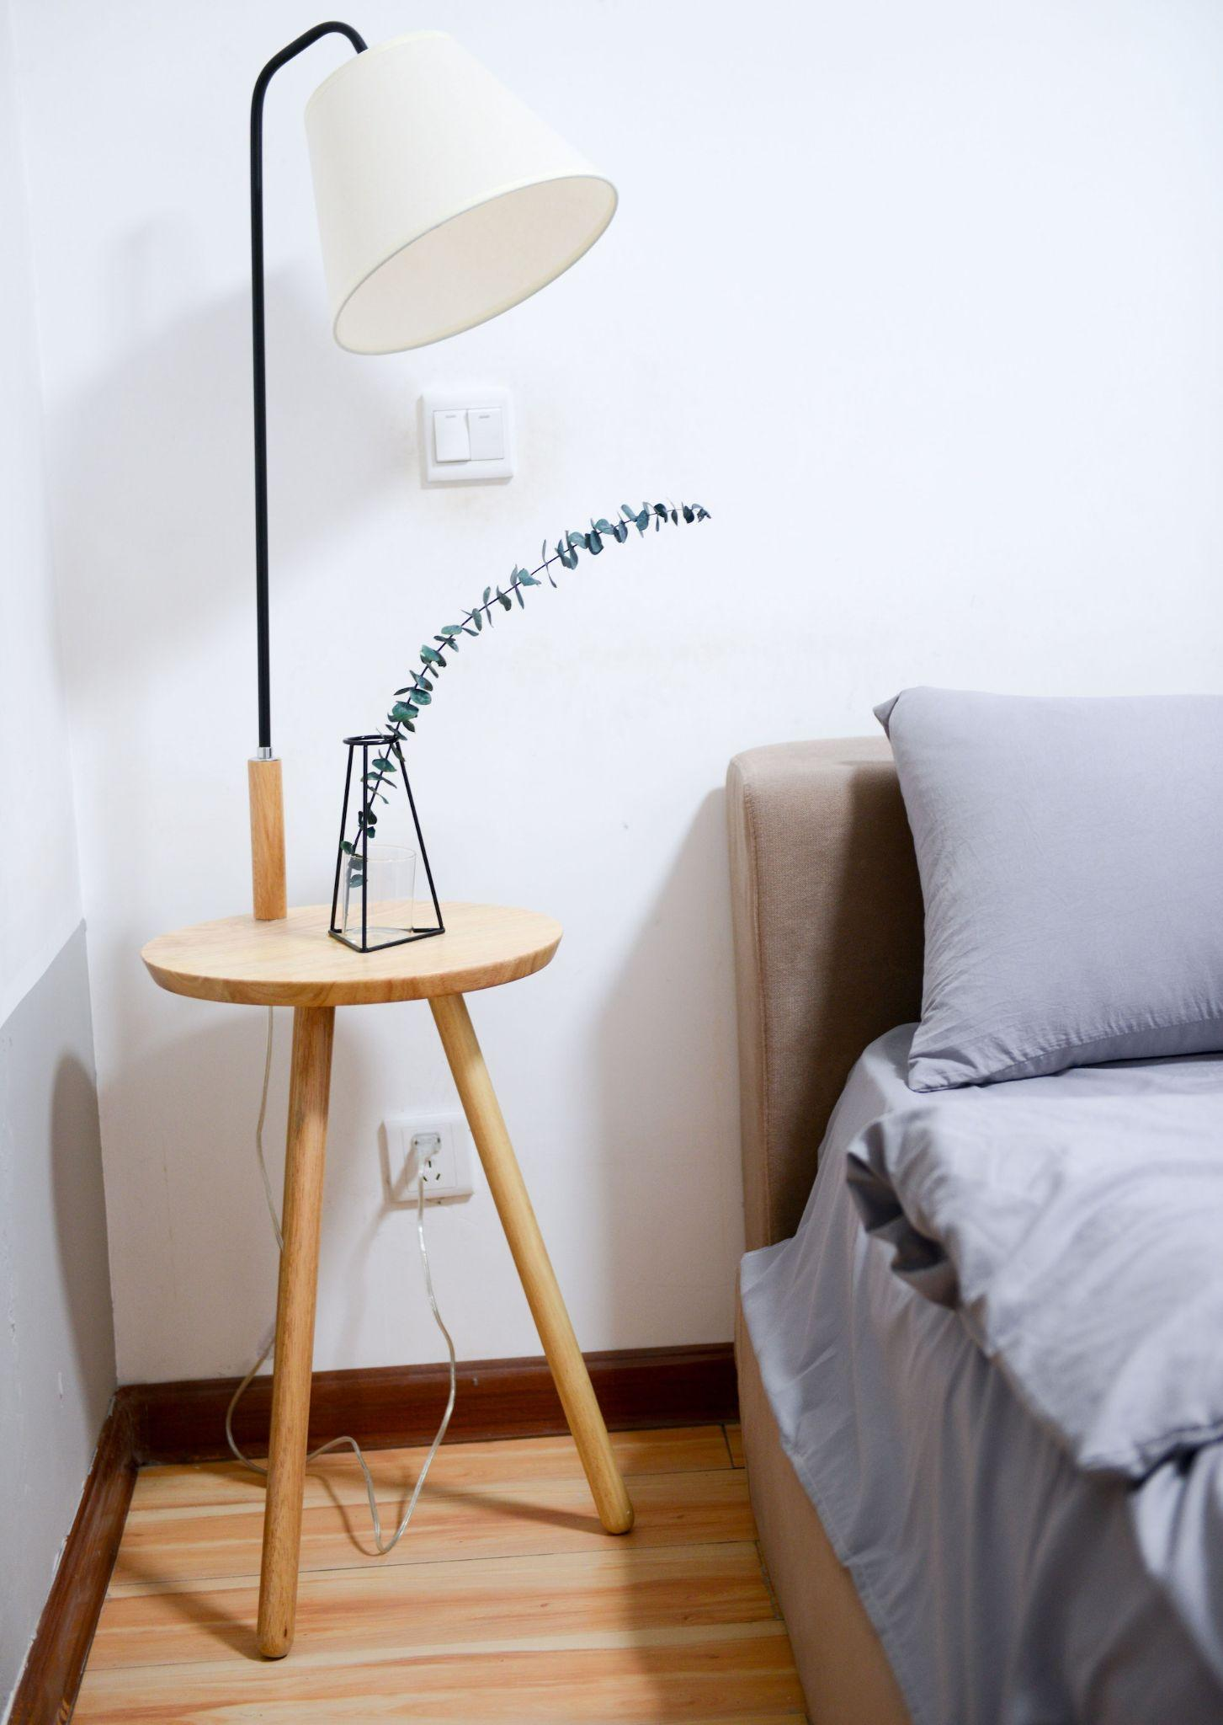
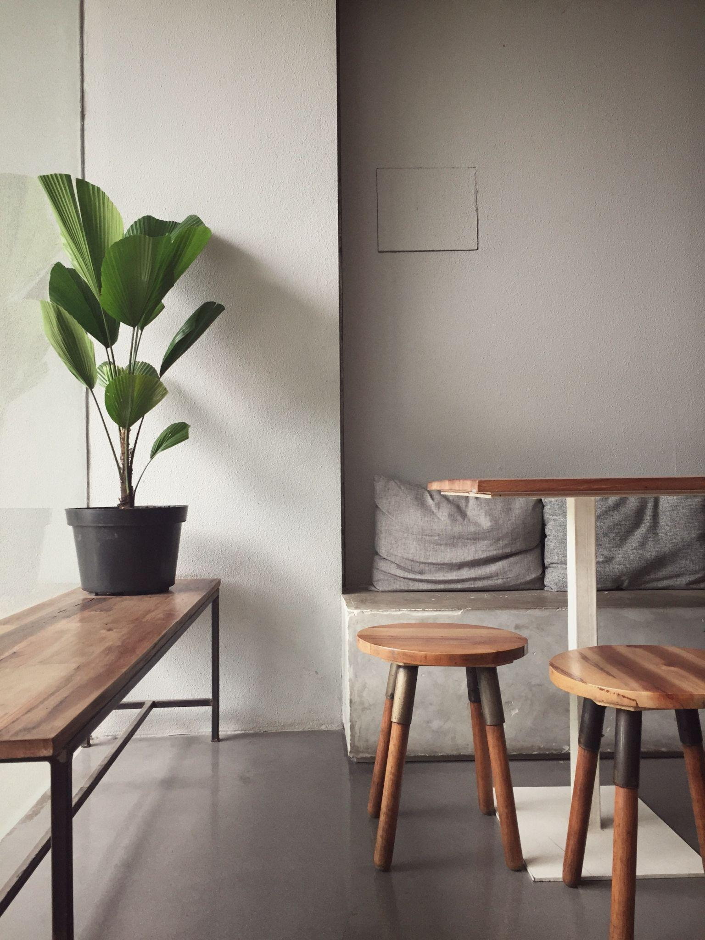
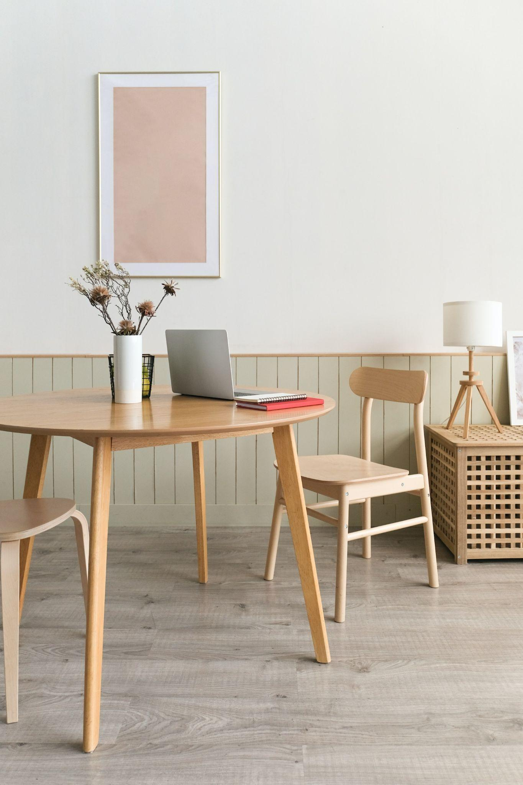
New Listings
Address
BED
BATH
SQ FT.
Days
Price
81857 Madyson Plaza Suite 383
1
1
2200
4
$1.250.000
9903 Jamey Pine Suite 207
2
2
1500
6
$850.000
608 Schmitt Well
1
1
1200
4
$2.250.000
5801 Lulu Corner Suite 873
1
2
1800
1
$1.350.000
54388 Conn Square
2
1
2100
4
$950.000
208 Murray Spur
1
2
1600
12
$2.250.000
424 Oren Knolls Apt. 532
2
1
2600
4
$1.750.000
885 Armani Crescent
1
2
2200
8
$1.250.000
Market Update
121
18
85
Homes
Sold
Days on
market
New
listings
2.8
$650.4500
$750.4500
Months of
inventory
AVG Sale
price
AVG List
price
Sold Listings
Address
BED
BATH
SQ FT.
Days
Price
54388 Conn Square
2
2
1700
8
$850.000
208 Murray Spur
1
1
1800
3
$950.000
81857 Madyson Plaza Suite 383
2
2
2200
8
$1.250.000
5801 Lulu Corner Suite 873
2
1
2800
2
$2.350.000
424 Oren Knolls Apt. 532
1
2
1100
8
$850.000
608 Schmitt Well
2
1
2600
6
$1.250.000
885 Armani Crescent
1
2
1600
8
$2.750.000
9903 Jamey Pine Suite 207
2
1
1200
4
$1.250.000

Slide 4
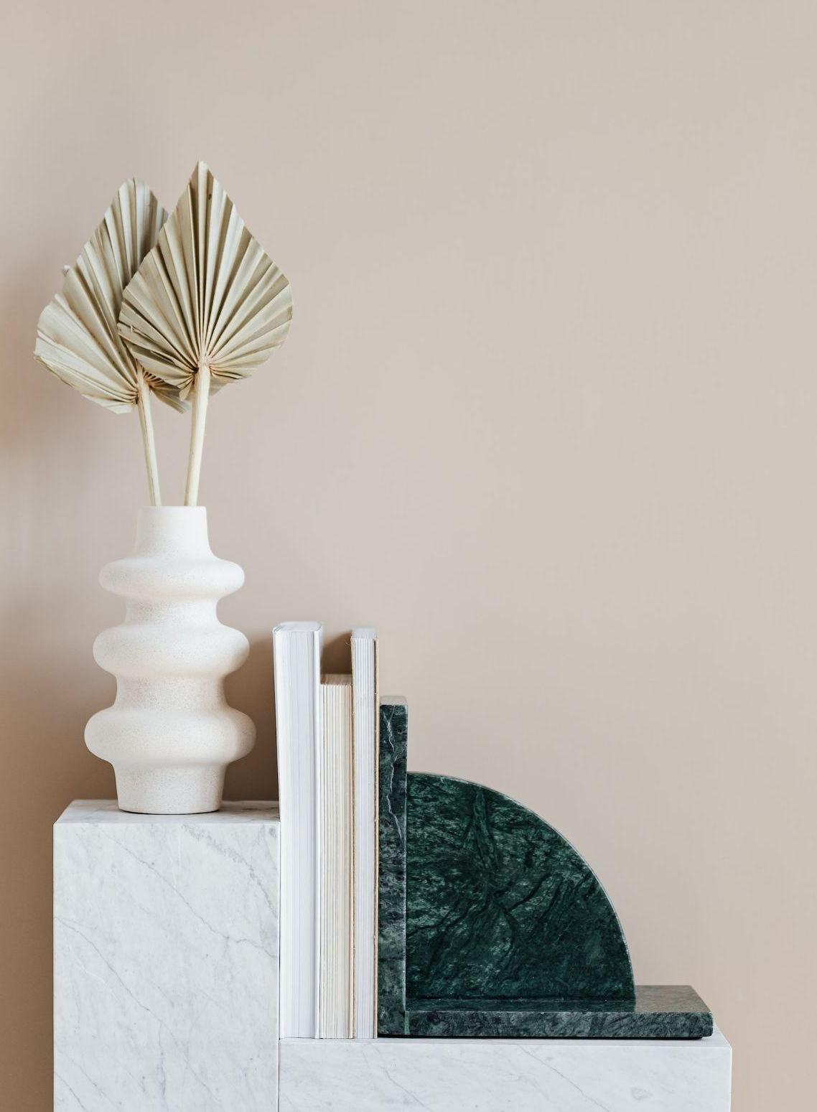
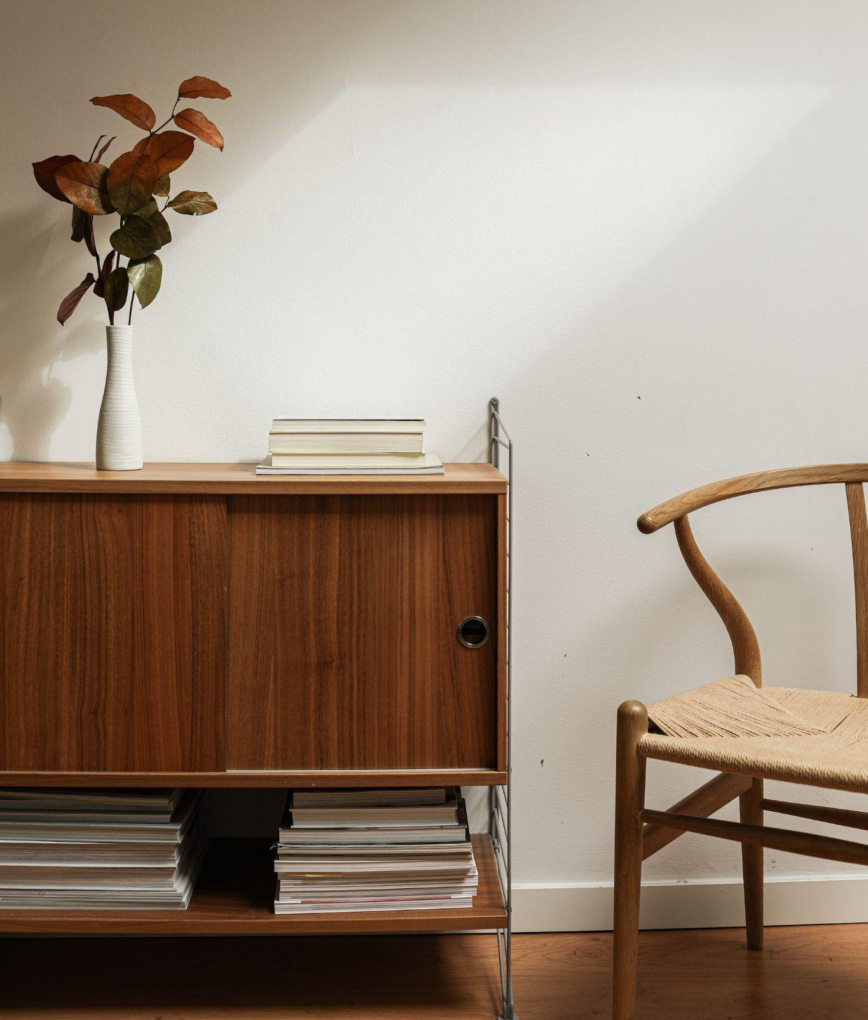
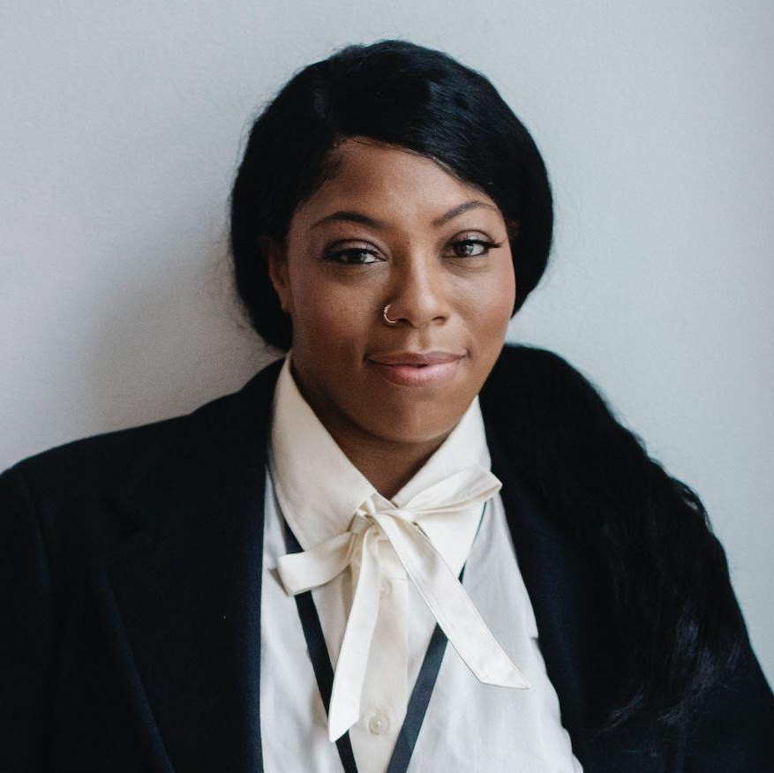
DECORATING TO SELL
• Use neutral colours
Clean walls will make your house look more appealing for potential buyers. Instead of touching up the current colour think about something to suit everyone.
• Clean
Once you’ve cleared excessive clutter, pay attention to rooms that attract dirt like your bathroom and kitchen. Make sure that they’re gleaming before each viewing and smell nice too.
• Clear the clutter
This is such a simple thing that many people overlook. Keeping your home tidy inside and out and putting away ‘stuff’ helps people to see your home for what it is.
How to sell your
home faster
1. Let the light in
People love light and bright, and the best way to show off your house is to let the sunshine in.
2. Remove excess furniture
Nothing makes a home seem smaller than too much big furniture.
3. Consider staging your home.
While you may have a fun sense of style, your furniture may make it hard for buyers to see the home as a blank slate.
4. Perfect the entryway.
Mylene Heathcote
While your house is on the market, make sure the foyer is kept clean, clutter-free and appears as open and welcoming as possible.
Real Estate Agent
myexample@mail.com
T: 1-123-4567-901

