Slide 1




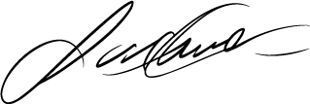
C O M P A N Y
Nova Tech Solutions
To:
Mark Johnson
+1 (123)-4567-890
P:
+1 (123)-4567-890
E:
Recipient@mail.ltd
A:
789 Elm Street, Suite 120
Austin, TX 73301
Date: October 10, 2028
contact@mail.ltd
Subject: Service Agreement Renewal
www.company.ltd
Dear Mr. Johnson,
I hope you are doing well. This letter serves as a reminder regarding the upcoming renewal of your service agreement with NovaTech Solutions. As we approach the expiration date, we wanted to outline the renewal terms and ensure your continued access to our premium services.
Please review the attached document for detailed information regarding the renewal process, pricing, and any changes to the terms and conditions. We are happy to discuss any questions or make necessary adjustments to suit your needs.
Thank you for your continued trust in NovaTech Solutions. We look forward to our ongoing collaboration.
245 Silicon Avenue, Suite 300
San Francisco, CA 94105
Best regards,
Sarah Williams
Client Relations Manager
NovaTech Solutions

