Slide 1


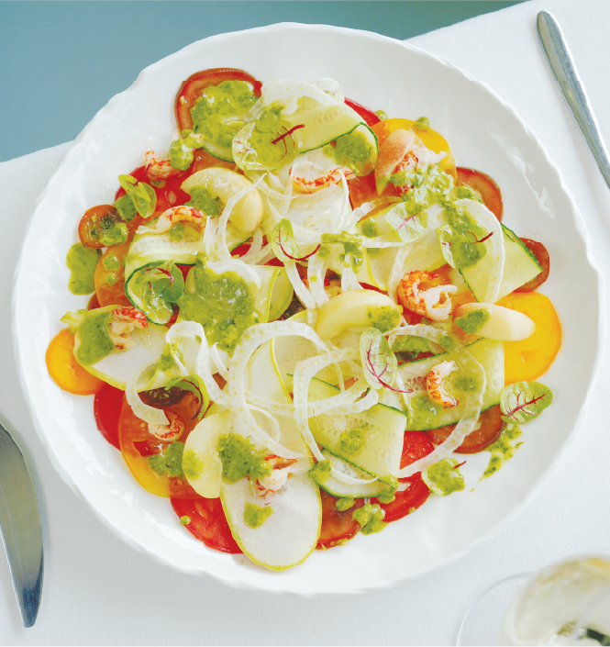
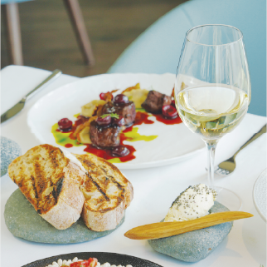
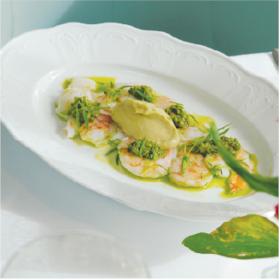
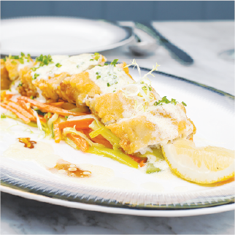
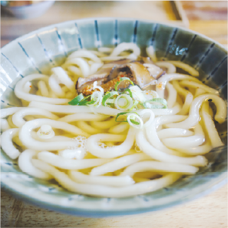
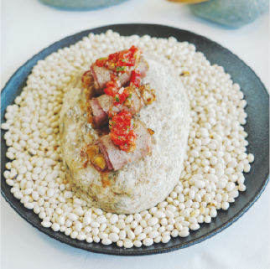
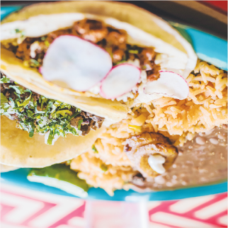
Lunch Restaurant
FIRST COURSE
Nachos
$7.50
House-made crispy tortilla chips
Chicken Wings
$12.00
With 4 different sauces on your choice
Steak
$20.00
Well Done, Medium, Rare
Spaghetti
$9.50
With tomato, garlic cheese, truffle
Fish and Chips
$11.00
Fish in cream, tomato sauce
MAIN DISH
Steak
$20.00
Well Done, Medium, Rare
Spaghetti
$9.50
With tomato, garlic cheese, truffle
Fish and Chips
$11.00
Fish in cream, tomato sauce
DESSERT
Chocolate Cake
$6.50
Chocolate cake with strawberry
Strawberry Cheesecake
$13.50
Strawberry cheesecake and
vanilla ice cream
$8.00
Chocolate Cake with Banana
Chocolate cake ice cream and banana

