Slide 1
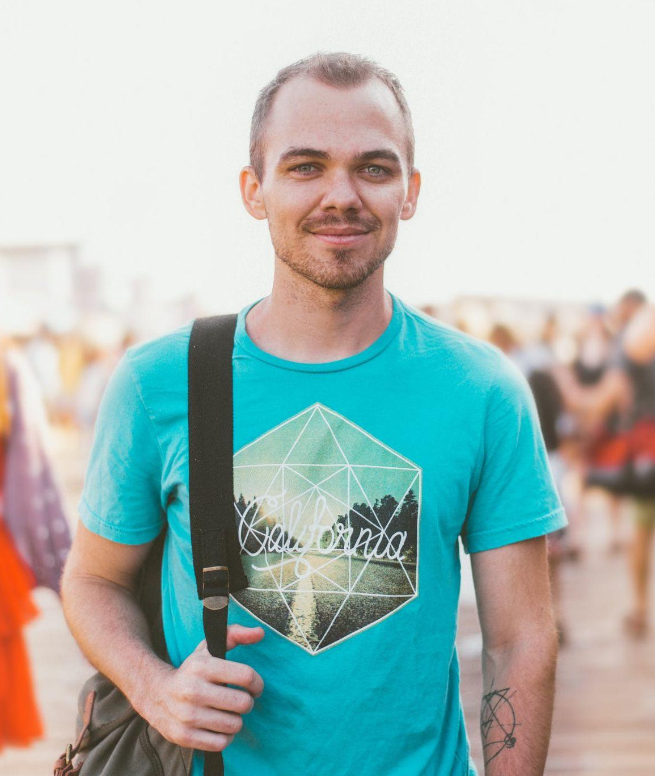
!MISSING!
DYLAN ABSHIRE
MISSING SINCE 01/12/2023
NAME: Dylan Abshire
HAIR COLOR: Blond
HEIGHT: 5’4
AGE: 31
EYE COLOR: Green
WEIGHT: 156 Lbs
If you have any information, please contact Price Gutmann at +0 123 4567 890
or Pricegutmann@email.com
+0 123 4567 890

