Slide 1
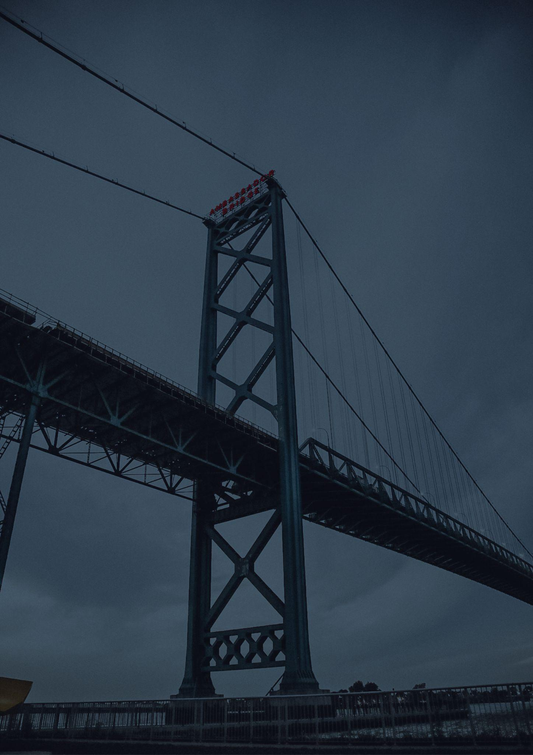
Travel bucket list
MICHIGAN
Mackinac Island
Michigan Historical Museum
Lake Michigan
Henry Ford Museum
Detroit Institute of Arts
Michigan State Capitol
Pictured Rocks
University of Michigan
Frederik Meijer Gardens
Isle Royale National Park
Sculpture Park
Sleeping Bear Dunes
The Henry Ford, Dearborn
Colonial Michilimackinac
Isle Royale National Park
Detroit Zoo
Detroit Zoo
Michigan History Center
University of Michigan
Mackinac Bridge
Belle Isle Park
Soo Locks Boat Tour
Fort Mackinac
Motown Historical Museum
Kitch-iti-Kipi, Manistique
Michigan’s Adventure
Windmill Island
Isle Royale National Park
Great Lakes Shipwreck Museum
Detroit Institute of Arts

