Slide 1










WE ARE HERE TO
HELP
WHEN TO PAY
ATTENTION?
WWW.MENTALHEALTH.LTD
Everyone can feel sad, anxious,
or tired from time to time — that’s
normal. But if these feelings don’t
go away, or they start interfering with daily life, it may be a signal
that you need extra support.
(123) 456-7890
Caring for
MENTALHEALTH@EXAMPLE.COM
MENTAL
HEALTH
123 MANSFIELD AVE, PORTLAND
WWW.MENTALHEALTH.LTD
Simple steps to balance and
build inner strength.
Asking for help is not weakness —
it’s a step toward healing.
Many people believe they must handle challenges on their own, but the truth is different. It takes strength to admit that you are struggling, and even more courage to open up and share it with someone you trust. When we reach out, we give others the chance to support us. A caring friend, family member, or professional can provide not only guidance, but also comfort and understanding.
KEY ASPECTS OF MENTAL HEALTH:
recognizing and managing emotions
building healthy relationships
coping with stress
and challenges
COMPANY NAME WWW.MENTALHEALTH.LTD (123) 456-7890
HOTLINE (123) 456-7890

Slide 2


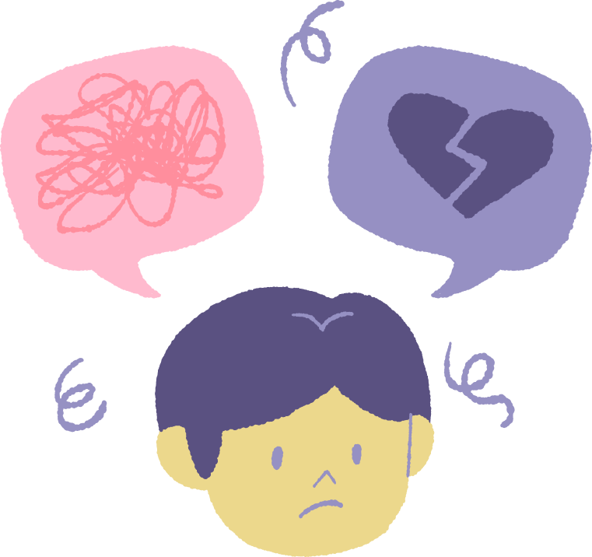
TOOLS FOR SUPPORTING MENTAL HEALTH
BREAKING THE STIGMA
Talking about mental health is just as important as talking about physical health. Yet, many people still feel afraid or ashamed to share their struggles. This silence can make challenges feel even heavier and prevent people from getting the help they need.
Breaking the stigma means changing the way we think and speak about mental health. When we are open and supportive, we show that it’s normal to have ups and downs, and that seeking help is a sign of strength, not weakness.
Caring for your mind is as vital as caring for your body. Practical tools can help build resilience and balance. Here are three key strategies:
1. Daily Self-Care
Simple habits such as regular sleep, balanced meals, physical activity, and time for relaxation play a powerful role in mental well-being. Even small routines, like journaling or mindful breathing, can reduce stress and improve mood.
STRESS MANAGEMENT TOOLS
Practice deep breathing or short mindfulness exercises
2. Social Connection
Strong relationships are a natural source of support. Talking with friends, family, or joining a community group can ease feelings of isolation and remind you that you are not alone. Sharing experiences helps create a sense of belonging.
Take a break and go for a nature walk
3. Professional Support
Keep a regular sleep
and rest routine
Sometimes self-care isn’t enough. Professionals can offer guidance, coping tools, and a safe space to share. Asking for help is a strong step toward healing.
By encouraging honest conversations and showing empathy, we create a kinder, healthier community where
no one has to suffer in silence.
Organize tasks into small, manageable steps
COMPANY NAME WWW.MENTALHEALTH.LTD (123) 456-7890

