Slide 1
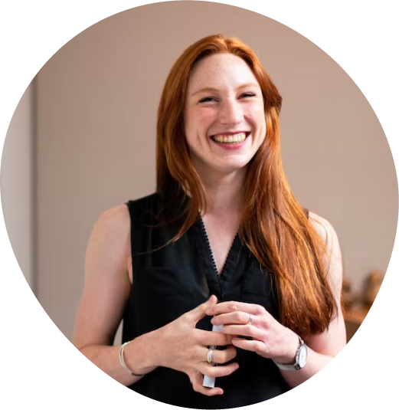
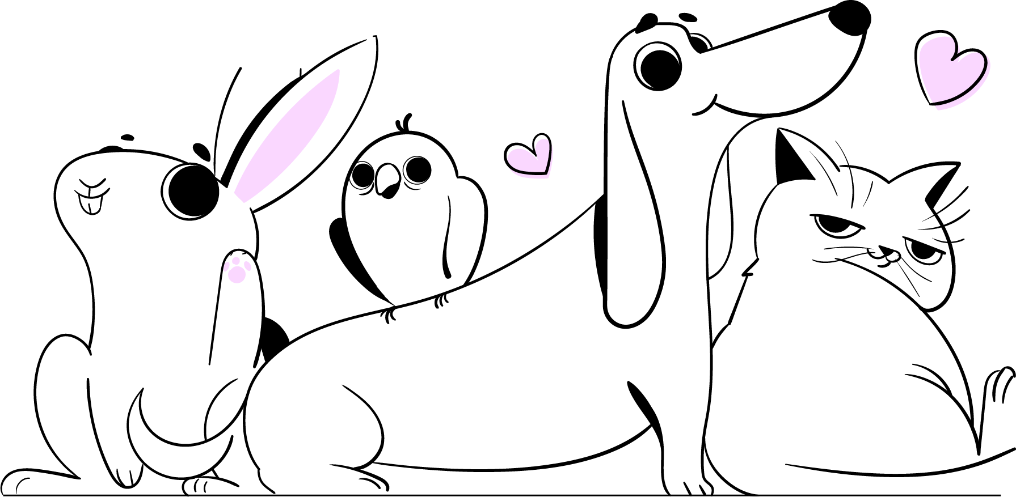
MEET THE
TEACHER
Ms Chemello
About Me
Hello new Grade 1 friends! I am your new teacher, Ms Chemello, and i am so excited to mmet you on your first day back at school. We are going to have a wonderful year together, learning all about numbers, spelling, reading and writing.
Favourites
Contact Me
• Sushi and ice cream
• Hello Kitty and friends
• Iced coffee and chocolate
• Watching sunsets on the beach
You can contact me during school hours via email.

