Slide 1
Contact Details:
YOUR
GUIDE TO
HEALTH &
WELLNESS
Phone:
+1 615-618-2559
Address:
261 Green Street, North Little Rock, Arkansas
Mail:
HealthcarePartner@mail.com
Website:
HealthcarePartner.com
Compassionate Care
for Every Patient
Preparing for
Your Appointment:
To make the most of your visit, here are a few tips:
• Arrive 15 minutes before your scheduled appointment to
complete any necessary paperwork.
• Bring your insurance information, identification, and a list of
medications you are currently taking.
• If you need to cancel or reschedule, kindly notify us at least
24 hours in advance.

Slide 2
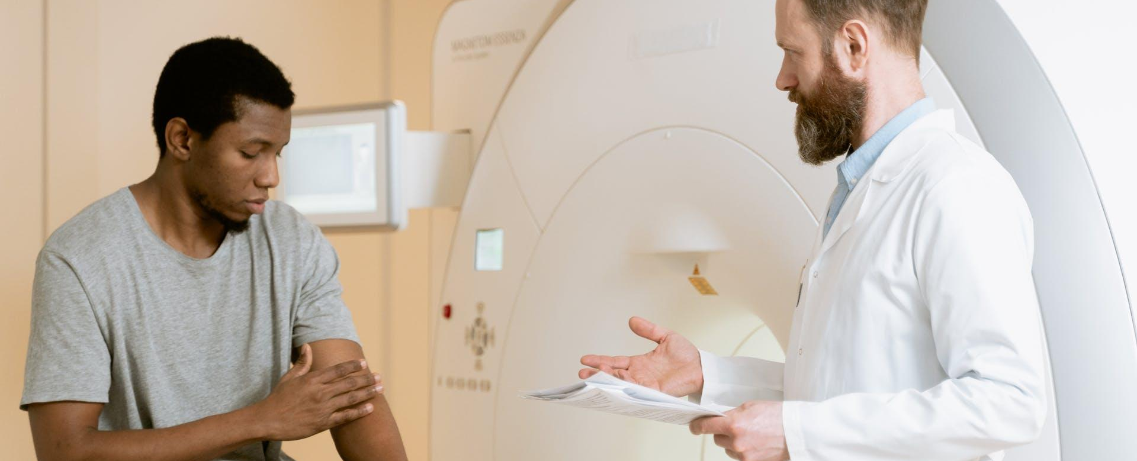
Contact Details:
About Us:
Our Services:
Phone:
Welcome to [Medical Practice Name], where your well-being is our priority. We're dedicated to providing comprehensive and compassionate healthcare to our community.
Primary Care Services:
+1 615-618-2559
• Annual check-ups
• Preventive care
• Vaccinations
Address:
261 Green Street, North Little Rock, Arkansas
Our mission:
Mail:
Specialized Care:
HealthcarePartner@mail.com
Our mission is to deliver personalized medical care with a focus on wellness, ensuring every patient receives the attention they
deserve.
• Cardiology
• Dermatology
• Oncology
• Neurology
• Orthopedics
• Gastroenterology
• Pediatrics
• Psychiatry
Expert Care Team:
Preparing for
Your Appointment:
We take pride in our team of experienced healthcare professionals who are committed to excellence. Our doctors, specialists, nurses, and support staff work collaboratively to ensure comprehensive and individualized care for every patient.
Diagnostic Facilities:
To make the most of your visit, here are a few tips:
• Imaging Services
• Laboratory Tests
• Cardiac Diagnostics
• Neurological Diagnostics
• Respiratory Tests
• Gastrointestinal Diagnostics
• Arrive 15 minutes before your scheduled appointment to
complete any necessary paperwork.
• Bring your insurance information, identification, and a list of
medications you are currently taking.
• If you need to cancel or reschedule, kindly notify us at least
24 hours in advance.

