Slide 1
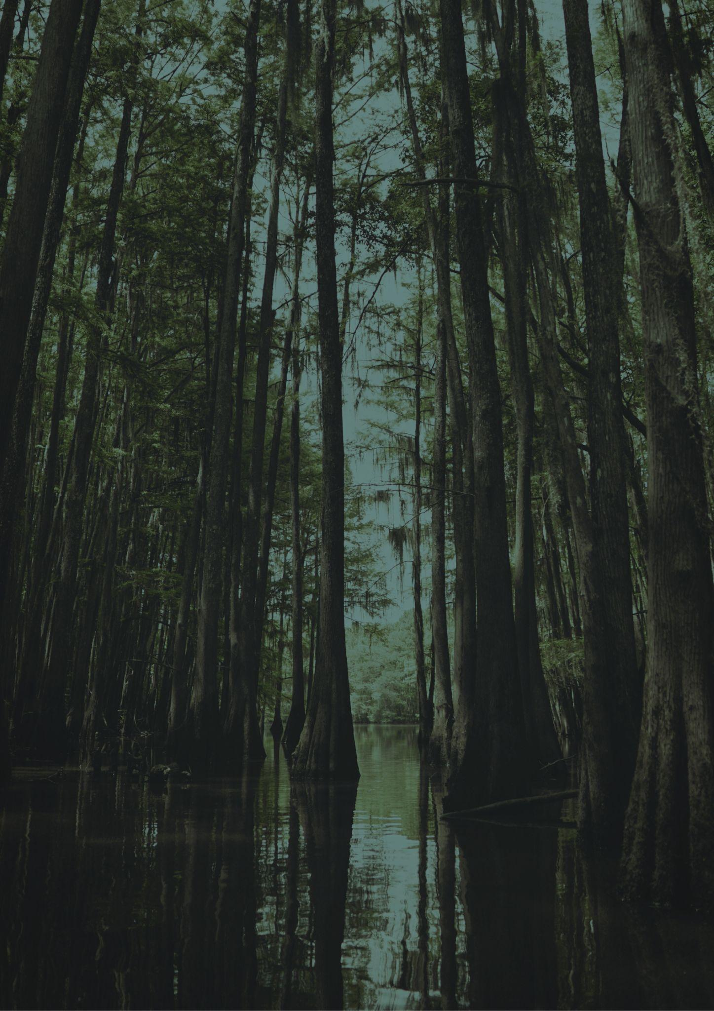
Travel bucket list
LOUISIANA
Swamp Tours
Mardi Gras World
New Orleans' French Quarter
Vermillionville Historic Village
National WWII Museum
Honey Island
Mardi Gras
Jean Lafitte Historical Park
Melrose Plantation
Louisiana's Old State Capitol
Old State Capitol
R. W. Norton Art Gallery
Laura Plantation
Zoosiana
Vermilionville
National WWII Museum
Beach in Louisiana
Melrose Plantation
Sci-Port Discovery Center
Preservation Hall
Frenchmen Street
Mike the Tiger’s Habitat
Rosedown Plantation
Musical Legends Park
Oak Alley Plantation
Jungle Gardens
DeQuincy Railroad Museum
Audubon Zoo
French Quarter
LARC's Acadian Village

