Slide 1



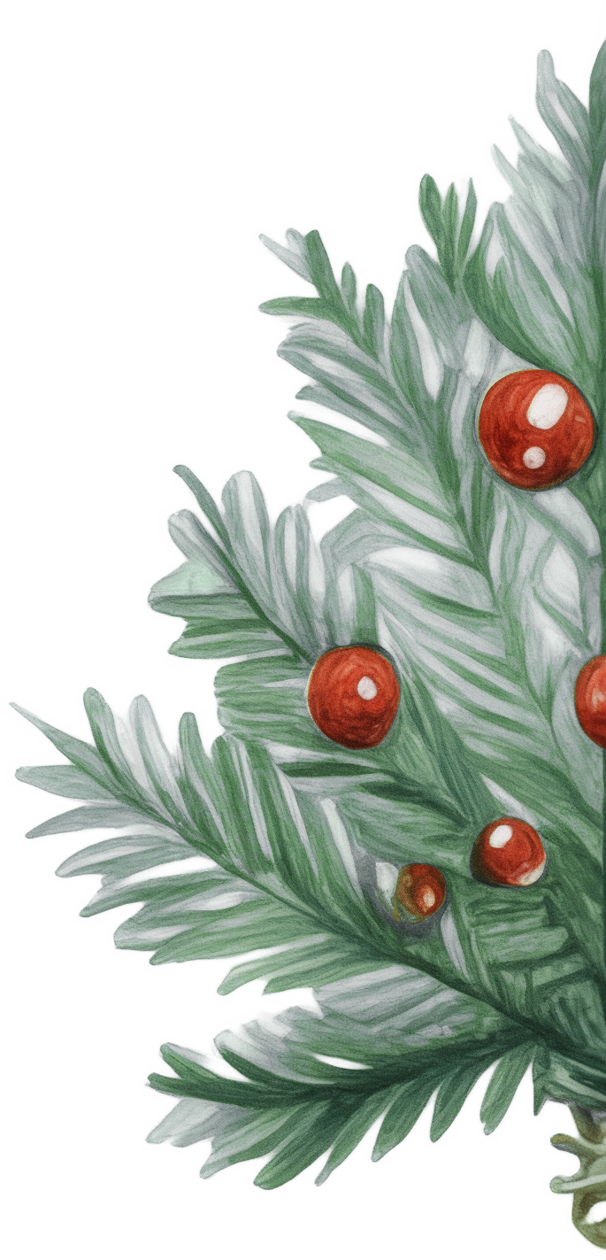
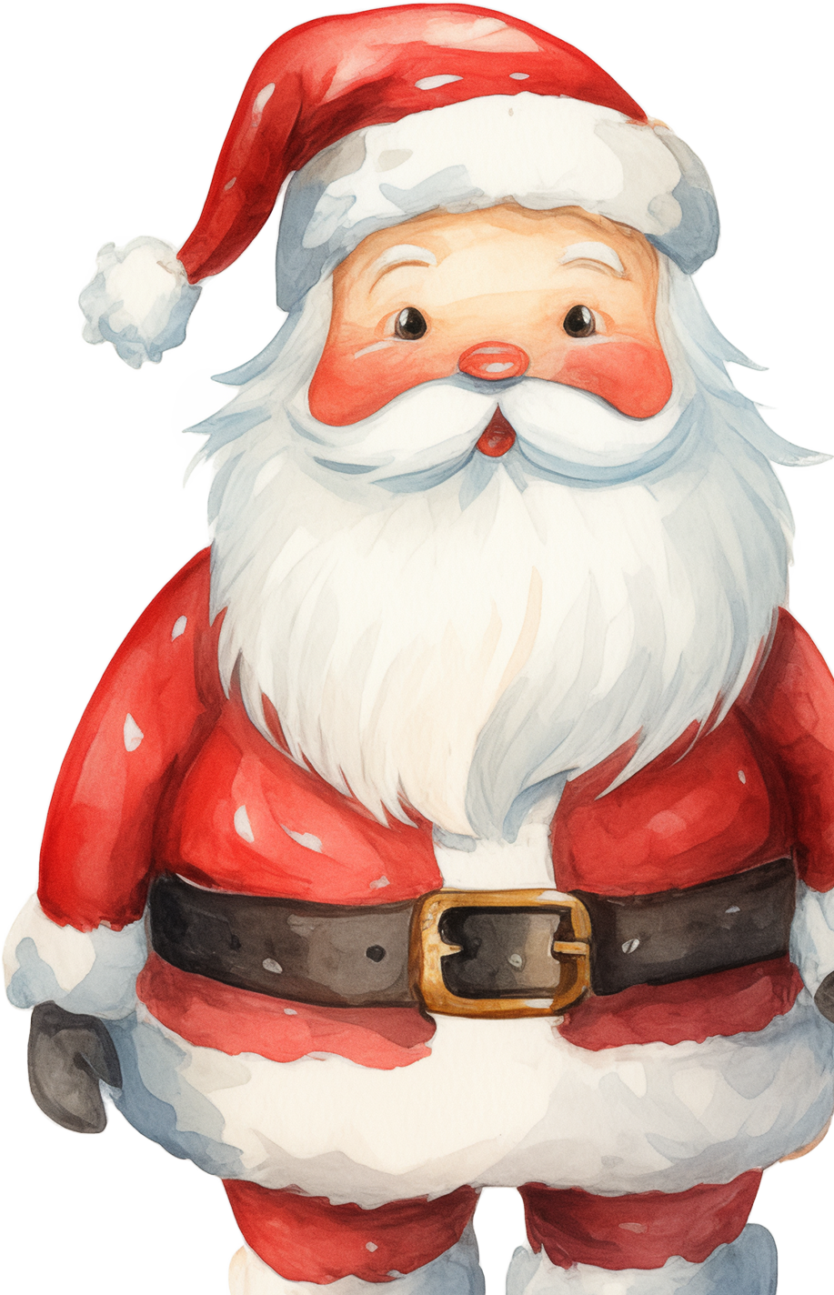

Dear Santa,
Hi Santa! I hope you and Mrs. Claus are
doing well! I’ve been super good this year, and I’m really excited for Christmas. I’ve been helping my family, doing my homework (most of the time!), and being nice to my friends.
Here’s what I would love for Christmas this year: A new bike – I’ve grown a lot, and my old bike is too small now. I would love a shiny red one if possible! A big box of Legos – I want to build the coolest things, maybe even a castle!
A surprise – I love surprises, so you can bring me anything you think I’d like! I promise I’ll
leave you cookies and milk, and I’ll make
sure to put out some carrots for
the reindeer, too. Have a safe
trip around the world!
Love,
Emily

