Slide 1
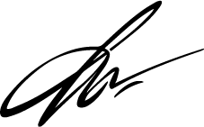
Johnson
& Green LLP
P: (555) 123-4567 | E: contact@mail.ltd | W: contact.ltd
A: 1234 Justice Lane, Suite 500,New York, NY 10001
To: Jane Doe
October 11, 2028
Human Resources Manager
ABC Corporation
5678 Corporate Blvd
New York, NY 10001
Subject: Employment Contract Review
Dear Ms. Doe,
I am writing to follow up on the employment contract review we discussed last week. After carefully examining the terms, I have identified several areas that may benefit from further clarification, particularly the sections concerning non-compete agreements and severance terms.
I recommend scheduling a meeting to discuss these points in greater detail and ensure both parties are fully aligned on the contract's implications. Please let me know your availability next week for a brief call or in-person meeting.
Thank you for your attention to this matter, and I look forward to hearing from you soon.
Best regards,
Michael Johnson
Attorney at Law
Johnson & Green LLP

