Slide 1


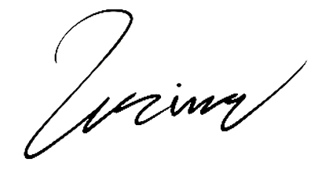
rec@company.com
+1 (555) 987-6543
123 Main Street, Suite 567
recipicompany.com
+1 (555) 987-6543
Cityville, Stateland, ZIP123
To: Alex Turner
Director of Partnerships
43 Main St. Suite 29, Cityville,
Stateland, ZIP678
25.08.2024
Dear Alex,
I trust this letter finds you well. We are writing to you on behalf of [Law Firm Name], a respected and dedicated law firm committed to providing exceptional legal services. our interests are our priority, and we are pleased to offer our expertise to address your legal needs.
At [Law Firm Name], our team of experienced attorneys specializes in [mention areas of legal expertise, e.g., civil litigation, family law, corporate law]. With a proven track record of successful cases and a commitment to achieving the best possible outcomes for our clients, we are equipped to handle even the most complex legal matters.
If you require legal assistance or have questions about your situation, please do not hesitate to contact us. You can reach us by phone at [Phone Number] or by email at [Email Address]. We would be pleased to schedule a consultation to discuss your needs further.
Thank you for considering [Law Firm Name] as your legal partner. We look forward to the opportunity to assist you and provide effective solutions.
Sincerely,
Emily Reynolds
Lawyer

