Slide 1
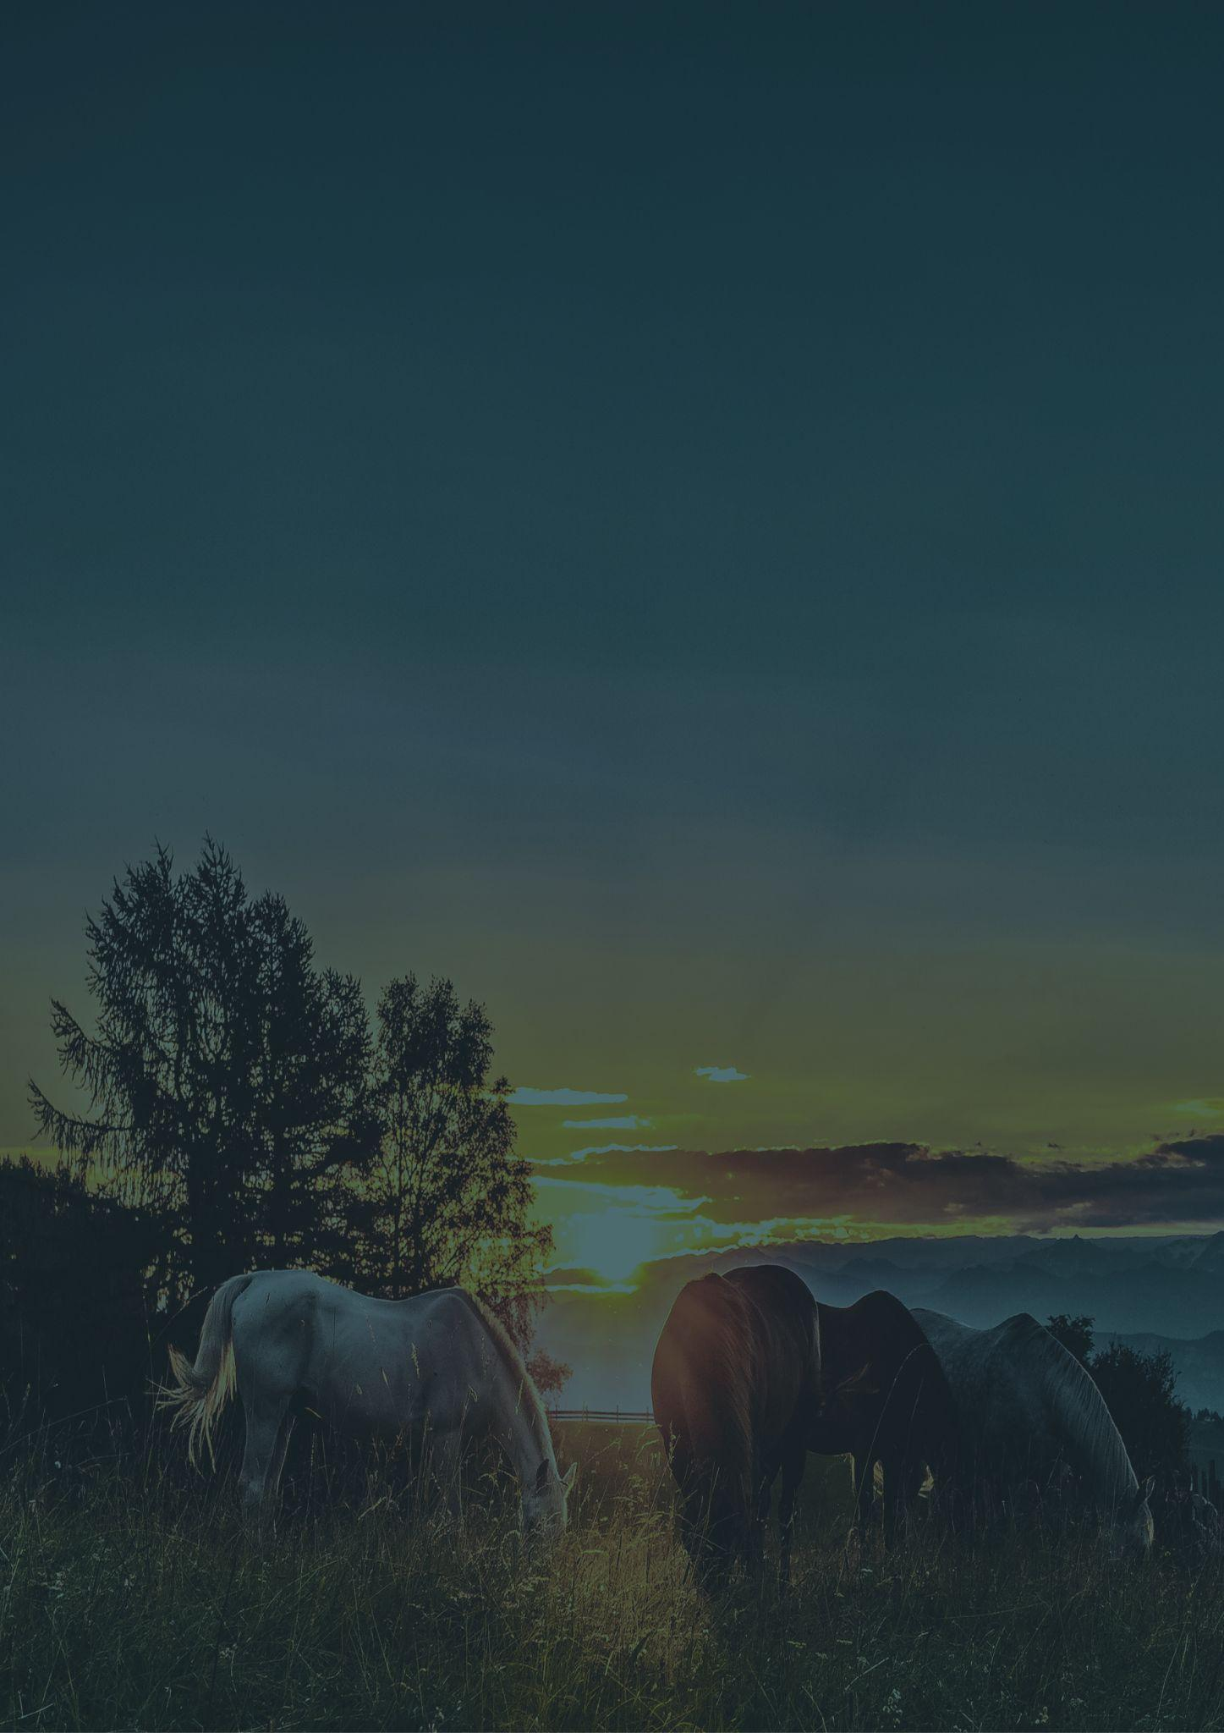
Travel bucket list
KENTUCKY
KENTUCKY DERBY
MAMMOTH CAVE NATIONAL PARK
LOUISVILLE SLUGGER MUSEUM
CHURCHILL DOWNS
DANIEL BOONE NATIONAL FOREST
KENTUCKY HORSE PARK
CUMBERLAND GAP PARK
CUMBERLAND FALLS
ABRAHAM LINCOLN BIRTHPLACE
CREATION MUSEUM
MAMMOTH CAVE PARK
NEWPORT AQUARIUM
KENTUCKY HORSE PARK
LOUISVILLE ZOO
MUHAMMAD ALI CENTER
NEWPORT AQUARIUM
THE KENTUCKY DERBY MUSEUM
KENTUCKY KINGDOM
LOST RIVER CAVE
LOUISVILLE MEGA CAVERN
LOUISVILLE MEGA CAVERN
BIG FOUR BRIDGE
CUMBERLAND FALLS PARK
NATIONAL CORVETTE MUSEUM
SHAKER VILLAGE OF PLEASANT HILL
ARK ENCOUNTER
NEWPORT AQUARIUM
PERRYVILLE BATTLEFIELD
DOLLHOUSE MUSEUM
NATIONAL QUILT MUSEUM

