Slide 1


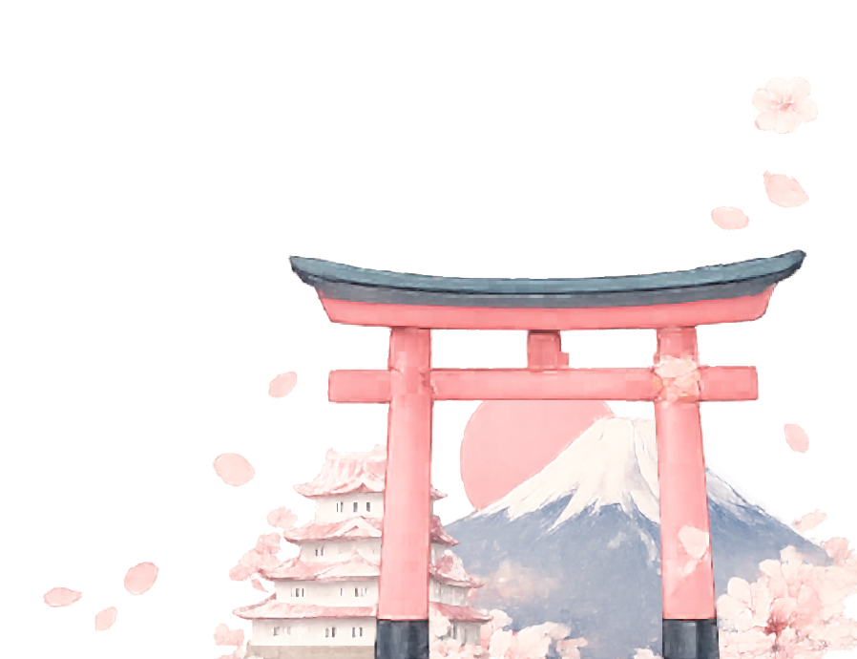
Daily Travel Plan
1
Tokyo
2
Kyoto
Time
08:30
10:30
14:00
18:30
Activity
Arrival & hotel check-in
Meiji Shrine visit
Tokyo Tower viewpoint
Shinjuku walk & dinner
Time
07:30
10:30
15:30
19:00
Activity
Bullet train to Kyoto
Ryoan-ji Temple
Explore Gion streets
Traditional dinner
3
Osaka
4
Kyoto
Time
08:00
10:30
15:00
19:30
Activity
Train to Osaka
Osaka Castle & park
Dotonbori street food
Night city walk
Time
08:30
11:30
15:30
18:30
Activity
Fushimi Inari Shrine
Philosopher’s Path walk
Kyoto Imperial Palace
Kaiseki-style dinner
5
Nara
6
Osaka
Time
09:00
11:00
14:00
16:00
20:00
Activity
Trip to Nara
Todaiji Temple
Lunch in Nara
Return to Osaka
Dinner & nightlife
Time
09:30
14:00
19:00
Activity
Universal Studios
Aquarium visit
Dinner in a restaurant
7
Tokyo
Time
09:00
12:00
15:00
Activity
Return to Tokyo
Souvenir shopping
Departure to airport

