Slide 1
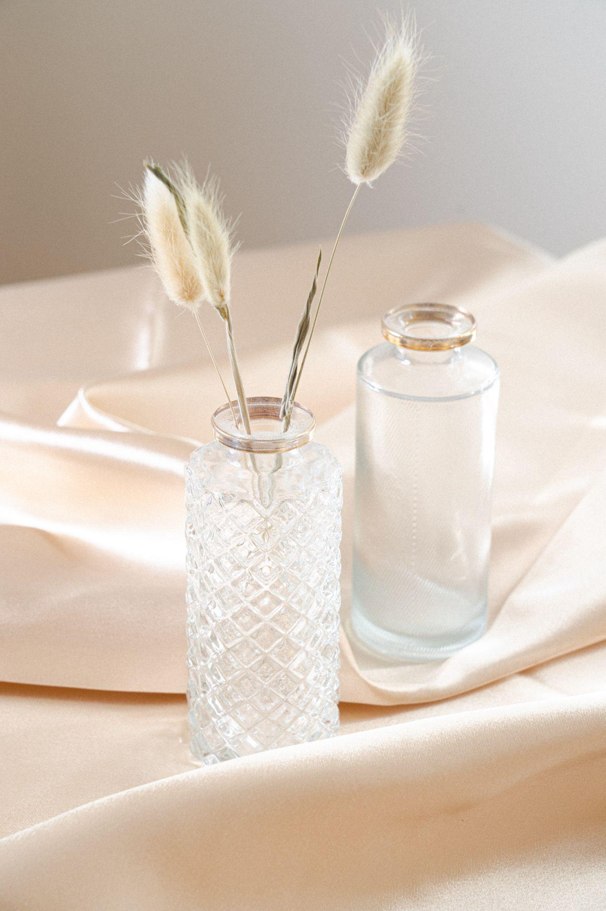
Invoice to:
INVOICE
BUDDY GULGOWSKI
123-456-7890
27 San Carlo Street, London
buddygulgowski@gmail.com
29 June 2025
Description
Qty
Price
Total
Premium Package - Living Room
1
$150.50
$150.50
Additional Living Room Concept
1
$175.00
$175.00
Premium Package - Master Bed
1
$130.50
$130.50
Basic Package - Childrens Bedroom
1
$145.50
$145.50
In Home Room Styling Session
2
$150.50
$300.00
Sub-total:
$902.00
Tax:
$640.00
Total:
$1.542
123-456-7890
gdoc.io
RECEIVE YOUR ESTIMATE
Prior to your consultation, receive your estimate for your selected services
COMMITMENT FEE
Paid to seal the agreement that you agree to use our services
DESIGN PROCESS
Your project will begin and is estimated to complete within the next X-Y weeks.

