Slide 1


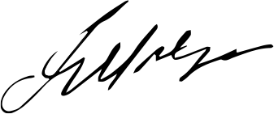
CERTIFICATE
OF INTERNSHIP
This Certificate is proudly presented to
Ms. Sophia Bennett
in recognition of Ms. Bennett's outstanding completion of the compulsory internship program at at Kleven Construction Co. from July to December 2024.
1
09.12.24
Date
Signature

