Slide 1
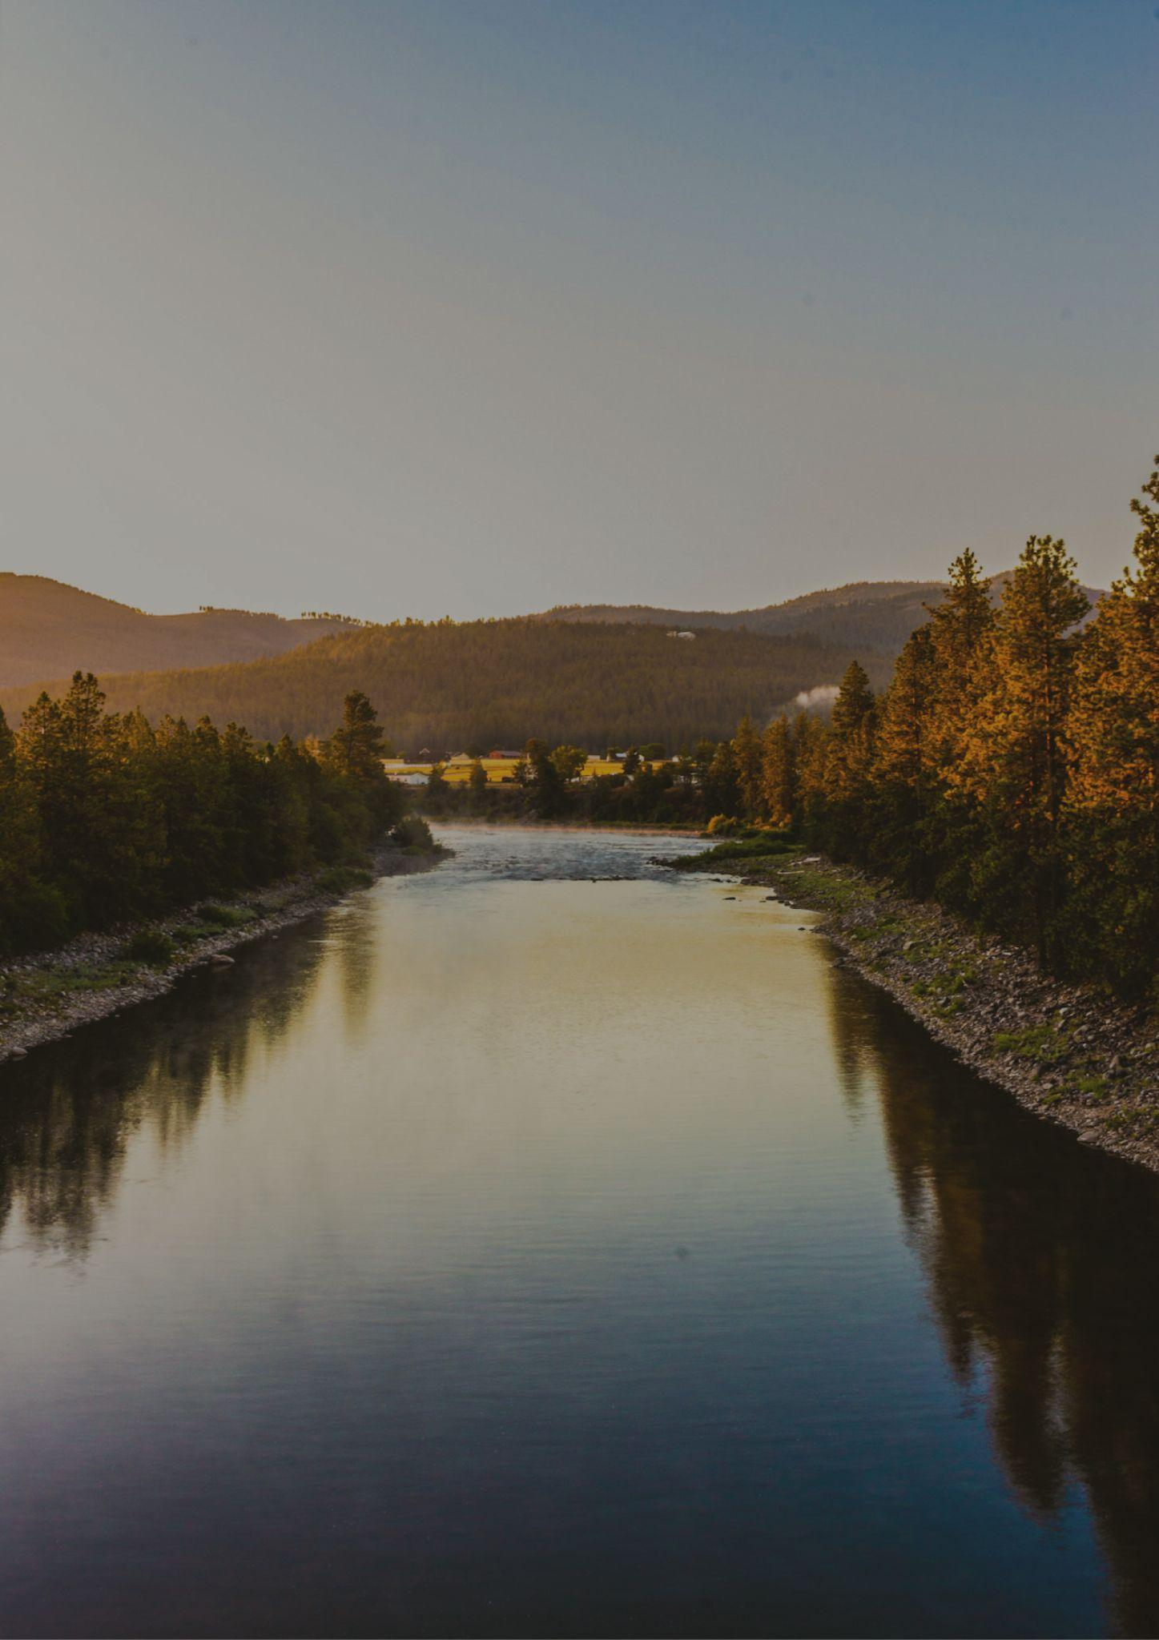
IDAHO
TRAVEL BUCKET LIST
Idaho Potato Museum
Lava Hot Springs
Shoshone Falls
Minidoka
Boise River Greenbelt
Yellowstone Bear World
Silverwood Theme Park
Miner’s Hat Realty
Idaho Botanical Garden
Museum of Idaho
Atomic Museum
City of Rocks
Cowboy Muffler Man
Big Idaho Potato Hotel
Coeur d'Alene
Yellowstone National Park
Shoshone Ice Caves
Collectors’ Corner Museum
Sun Valley
Snake River Adventures
Atomic City
Zoo Boise
Shoshone Falls
Bruneau Dunes State Park

