Slide 1
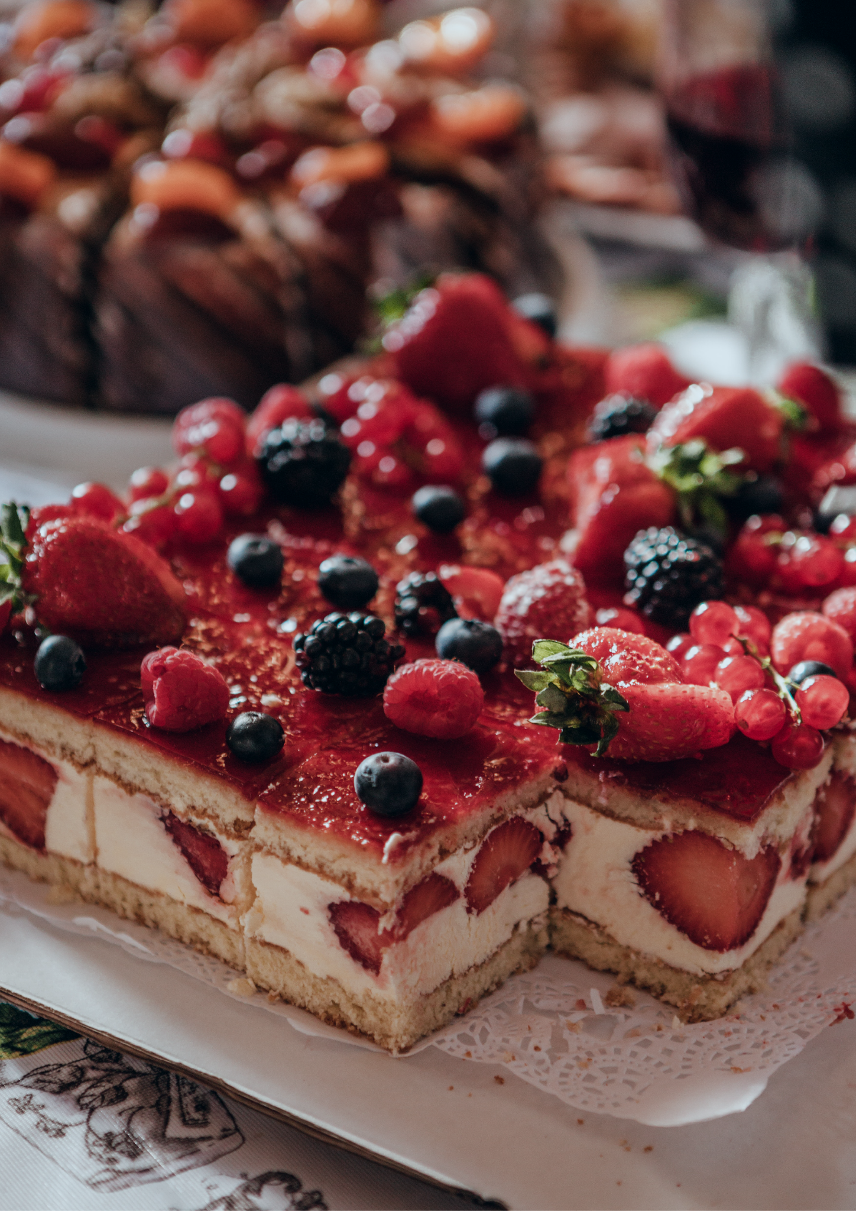
Homemade Cake
Price List

Slide 2
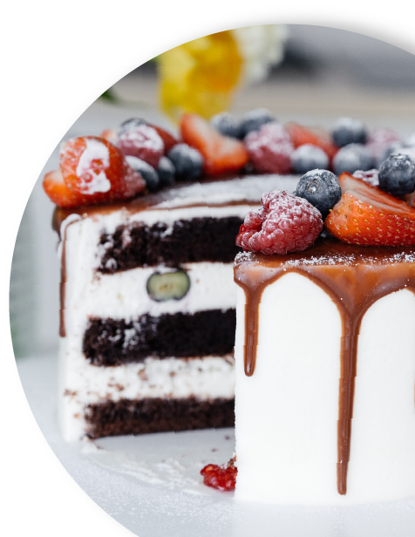
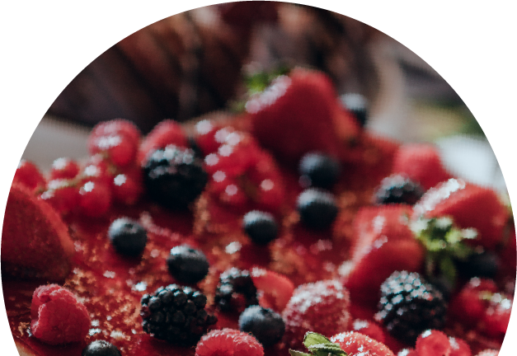
Homemade Cake
Price List
Classic vanilla cake with
buttercream frosting:
Lemon cake with
lemon curd filling and
buttercream frosting:
6 inch round cake: $25-$30
8 inch round cake: $35-$40
6 inch round cake: $25-$30
10 inch round cake: $45-$50
8 inch round cake: $35-$40
10 inch round cake: $45-$50
Chocolate cake with
chocolate ganache:
Strawberry cake with
whipped cream frosting:
6 inch round cake: $30-$35
8 inch round cake: $40-$45
6 inch round cake: $35-$40
10 inch round cake: $55-$60
8 inch round cake: $50-$55
Red velvet cake with
cream cheese frosting:
10 inch round cake: $65-$70
Funfetti cake with vanilla
buttercream frosting:
6 inch round cake: $35-$40
8 inch round cake: $50-$55
6 inch round cake: $25-$30
10 inch round cake: $65-$70
8 inch round cake: $35-$40
10 inch round cake: $45-$50
Carrot cake with cream
cheese frosting:
6 inch round cake: $35-$40
8 inch round cake: $50-$55
10 inch round cake: $65-$70

