Slide 1
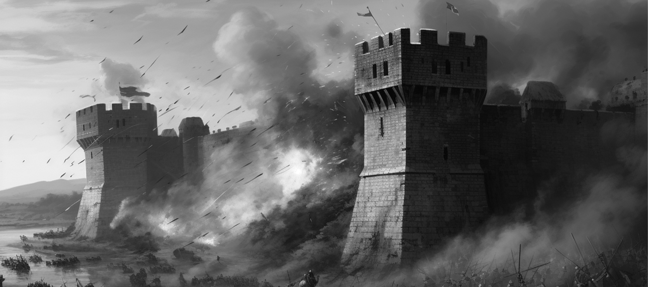
Volume 1
Historical Herald
July 7
Issue 1
2024
THE DAWN OF A NEW ERA
The Fall of Constantinople
A detailed illustration depicting the final assault on the walls of Constantinople by Ottoman forces in 1453
On May 29, 1453, history witnessed the fall of Constantinople, marking the end of the Byzantine Empire. The city, renowned for its architectural marvels and strategic importance, succumbed to the forces of the Ottoman Sultan, Mehmed II. This event not only changed the course of history but also marked the beginning of a new era in the Mediterranean and the world. The siege, lasting for nearly two months, was a display of military innovation and determination. The Ottomans utilized massive cannons to breach the formidable Theodosian Walls, long considered impregnable.
The defenders, led by Emperor Constantine XI, fought valiantly but were ultimately overwhelmed by the superior.
The siege, lasting for nearly two months, was a display of military innovation and determination. The Ottomans utilized massive cannons to breach the formidable Theodosian Walls, long considered impregnable. The defenders, led by Emperor Constantine XI, fought valiantly but were ultimately overwhelmed by the superior numbers and technology of the Ottoman forces.
The fall of Constantinople, marking the end of the Byzantine Empire, had far-reaching consequences. It severed the last remnants of the Roman Empire and shifted the balance of power in the region. Istanbul became the new capital of the Ottoman Empire and a significant center of Islamic culture and learning.
A detailed illustration depicting the final assault on the walls of Constantinople by Ottoman forces in 1453, showcasing the formidable Theodosian Walls and the massive cannons used to breach them.
On May 29, 1453, history witnessed the fall of Constantinople, marking the end of the Byzantine Empire. The city, renowned for its architectural marvels and strategic importance, succumbed to the forces.
The siege, lasting for nearly two months, was a display of military innovation and determination. The Ottomans utilized massive cannons to breach the formidable Theodosian Walls, long considered impregnable. The defenders, led by Emperor.
THE SIEGE OF CONSTANTINOPLE
The siege, lasting for nearly two months, was a display of military innovation and determination. The Ottomans utilized massive cannons to breach the formidable Theodosian Walls, long considered impregnable. The defenders, led by Emperor Constantine XI, fought valiantly but were ultimately overwhelmed by the superior numbers and technology of the Ottoman forces.
The fall of Constantinople had far-reaching consequences. It severed the last remnants of the Roman Empire and shifted the balance of power in the region. The city, now Istanbul, became the new capital of the Ottoman Empire and a significant center of Islamic culture and learning.

Slide 2
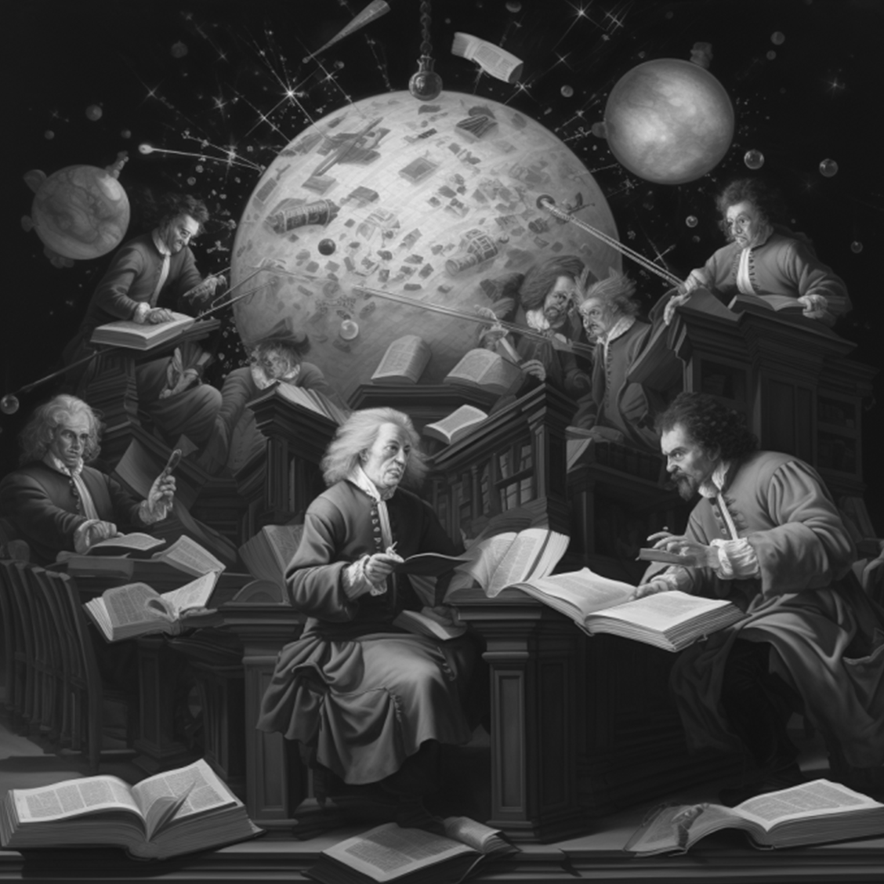
Volume 1, Issue 1
July 7, 2024
BIRTH OF MODERN
The Enlightenment: The Birth of Modern Thought
The Enlightenment, an intellectual and philosophical movement of the 17th and 18th centuries, emphasized reason, individualism, and skepticism of traditional authority. It fostered critical thinking and scientific inquiry, challenging long-held beliefs and laying the groundwork for modern democratic societies. The Enlightenment, an intellectual and philosophical movement of the 17th and 18th centuries, individualism, and skepticism.
The Enlightenment, an intellectual and philosophical movement of the 17th and 18th centuries, emphasized reason, individualism, and skepticism of traditional authority. It fostered critical thinking and scientific inquiry, challenging long-held beliefs and laying the groundwork for modern democratic societies. The reason, individualism, and skepticism of traditional authority. It fostered critical thinking and scientific inquiry.
Michelangelo's Sistine Chapel Ceiling
THE ENLIGHTENMENT: THE BIRTH OF MODERN
THE FRENCH REVOLUTION
The siege, lasting for nearly two months, was a display of military innovation and determination. The Ottomans utilized massive cannons to breach the formidable Theodosian Walls, long considered impregnable. The defenders, led by Emperor Constantine XI, fought valiantly but were ultimately overwhelmed by the superior numbers and technology of the Ottoman forces.
The fall of Constantinople had far-reaching consequences. It severed the last remnants of the Roman Empire and shifted the balance of power in the region. The city, now Istanbul, became the new capital of the Ottoman Empire and a significant center of Islamic culture and learning. The city, now Istanbul, became the new capital of the Ottoman Empire and a significant center of Islamic culture and learning. The city, now Istanbul, became the new capital of the Ottoman Empire and a significant.
A painting depicting key Enlightenment figures like Voltaire, Rousseau.
On May 29, 1453, history witnessed the fall of Constantinople, marking the end of the Byzantine Empire. The city, renowned for its architectural marvels and strategic importance, succumbed to the forces of the Ottoman Sultan, Mehmed II. This event not only changed the course of history but also marked the beginning of a new era in the Mediterranean and the world. The siege, lasting for nearly two months, was a display of military innovation and determination. The Ottomans utilized massive cannons to breach the formidable Theodosian Walls, long considered impregnable.
The siege, lasting for nearly two months, was a display of military innovation and determination. The Ottomans utilized massive cannons to breach the formidable Theodosian Walls, long considered impregnable. The defenders, led by Emperor Constantine XI, fought valiantly but were ultimately overwhelmed by the superior numbers and technology of the Ottoman forces.
The fall of Constantinople had far-reaching consequences. It severed the last remnants of the Roman Empire and shifted the balance of power in the region. The city, now Istanbul,
A detailed illustration depicting the final assault on the walls of Constantinople by Ottoman forces in 1453, showcasing the formidable Theodosian Walls and the massive cannons used to breach them.
On May 29, 1453, history witnessed the fall of Constantinople, marking the end of the Byzantine Empire. The city, renowned for its architectural marvels and strategic importance, succumbed to the forces of the
siege, lasting for nearly two months, was a display of military innovation and determination.

Slide 3
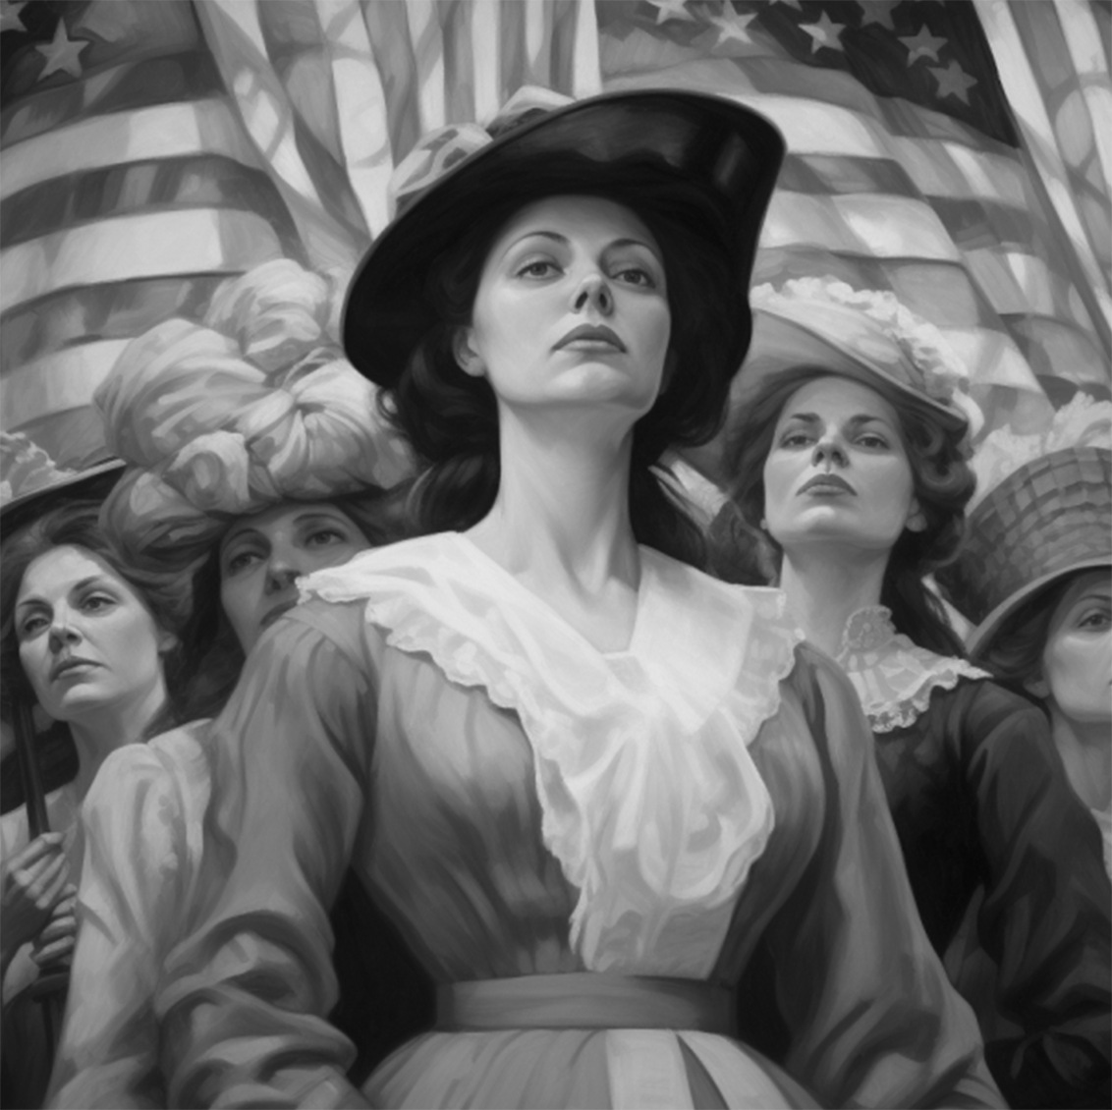
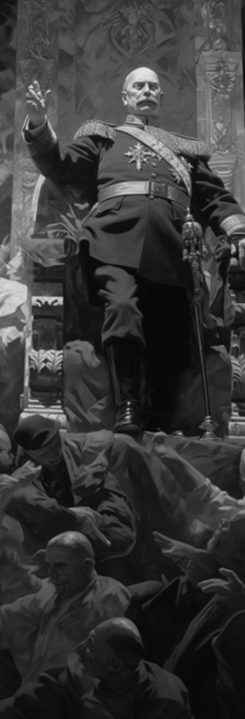
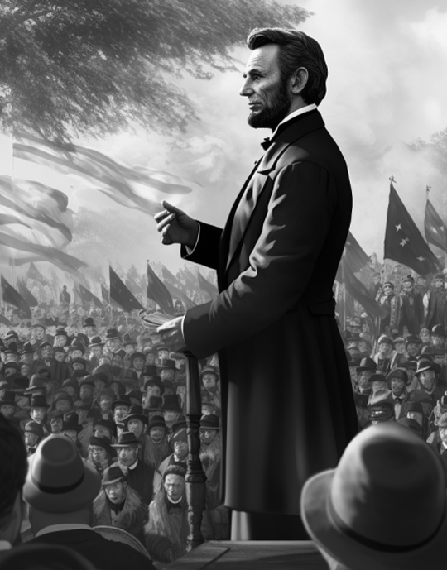
Volume 1, Issue 1
July 7, 2024
WOMEN IN THE UNITED STATES
This milestone was the culmination of decades of activism.
The 14th to 17th centuries saw an extraordinary flourishing of art, science, and culture in Europe, a period known as the Renaissance. Originating in Italy, this era was characterized by a revival of interest in the classical knowledge and artistic principles of Ancient Greece and Rome. Renowned figures.
Renowned figures like Leonardo da Vinci, Michelangelo, and Galileo Galilei emerged during this time, making groundbreaking contributions to art, science, and philosophy. Da Vinci’s masterpieces, such as the Mona Lisa and The Last Supper, epitomized the Renaissance ideal of combining
Michelangelo's Sistine Chapel Ceiling
A STRUGGLE FOR
UNITY FREEDOM
THE GERMAN EMPIRE
Abraham Lincoln Delivering
the Gettysburg Address
King Wilhelm I at the Hall of Mirrors
The American Civil War (1861-1865) was a defining moment in United States history, fought over the deep-seated issues of slavery and states' rights. The conflict between the Union (Northern states) and the Confederacy (Southern states) resulted in immense loss of life and destruction but ultimately led to the preservation of the Union and the abolition of slavery.
The American Civil War (1861-1865) was a defining moment in United States history, fought over the deep-seated issues of slavery and state abolition of slavery.
The American Civil War (1861-1865) was a defining moment in United States history, fought over the deep-seated issues of slavery.
The unification of Germany in the 19th century was a pivotal event that reshaped the political landscape of Europe. Spearheaded by Otto von Bismarck, the Prussian statesman, the unification process culminated in the proclamation of the German Empire in 1871, following the defeat of France in the Franco-Prussian War.
The unification of Germany in the 19th century was a pivotal event that reshaped event that reshaped.
Columbus' Arrival in the World
The Berlin Wall Falls

Slide 4
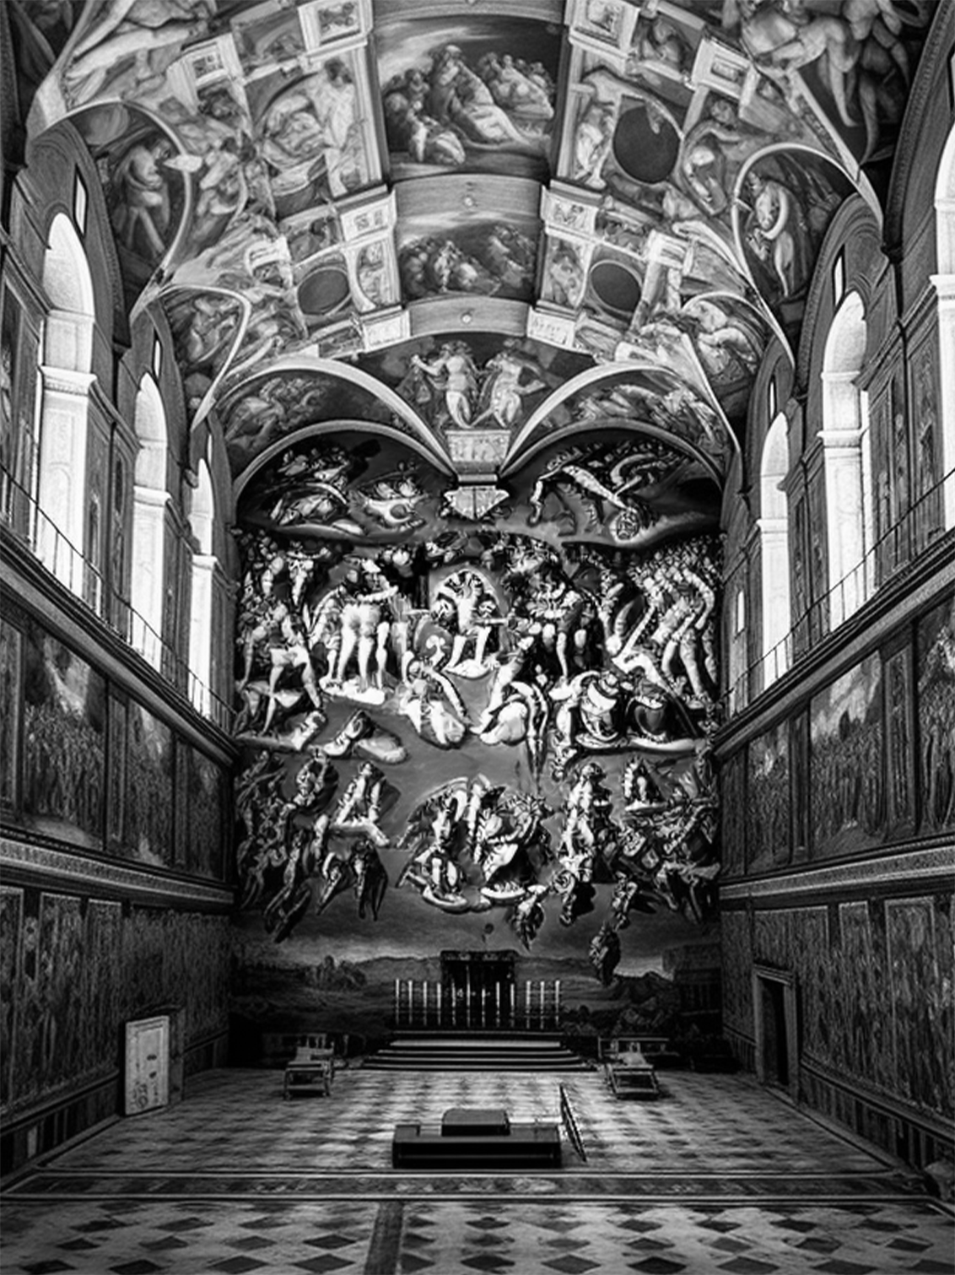

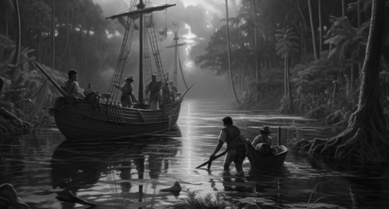
Volume 1, Issue 1
July 7, 2024
EXPLORING CULTURAL RICHES
Michelangelo's Chapel Ceiling
The 14th to 17th centuries saw an extraordinary flourishing of art, science, and culture in Europe, a period known as the Renaissance. Originating in Italy, this era was characterized by a revival of interest in the classical knowledge and artistic principles of Ancient Greece and Rome.
Renowned figures like Leonardo da Vinci, Michelangelo, and Galileo Galilei emerged during this time, making groundbreaking contributions to art, science, and philosophy. Da Vinci’s masterpieces, such as the Mona Lisa and The Last Supper, renaissance ideal.
Renowned figures like Leonardo da Vinci, Michelangelo, and Galileo Galilei emerged during this time, making groundbreaking contributions to art, science, and philosophy.
Da Vinci’s masterpieces, such as the Mona Lisa and The Last Supper, epitomized the Renaissance ideal of combining art and science.
Michelangelo’s sculptures and paintings, including the iconic ceiling of the Sistine Chapel, displayed an unparalleled mastery of human anatomy and emotion. Thus, making groundbreaking contributions to art, science, and philosophy.
Michelangelo's Sistine Chapel Ceiling
THE HISTORICAL HIGHLIGHTS
WALL
FALLS
Christopher Columbus' Arrival in the New World
The Fall of the
Berlin Wall
Christopher Columbus, an Italian explorer sponsored by Spain, reached the Americas in 1492, leading to an era of exploration and colonization that profoundly impacted global history.
An iconic painting of the presentation of the Declaration of Independence, signed on July 4, 1776, laying the foundation for the United States of America. On July 4,
An iconic painting of the presentation of the Declaration of Independence, signed on July 4, 1776, laying the foundation for the United
On November 9, 1989, the Berlin Wall fell, symbolizing the end of the Cold War and the reunification of East and West Germany. This momentous event marked a significant step toward the collapse of communist regimes in Eastern Europe.
On November 9, 1989, the Berlin Wall fell, symbolizing the end of the Cold War and the reunification of East.
Columbus' Arrival in the World
The Berlin Wall Falls

