Slide 1
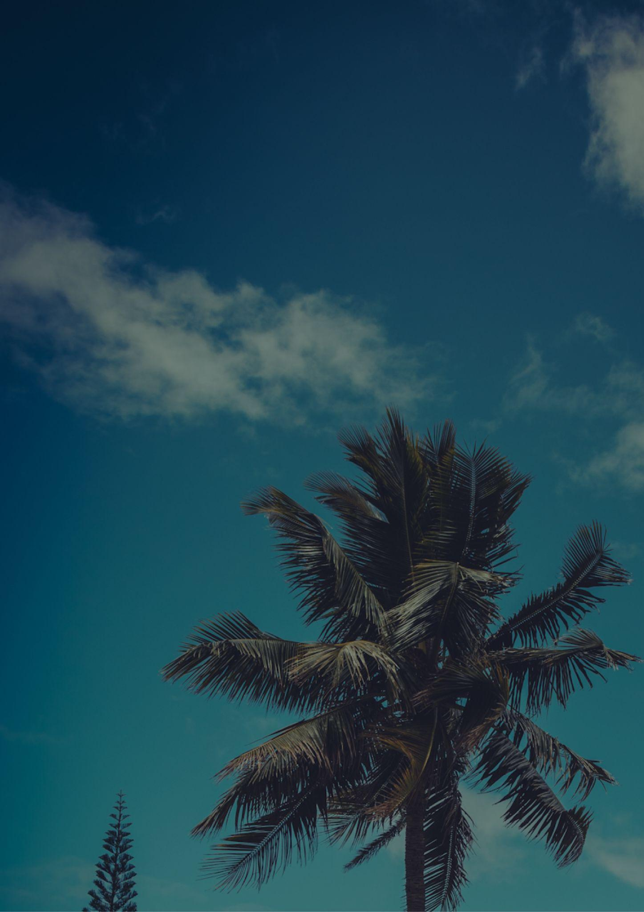
HAWAII
Travel bucket list
Waikiki Beach
Maui Ocean Center
Pearl Harbor
Polynesian Cultural Center
USS Arizona Memorial
Tour Iolani Palace
Volcanoes Park
Shop at Ala Moana
Haleakala National Park
Snorkel at Hanauma Bay
Waimea Canyon Park
Jump off Waimea Rock
Wilderness Park
Maui’s black-sand beach
Kona Coffee Farm
Kualoa Ranch
Hana Road
Akaka Falls
Waipio Valley Lookout
North Shore of Oahu
Dive with manta rays
Swim under the waterfalls
Mauna Kea
Visit Gilligan’s Island
Polynesian Cultural Center
Visit the Waimea Canyon

