Slide 1
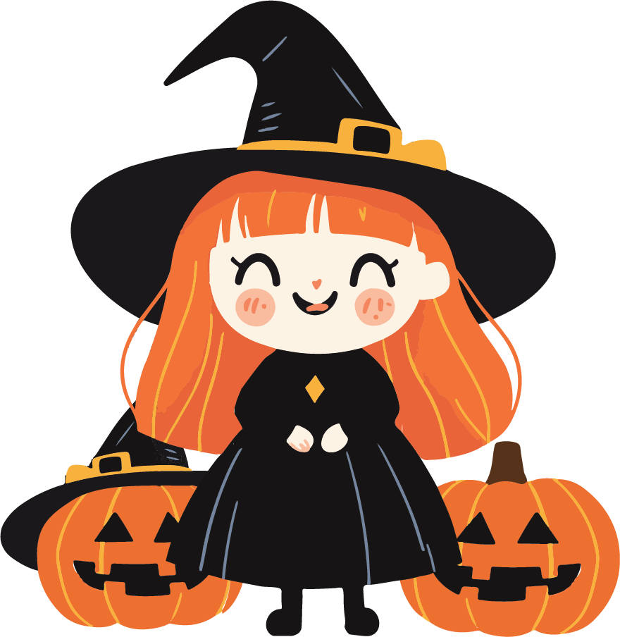
Join us for a night of frightful fun
Halloween
Party
OCTOBER, 31 AT 5:00 PM
123 Spooky Lane, Hauntville, NY 10001
Come if you dare, and prepare for
a night you’ll never forget!

