Slide 1
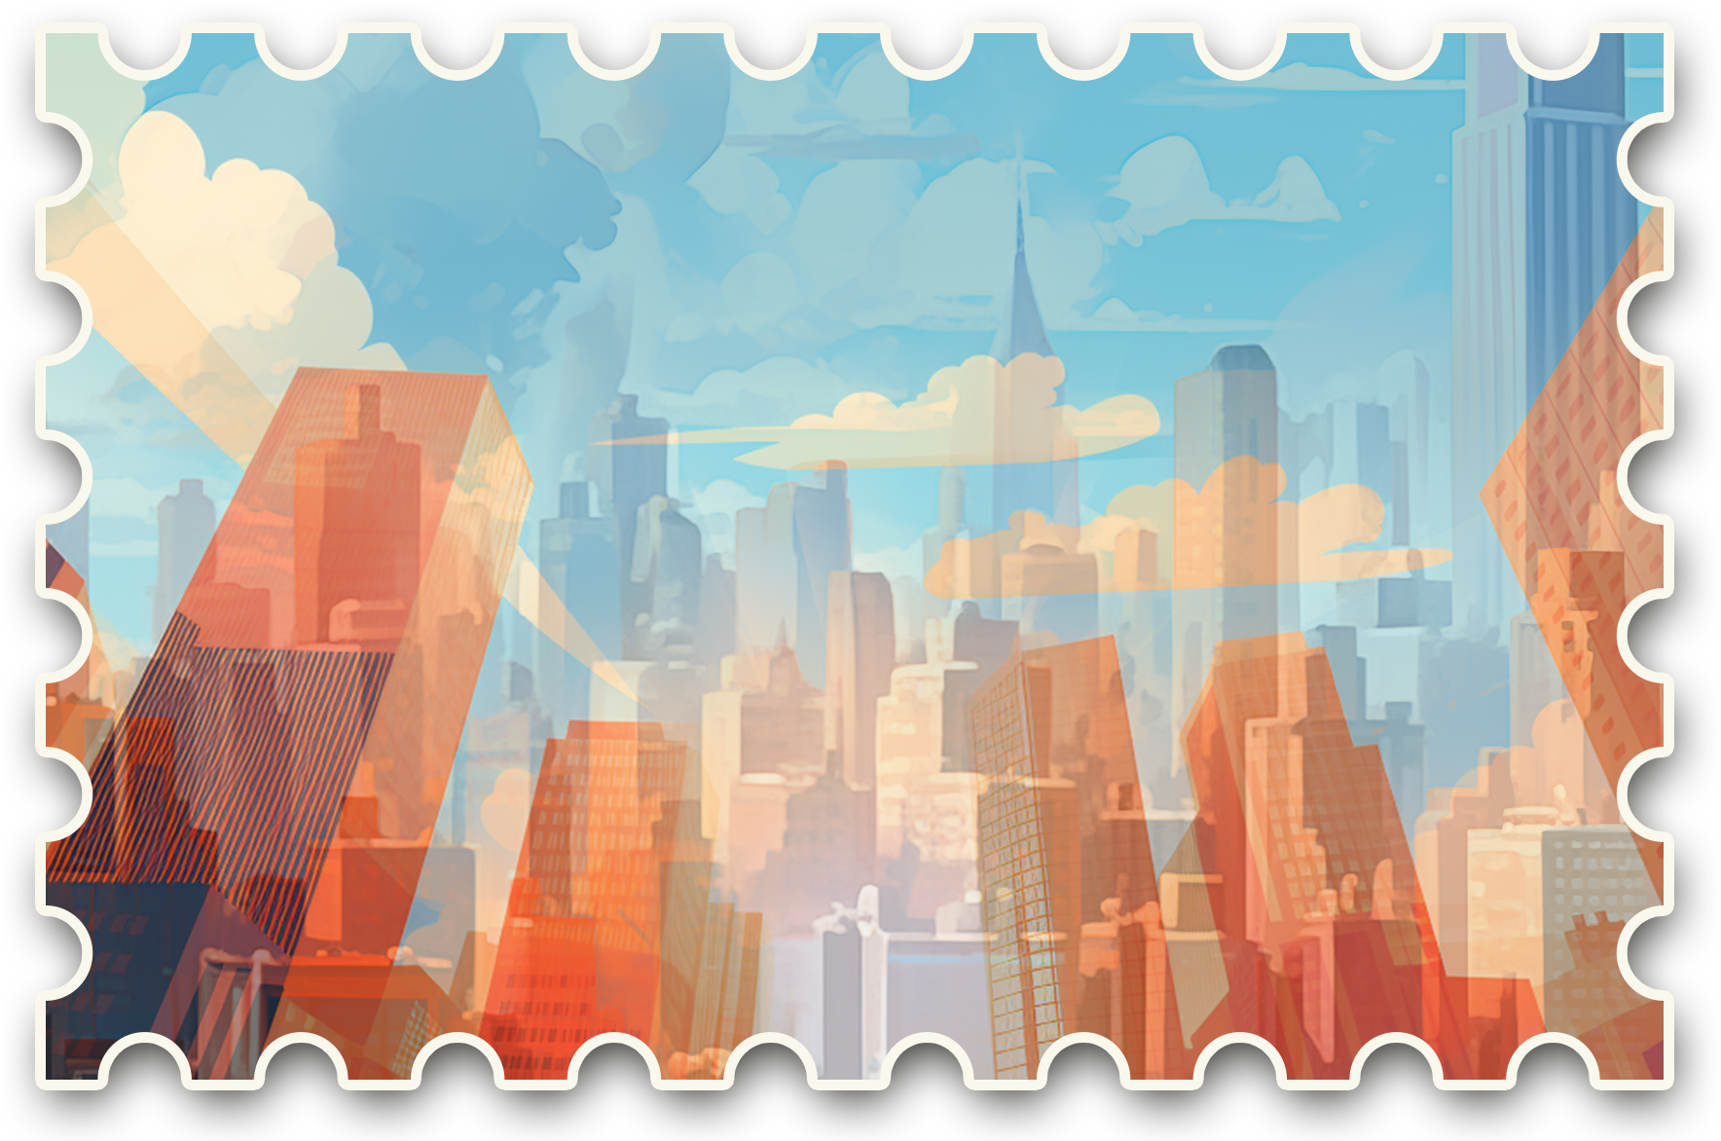
GREETINGS FROM
CITY

Slide 2
Greetings from New York Postcard

