Slide 1

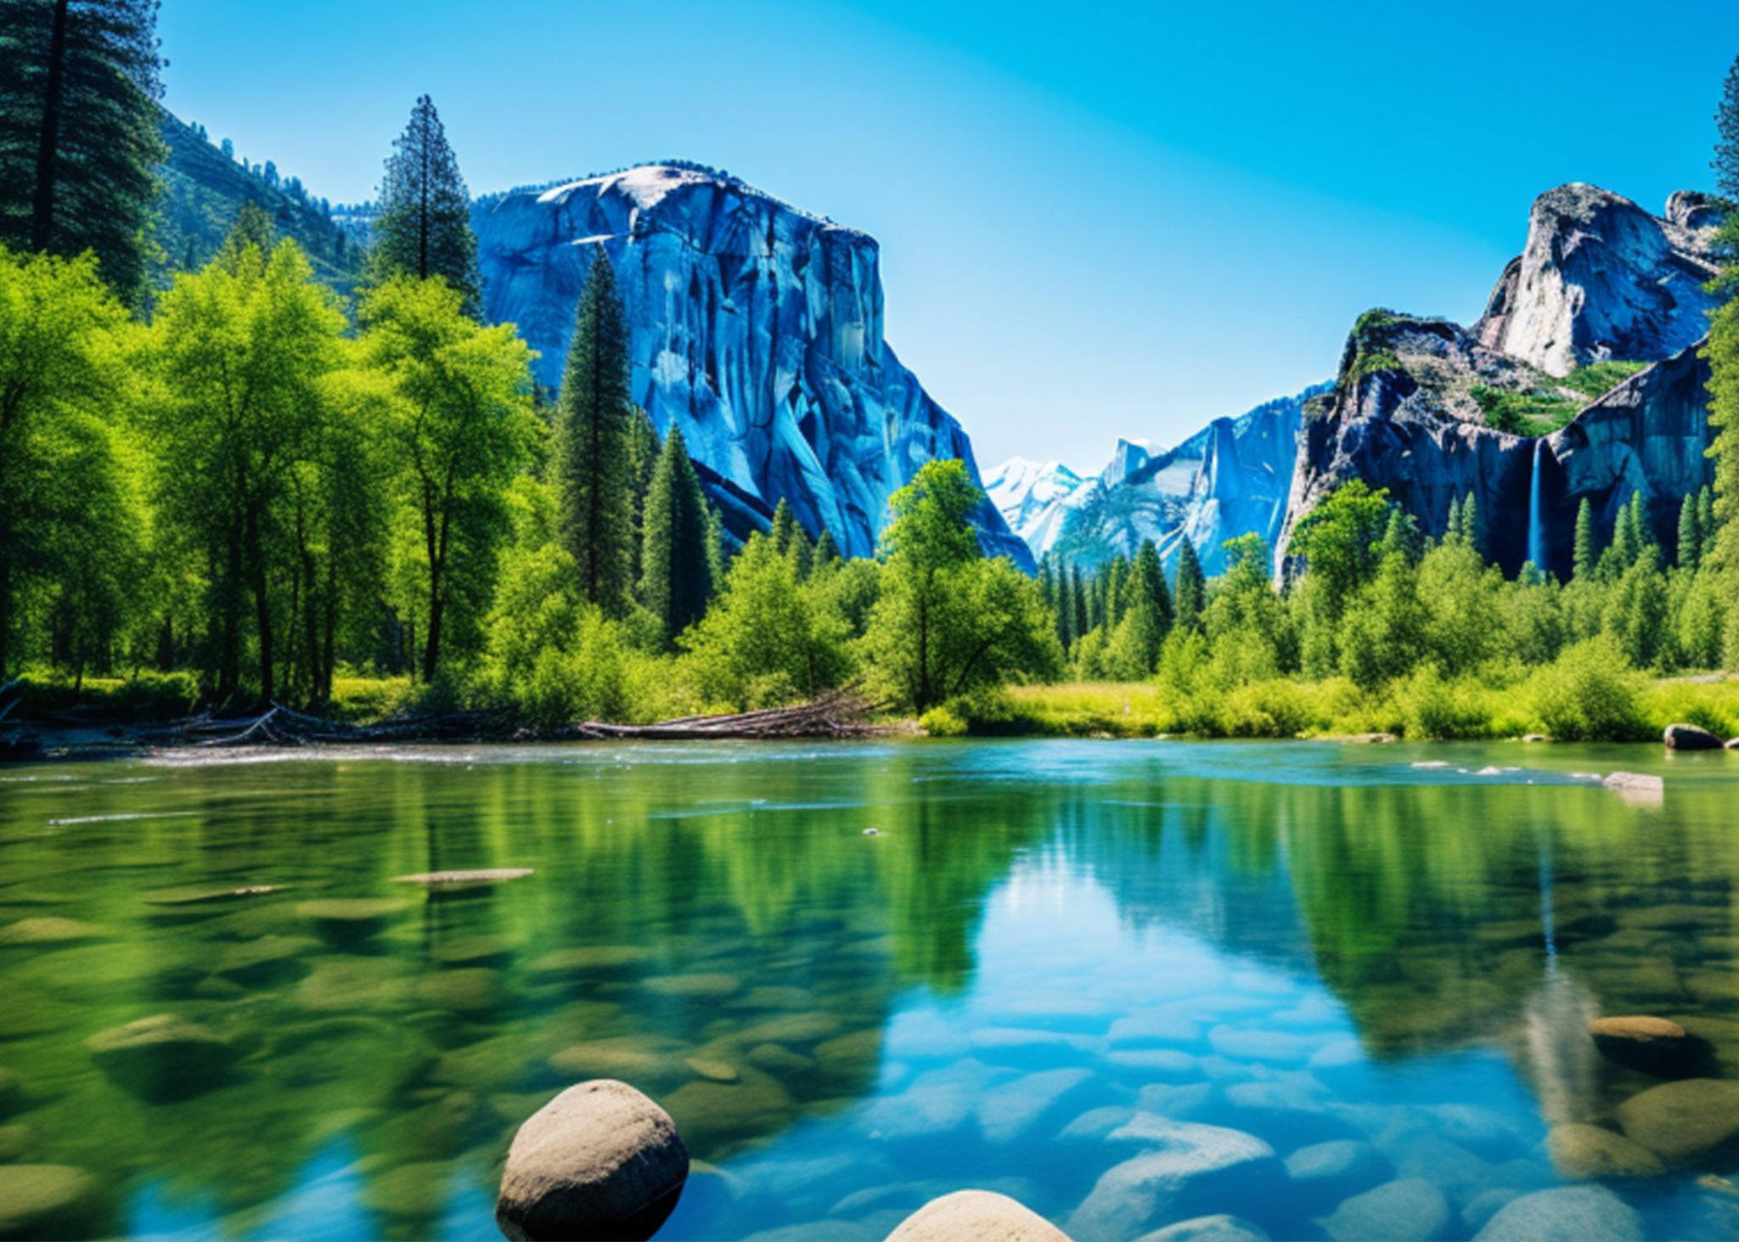



EXPLORE
THE PARK
Hiking Trails: Over 100 miles of trails ranging from easy walks to challenging hikes.
Camping: Enjoy a night
under the stars at one of
our many campsites.
CONTACT:
greennationalpark.ltd
Phone: (555) 321-7654
GREEN
NATIONAL
PARK
info@greennational.ltd
123 Nature Lane, Green Valley, NY 12345
Experience nature like never before at Green National Park, where lush forests, serene lakes, and diverse wildlife await. Plan your adventure today!

Slide 2

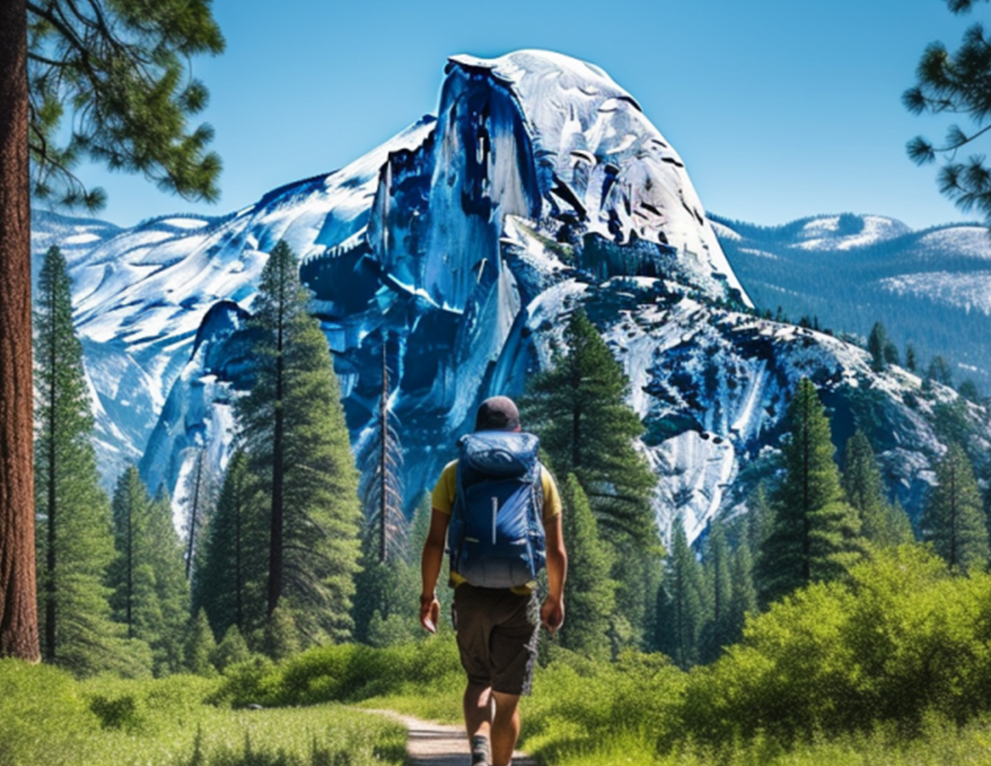

TIPS FOR
A GREAT
VISIT:
UPCOMING
EVENTS
Wear comfortable shoes and bring plenty of water.
Summer Celebration:
Respect wildlife and maintain a safe distance.
June 21st
Carry out all trash to keep the park clean.
EVENTS
Photography Workshop:
July 15th
Junior Ranger Program: Fun and educational activities for kids.
Autumn Leaves Festival:
Seasonal Festivals: Celebrate the changing seasons.
October 12th
Workshops and Classes:
Learn about nature and more.

