Slide 1

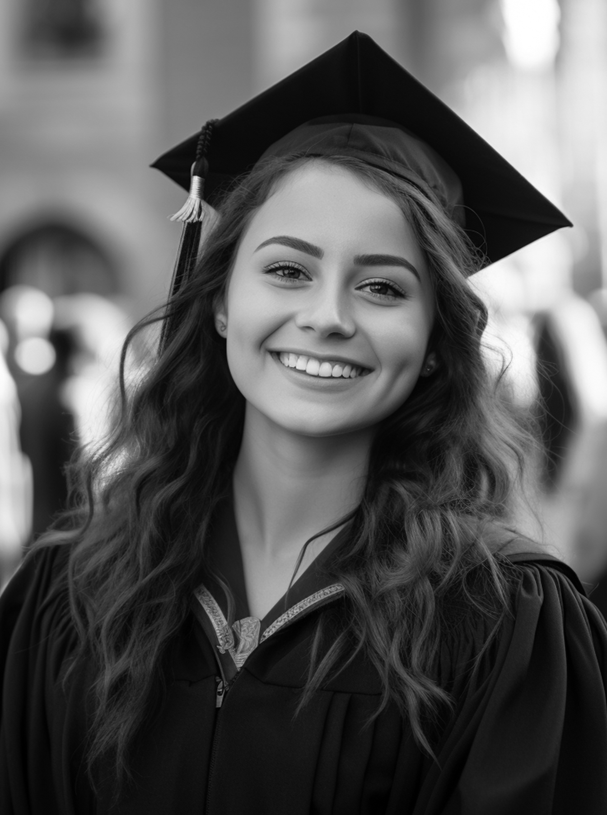
CLASS OF
Emily Johnson
2024
You're invited to toast
Emily Johnson and the Princeton
Class of 2024
At the luxury hotel
Sunday, July 1st at 2 P.M.

