Slide 1
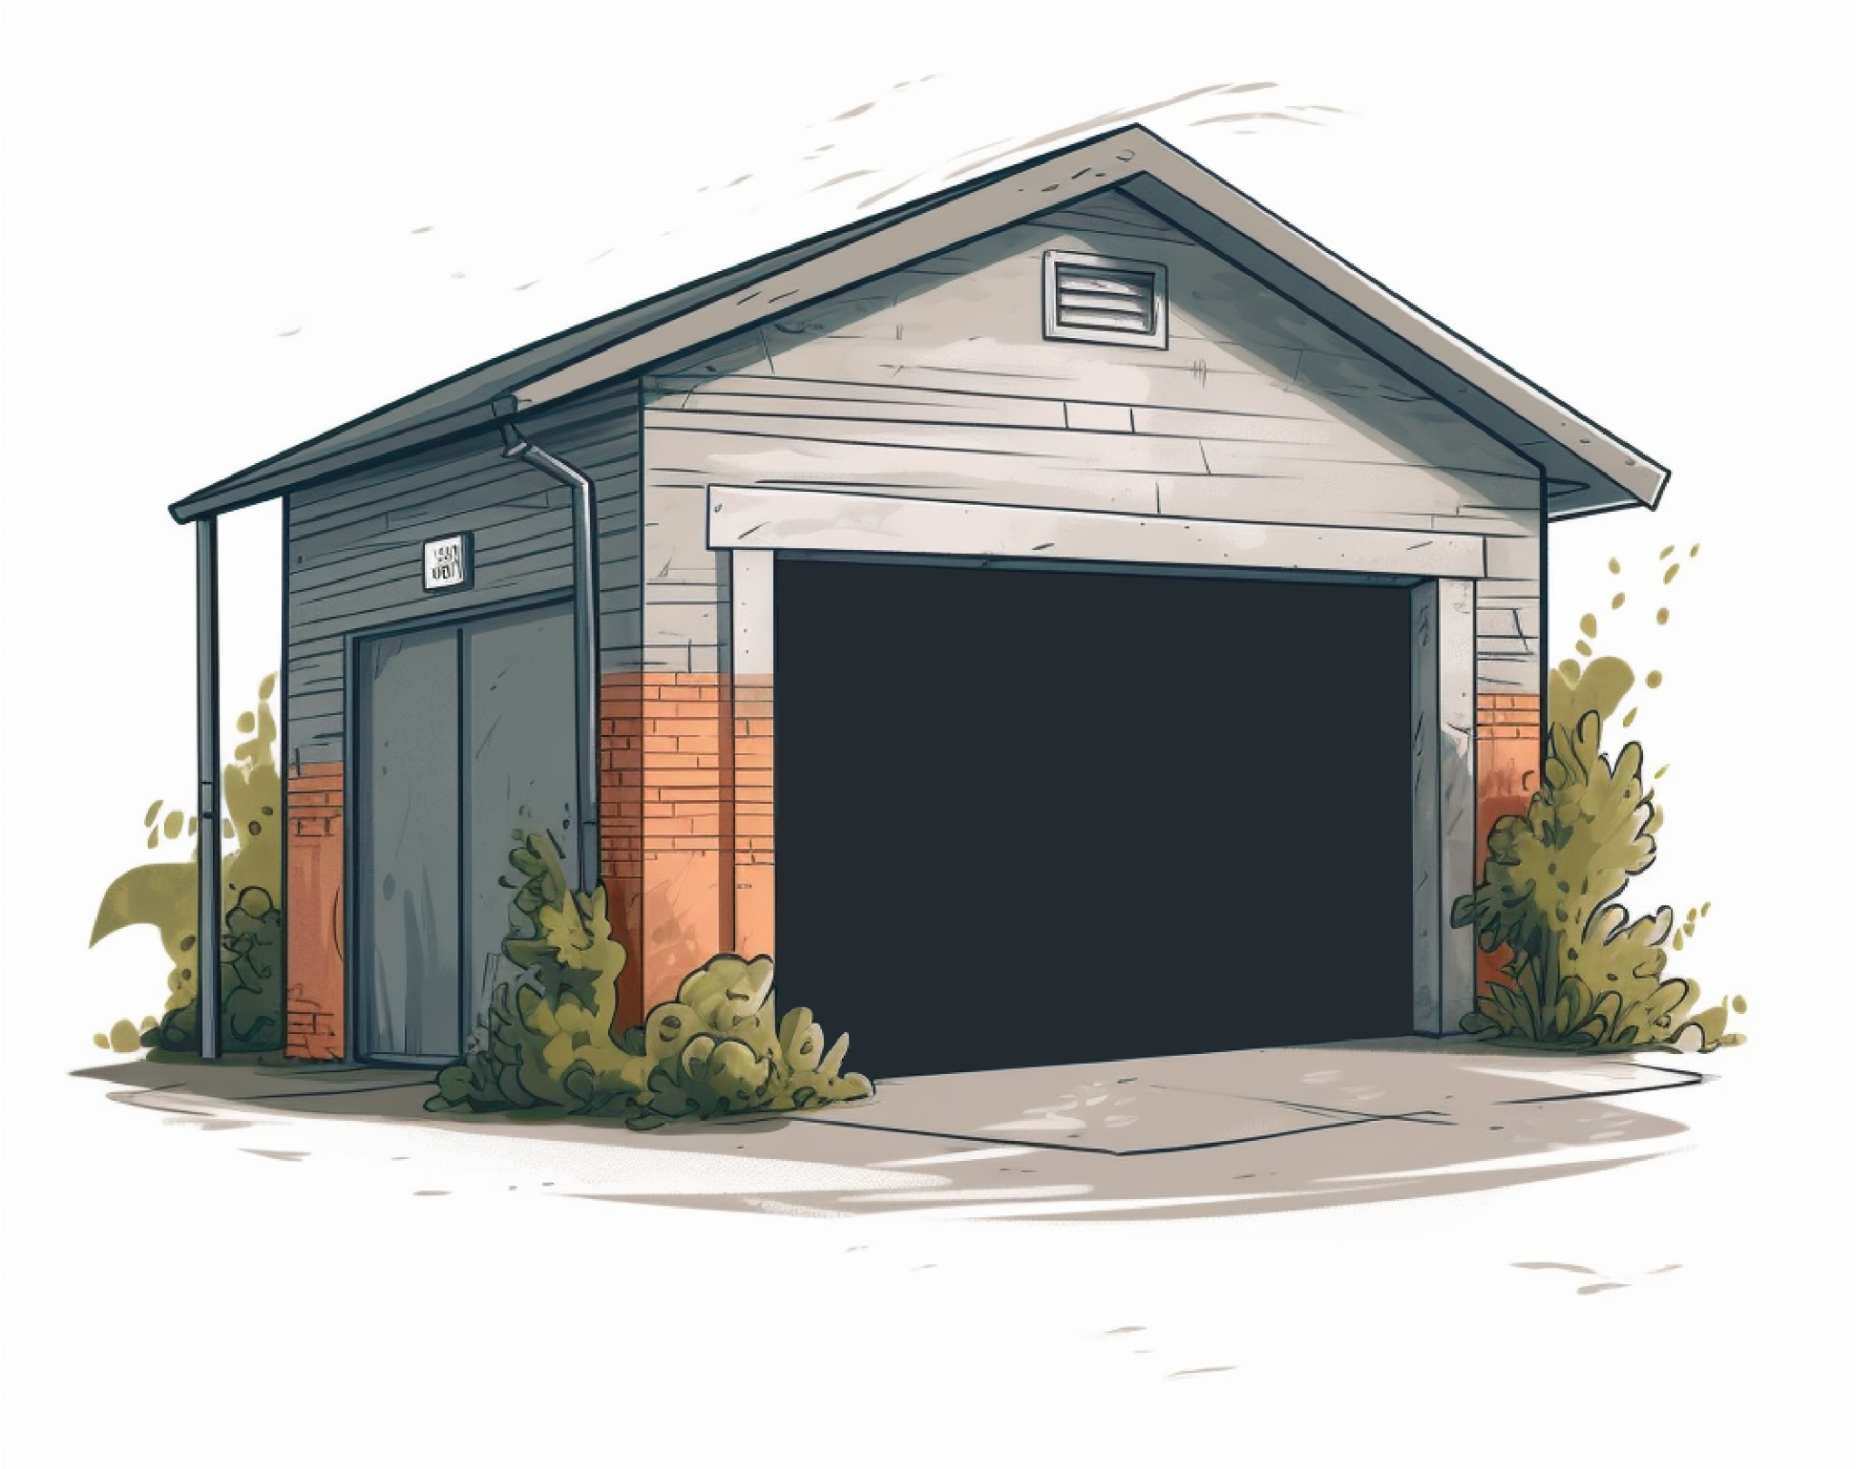
5$
10$
50$
25$
SATURDAY, OCTOBER
9TH AT 10AM-3PM
FURNITURE, CLOTHING, CAMPING GEAR, FANS,
BICYCLE PARTS AND MANY MORE!
89918 DEONTE CORNERS APT. 230,
ROCHEFORT IDAHO, 33444-3469
CREDIT & DEBIT ACCEPTED CALL ON T: +1-012-3456-789

Slide 2
ACCESSORIES
HOME DECOR
Backpacks ____________
$5.00-$10.00
Throw Pillows ___________
$5.00-$10.00
Costume Jewelry _________
$1.00-$3.00
Wall Decor _____________
$1.00-$3.00
Hair ________________
$5.00-$10.00
Candles ______________
$5.00-$10.00
Sunglasses ___________
$4.00-$10.00
Picture Frames (S) _______
$4.00-$10.00
LAWN CARE
Picture Frames (L) _______
$2.00-$10.00
Throw Pillows ___________
$5.00-$7.00
Power Tools __________
$15.00-$30.00
Lamps _______________
$5.00-$10.00
Riding Mower _________
$100.00-$300.00
Rugs _______________
$2.00-$25.00
Lawnmower ___________
$25.00-$30.00
Area Rugs ____________
$5.00-$10.00
Weed Eater (Elec) _______
$10.00-$15.00
Baskets _____________
$4.00-$13.00
Weed Eater (Gas)________
$21.00-$25.00
Mirrors _____________
$10.00-$30.00
Hand Tools ____________
$15.00-$17.00
KITCHEN
Edger (Gas) ___________
$5.00-$10.00
Flatware _____________
$5.00-$10.00
FURNITURE
Drinking Glasses _________
$1.00-$3.00
Desk _______________
$35.00-$50.00
Dishes _______________
$5.00-$10.00
Queen Size Bed _________
$40.00-$45.00
Pots and Pans _________
$4.00-$10.00
Full Size Bed ___________
$50.00-$60.00
Utensils _____________
$2.00-$10.00
Night Stand ___________
$34.00-$40.00
Appliances (Small) ________
$5.00-$7.00
King Size Bed __________
$52.00-$60.00
CLOTHES
BEAUTY
Kids ________________
$5.00-$10.00
Shampoo ______________
$1.00-$2.00
Adult ________________
$1.00-$3.00
Body Lotion ____________
$1.00-$3.00
Baby ________________
$5.00-$10.00
Nail Polish ____________
$1.00-$3.00
Jackets ______________
$4.00-$10.00
Conditioner ____________
$1.00-$2.00
Juniors ______________
$2.00-$10.00
Adult Shoes ____________
$5.00-$7.00
PARTY SUPPLIES
Winter Coats __________
$5.00-$10.00
Kids Shoes ____________
$2.00-$25.00
Gift Paper _____________
$0.50-$0.00
Wrapping Paper __________
$0.75-$0.50
Paper Plates (Set) ________
$0.50-$1.00

