Slide 1
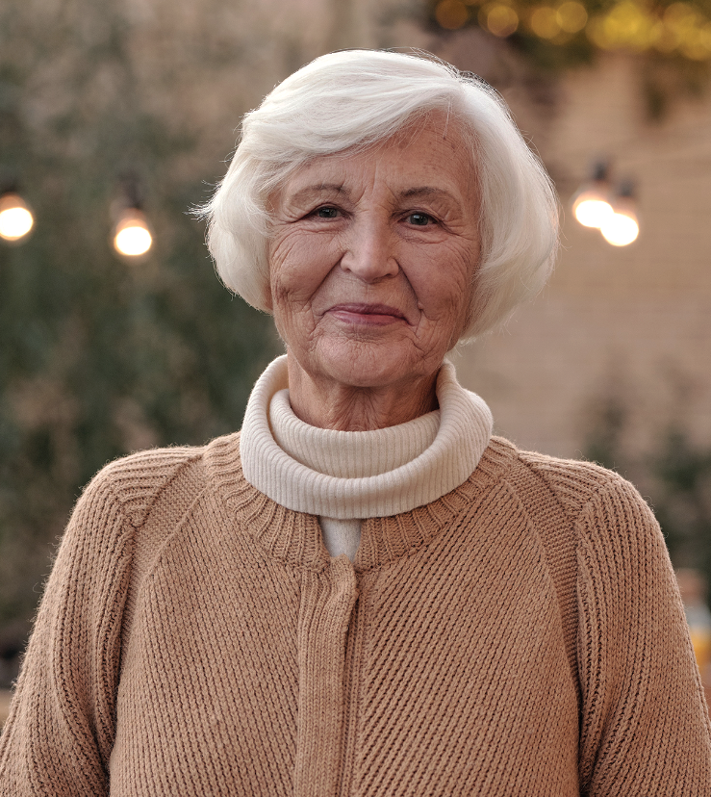
In loving memory of
Monica Johnson
A U G U S T 5
M A R C H 2 3
1 9 4 7
2 0 2 3
A funeral service will be held on
25
MARCH
9 AM
6 7 8 9 0 L U I S E N P L A T Z S T R A S S E B L D . 9 0
B E R L I N , G E R M A N Y

