Slide 1


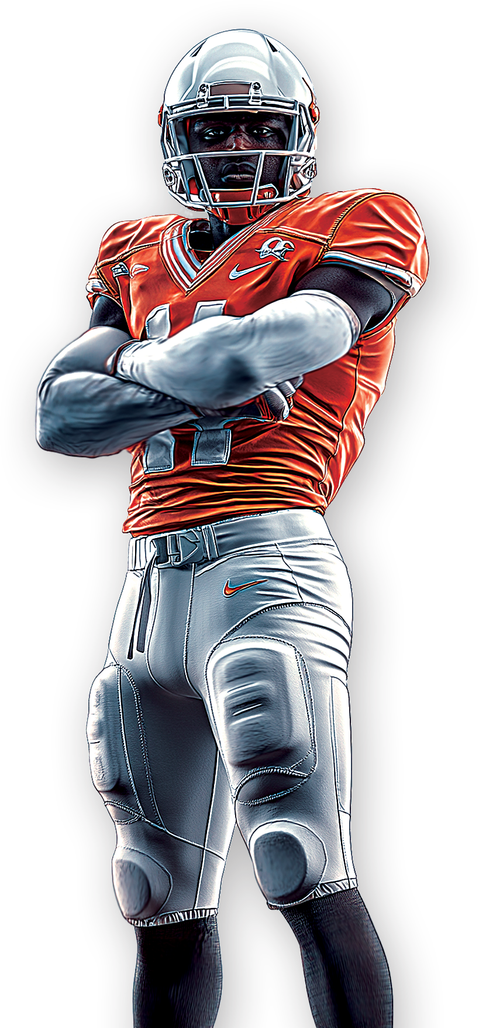
SEPTEMBER 20, 2026
NEW ENGLAND
PATRIOTS
VERSUS
RAVENS
BALTIMORE
LIVE AT
JOEY’S PUB
1 2 3 - 4 5 6 - 7 8 9 0 I 1 2 3 E A S T S I D E I M I A M I , F L 1 2 3 4 5

