Slide 1
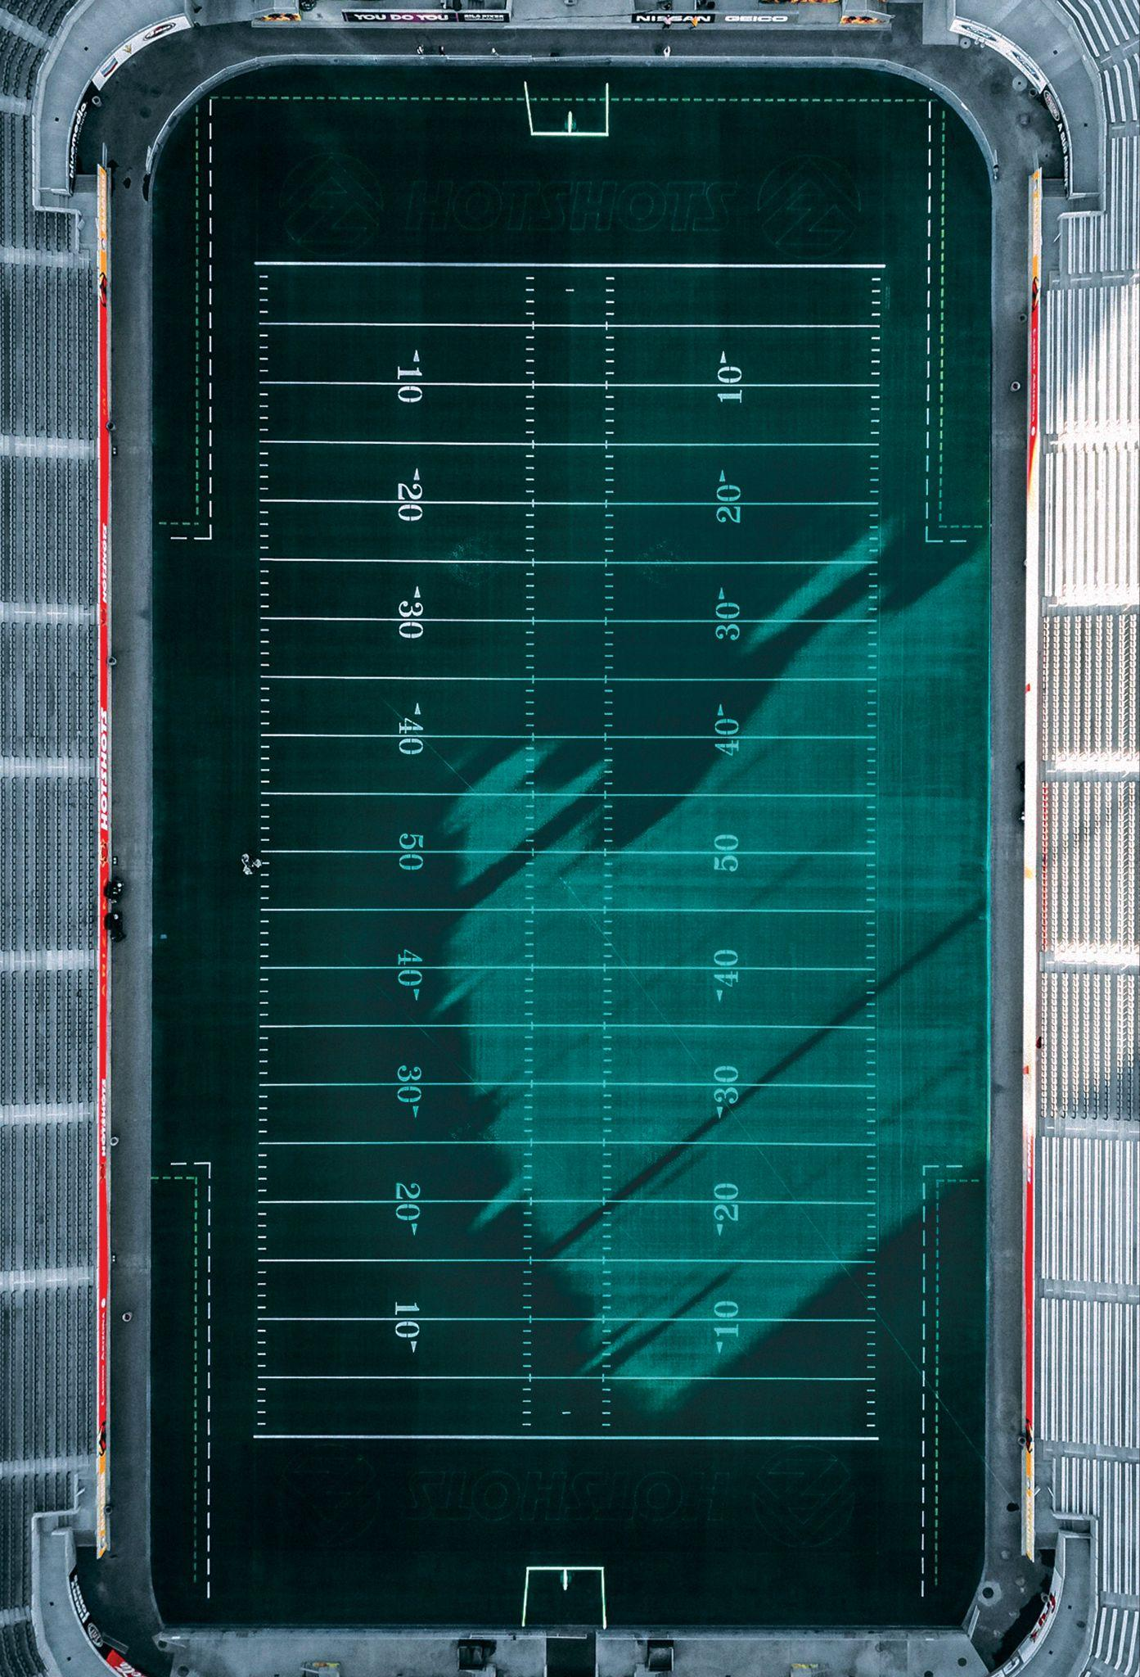


Y O U R P L A C E P R E S E N T S
VS
TITANS
RAVENS
NOVEMBER 24TH
1 2 3 4 5 6 B R I D G E S T . S A N F R A N C I S C O , C A

