Slide 1
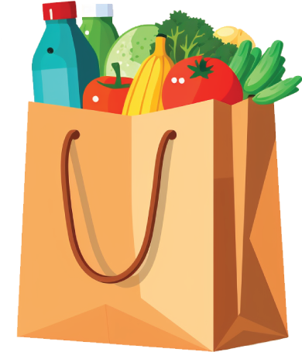
Organization Name
Food
Drive
MOST NEEDED
ITEMS:
Pasta, canned vegetables,
rice, canned foods, snack, juice box, cereal, fruits, milk, coffee, sugar, tea, sandwiches.
FOR MORE INFORMATION
SUN/07.08.2024
+123-456-7890
www.reallygreatsite.com

