Slide 1
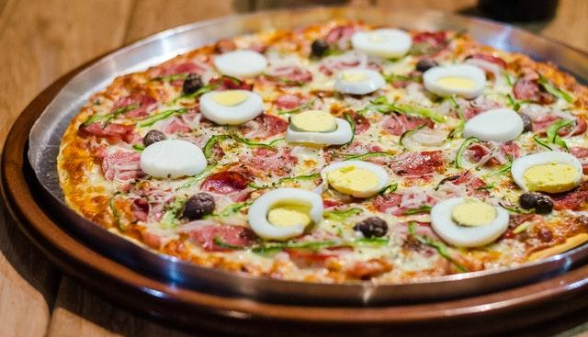


Fast Food
RESTAURANT

Slide 2
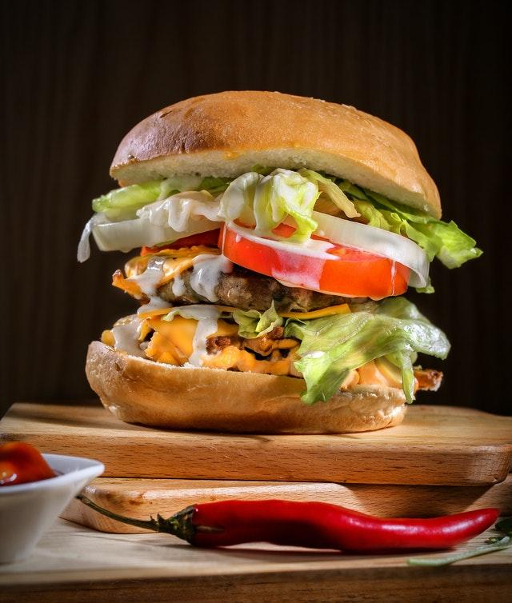


Fast Food
123-456-7890
123-456-7890
1483 Kling Gardens
Gloverburgh, Bilzen
Fast Food
RESTAURANT
example@mail.com
www.example.com

