Slide 1
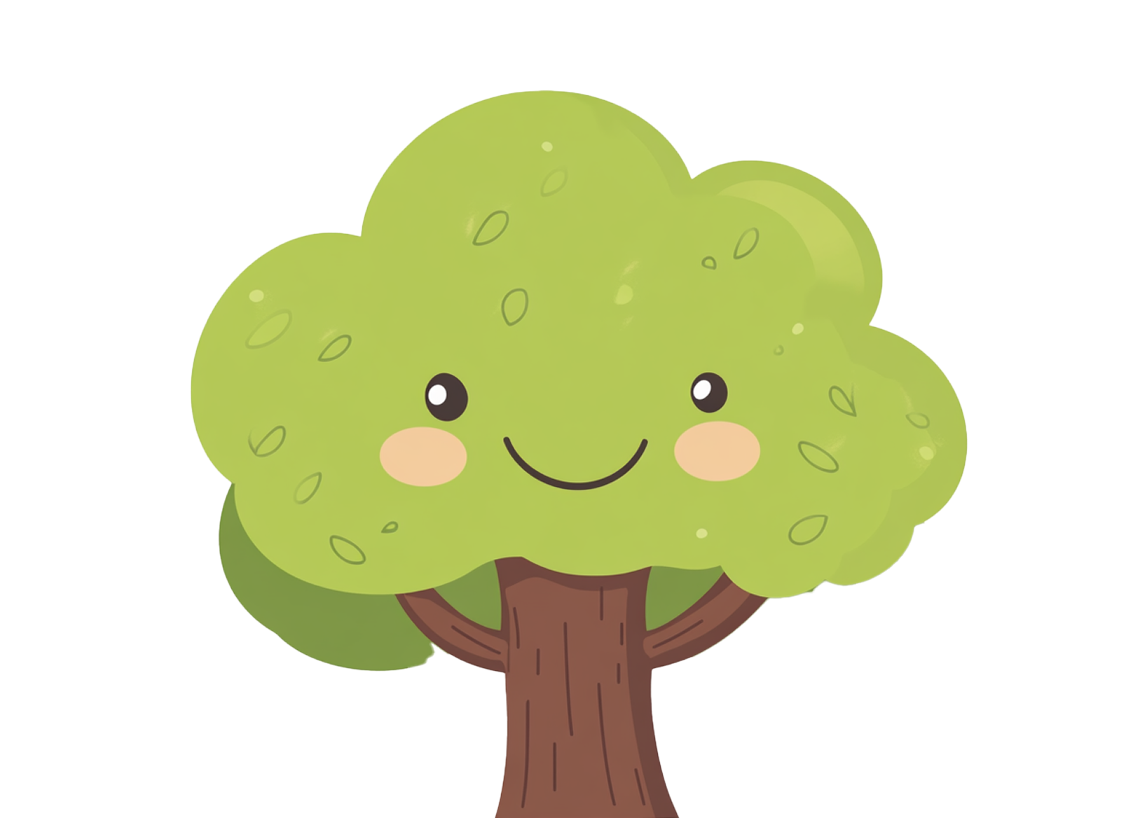
Great-Grandmother
My Family
Tree
Great-Grandmother
Grandmother
Grandmother
Great-Grandfather
Great-Grandfather
Mother
Father
Great-Grandmother
Great-Grandmother
Grandfather
Grandfather
Me
Great-Grandfather
Great-Grandfather

