Slide 1

VOLUME 1, ISSUE 1
THE FABRICATOR
FAKE NEWS
ALL THE LIES THAT FIT TO PRINT
The Fabricator
In a world drowning in truth
In a world drowning in truth, we offer you
the life preserver of fabrication. Welcome to The Fabricator, your premier source for the news you never knew you needed. In these pages, you'll find stories that defy logic, challenge reason, and embrace the absurd.
“Welcome to The Fabricator, your premier source for the news you never knew you needed.”
Why settle for the mundane when you
can indulge in the extraordinary? Join us as we dive headfirst into a sea of deception, where every headline is a work of fiction and every byline is a pseudonym.
In a world where truth is a currency, we're here to make you rich in imagination. Welcome to The Fabricator – where reality takes a back seat to the thrill of the story.
Photo Description: Aerial view of the intricate
The Fabricator
Twisting Reality
Headlines Today
In a world drowning in truth,
we offer you the life preserver of fabrication. Welcome to The
Fabricator, your premier source
for the news you never knew you needed.
In these pages, you'll find stories that defy logic, challenge reason, and embrace the absurd. Our team of dedicated writers, who may or may not exist, work tirelessly to bring you.
Why settle for the mundane when you can indulge in the extraordinary? Join us as we dive headfirst into a sea, where every headline is a work of fiction and every byline is a pseudonym.

Slide 2
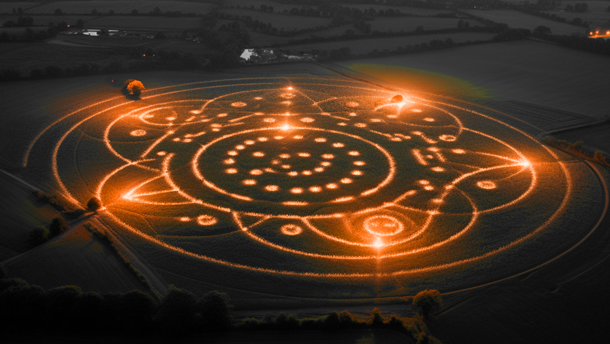
UNVEILING THE UNBELIEVABLE
Farmers in the rural town of Greenfield awoke.
What Are The Mysterious Crop Circles Spell Out Love Letters
experts believe to be a love letter addressed to planet Earth. The origin of the message remains unknown, leading to speculation about extraterrestrial visitors or perhaps a secret society with a profound admiration for our humble planet.
To a peculiar sight this morning as intricate crop circles appeared overnight in one of their fields. However, upon closer inspection, it was revealed that these circles
Photo Description: Aerial view of the intricate crop circles in the field, with farmers and researchers examining the patterns.
Man Discovers Fountain of Youth,
And Turns Neighbor into Toddler
In a backyard experiment gone awry, local inventor Dr. Benjamin Smith accidentally stumbled upon the legendary Fountain of Youth. Excited by his discovery, Dr. Smith hastily tested the waters, only to find himself transformed into a sprightly young man. However, tragedy struck when his neighbor, Mr. Jenkins, unsuspectingly took a sip and regressed into a giggling toddler. Dr. Smith is now racing against time
to reverse the effects and restore
Mr. Jenkins to his former self.
Man Discovers Fountain of Youth, Accidentally Turns Neighbor into Toddler
In a backyard experiment gone awry, local inventor Dr. Benjamin Smith accidentally stumbled upon the legendary Fountain of Youth. Excited by his discovery, Dr. Smith hastily tested the waters, only to find himself transformed into a sprightly young man. However, tragedy struck when his neighbor, Mr. Jenkins, unsuspectingly took a sip and regressed into a giggling toddler. Dr. Smith is now racing against time to reverse the effects and restore Mr. Jenkins to his former self.

Slide 3


Local Grandmother Claims to Be Time Traveler
Local Grandmother
Claims to Be
Time Traveler
Grandma Edna, a beloved figure in the small town of Oakwood, has stunned her friends and family with a startling revelation: she claims to be a time traveler from the year 2150. According to Grandma Edna, she has journeyed back in time to share her wisdom and,
More importantly, her cookie recipes from the future. While skeptics scoff at her claims, many residents have lined up to taste her futuristic treats and hear tales of the world yet to come. Grandma Edna,
a beloved figure in the small town of Oakwood, has stunned her friends
Family with a startling revelation: she claims to be a time traveler from the year 2150. According to Grandma Edna, she has journeyed back in time to share her wisdom and, more importantly, her cookie recipes from the future. While skeptics scoff at her claims.
Photo Description: Aerial view of the intricate
First Talking Dog Elected Mayor
Local Man Discovers Portal to Parallel Universe in Basement
Aerial view of the intricate
Fido, known for his impressive vocabulary and charming demeanor, has won over the hearts of the town's residents with promises of more parks, longer walks, and unlimited treats for all. Critics question the legality of electing a non-human candidate, but Fido's supporters argue that his bark is worse than any politician's bite.
In a groundbreaking election
twist, the small town of Barksville
has elected Fido, a four-year-old golden retriever, as their new mayor. Fido, known for his impressive vocabulary and charming demeanor, has won over the hearts of the town's residents with
Aerial view of the intricate

Slide 4


Aliens Abduct
Local Politician
World's First
In a groundbreaking election twist, the small town of Barksville has elected Fido, a four-year-old golden retriever, as their new mayor. Fido, known for his impressive vocabulary and charming demeanor, has won over the hearts of the town's residents with promises of more parks, longer walks, and unlimited treats for all. Critics question the legality of electing a non-human candidate, but Fido's supporters argue that his bark is worse.
DEMAND PIZZA AS RANSOM
In a bizarre turn of events, extraterrestrial beings have allegedly abducted Mayor Johnson of Pinecrest City. Witnesses report seeing a bright light engulfing the mayor's car before it vanished into the night sky. The aliens have since made contact, demanding 100 large pizzas in exchange
“The aliens have since made contact, demanding 100 large pizzas.”
Local Man
In a bizarre turn of events, extraterrestrial beings have allegedly abducted Mayor Johnson of Pinecrest City. Witnesses report seeing a bright light engulfing the mayor's car before it vanished into the night sky. The aliens have since made contact, demanding 100 large pizzas in exchange for the safe return of Mayor Johnson. Pinecrest City authorities are scrambling to fulfill the otherworldly ransom demands while assuring citizens that they are
In a basement in the quiet suburb of Willowbrook, local resident Harold Smith stumbled upon what appears to be a portal
to a parallel universe. Smith claims that after accidentally knocking over a stack of old magazines, he fell through a shimmering portal into a world where dinosaurs roam the streets and humans communicate through interpretive dance.
Photo Description: Aerial view of the intricate crop circles
Aliens Abduct Local
Politician, Demand
Pizza as Ransom
The aliens have since made contact, demanding 100 large pizzas in exchange for the safe return of Mayor Johnson. Pinecrest City authorities are scrambling to fulfill the otherworldly ransom demands while assuring citizens that they are doing everything in their power to secure the mayor's safe return.
The aliens have since made contact

