Slide 1






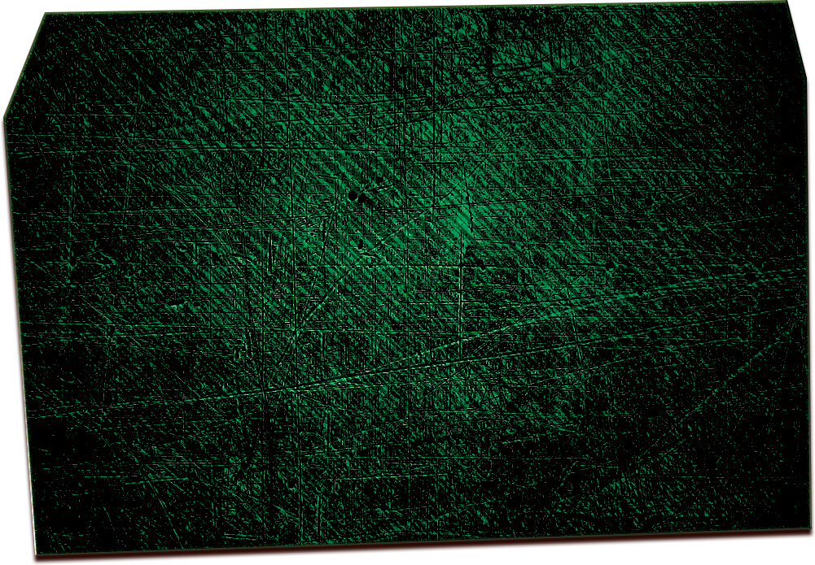


your bar presentS
S A T U R D A Y, S E P T E M B E R 3 0
UFEA CHAMPIONS LEAGUE PLAY-OFF 2028
REAL MADRID VS BARCELONA
beers from $5 i ALL-YOU-CAN-EAT BUFFET $10 i free parking
your place name, 12 baseball st. san antonio, tx
www.yourbarname.com

