Slide 1







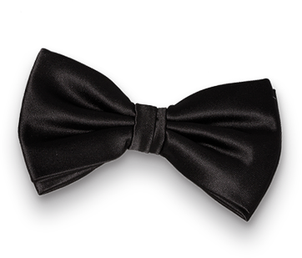

Y O U R C L U B P R E S E N T S
DEC
31
2026
You are invited to our
NEW YEAR
Doors open at 7.00 PM / Entry $20
Special Guest
MARC SPENCER
Join us on
Exclusive Club
333 Wrigley Drive, Lake Geneva, WI 53147

