Slide 1
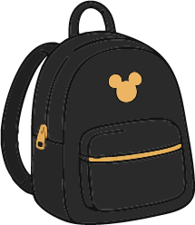
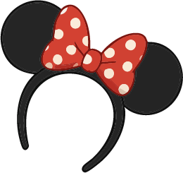
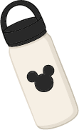
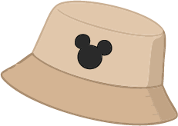
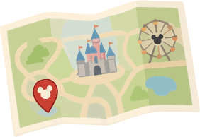
Disney Packing List
CLOTHING
TOILETRIES
ELECTRONICS
Walking Shoes
Socks
Shirts
Pajamas
Shorts/Skirts
Sunglasses
Sweatshirt/Jacket
Accessories/Jewelry
Underwear
Pants
Deodorant
Shampoo + Conditioner
Makeup
Toothbrush + Toothpaste
Body Wash
Glasses/Contacts
Razor + Shaving Cream
Hairbrush + Styling Tools
Travel Hand Soap
Hair Products
Headphones
Camera Batteries
Phone + Charger
Tablet + Charger
Cooling Neck Fan
Camera + Charger
Game Console + Charger
Camera Cards
eBook Reader + Charger
Power Bank
PARK DAYS
RESORT DAYS
TRAVEL DAYS
Sunscreen
MagicBand + Tickets
Autograph Book
Reusable Straws
Mickey Ears
Line Games
Fan/Cooling Towels
Umbrella/Poncho
Trading Pins
Refillable Water Bottle
Swimsuits
Pool Toys
Goggles
Flip-Flops/Sandals
Swim Cover-Ups
Beach Towels
Flotation Devices
Laundry Soap
Dress-Up Clothes
Sun Hat
ID/Passport
Travel Pillow
Ear Plugs
Books/Magazines
Reservation Info
Travel Games
Downloaded Movies
Car Seat/Stroller Bag
Compression Socks
Coloring/Activity Books
BABY CARE
FOOD/DRINKS
EXTRAS
Pacifier + Strap
Diapers + Swim Diapers
Wipes
Baby Toys
Changing Pad
Bottle Cleaner + Soap
Lovey/Blanket
Formula/Milk
Sippy Cup/Bottles
Bath Soap/Shampoo
Trail Mix
Juice Boxes
Chips/Crackers
Water Bottles
Granola Bars
Small Cooler + Ice Packs
Applesauce Pouches
Jerky/Meat Sticks
Dried Fruit/Fruit Snacks
Cereal
Hand Sanitizer
Masks
Ziploc Bags
Disney Gift Cards
Park Bag
Disinfecting Wipes
Hidden Mickey Book
Thermometer
Medications + First Aid Kit
Stroller Name Tag

