Slide 1
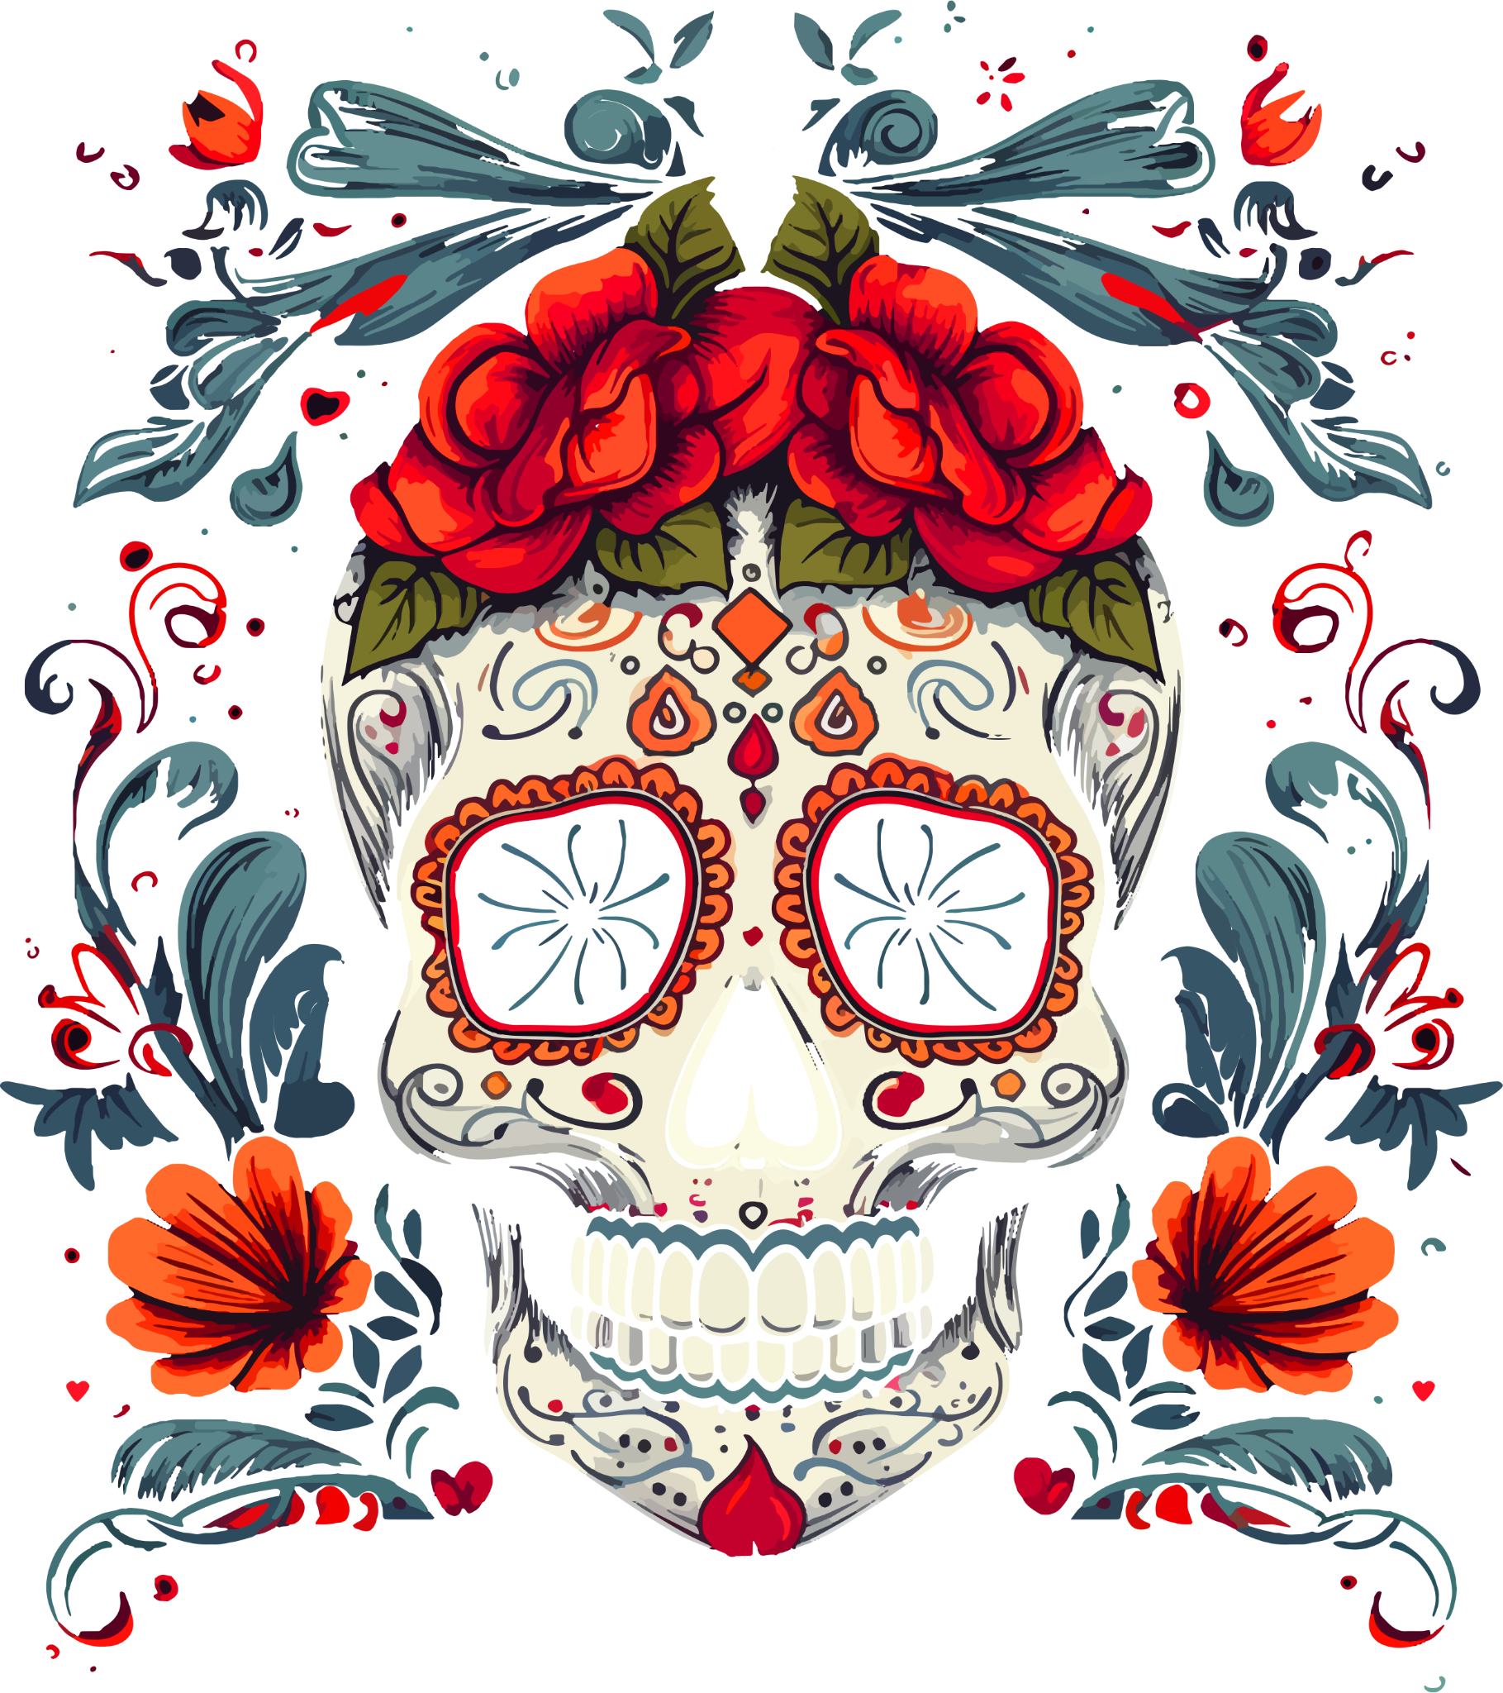
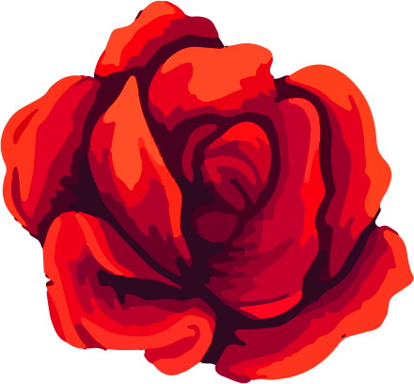
DIA DE LOS
MUERTOS
DAY OF THE DEAD
OCTOBER 30 - 7PM UNTIL 10PM
Special Mexican Buffet | Live Music | Dancing

