Slide 1


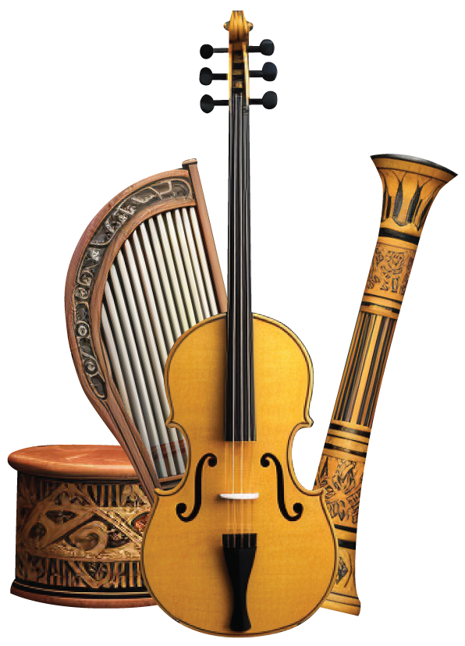
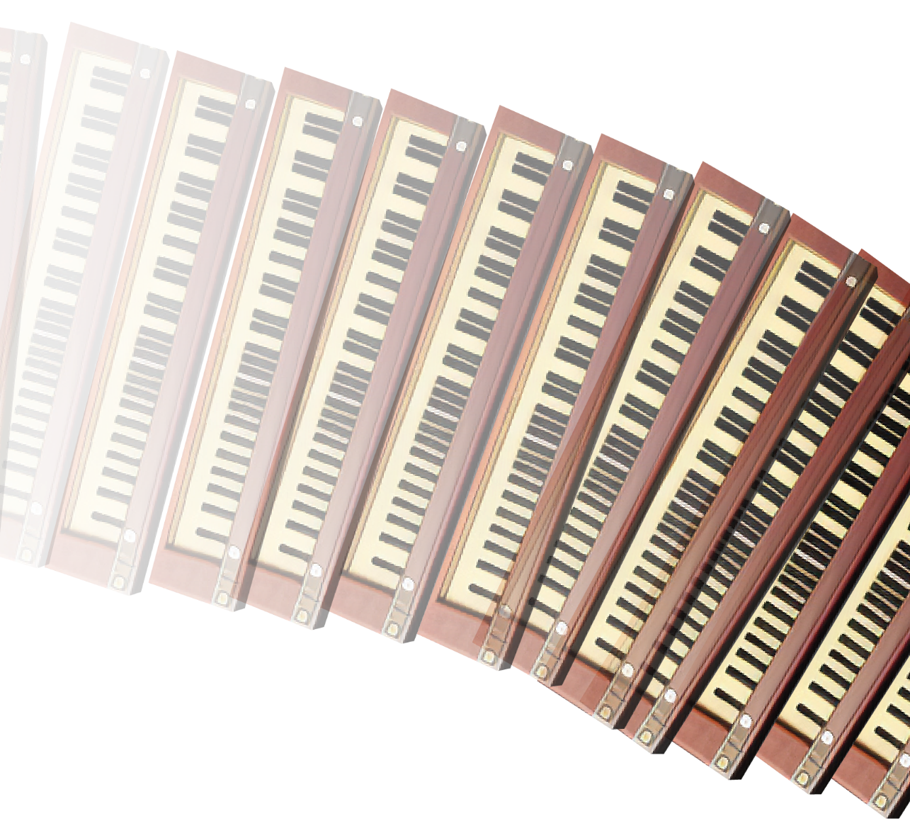

JUNE 12 2024
START 8:00 PM
ROYAL HALL
21,Jenny Hill Street London
Music
FESTIVAL
EXCLUSIVE RETRO MUSICIANS
JOHN BAKER’S - MORY KLONTE - SHEVE MAMMY
FOR MORE INFORMATION PLS VISIT WWW.MUSICFESTIVAL.COM

