Slide 1
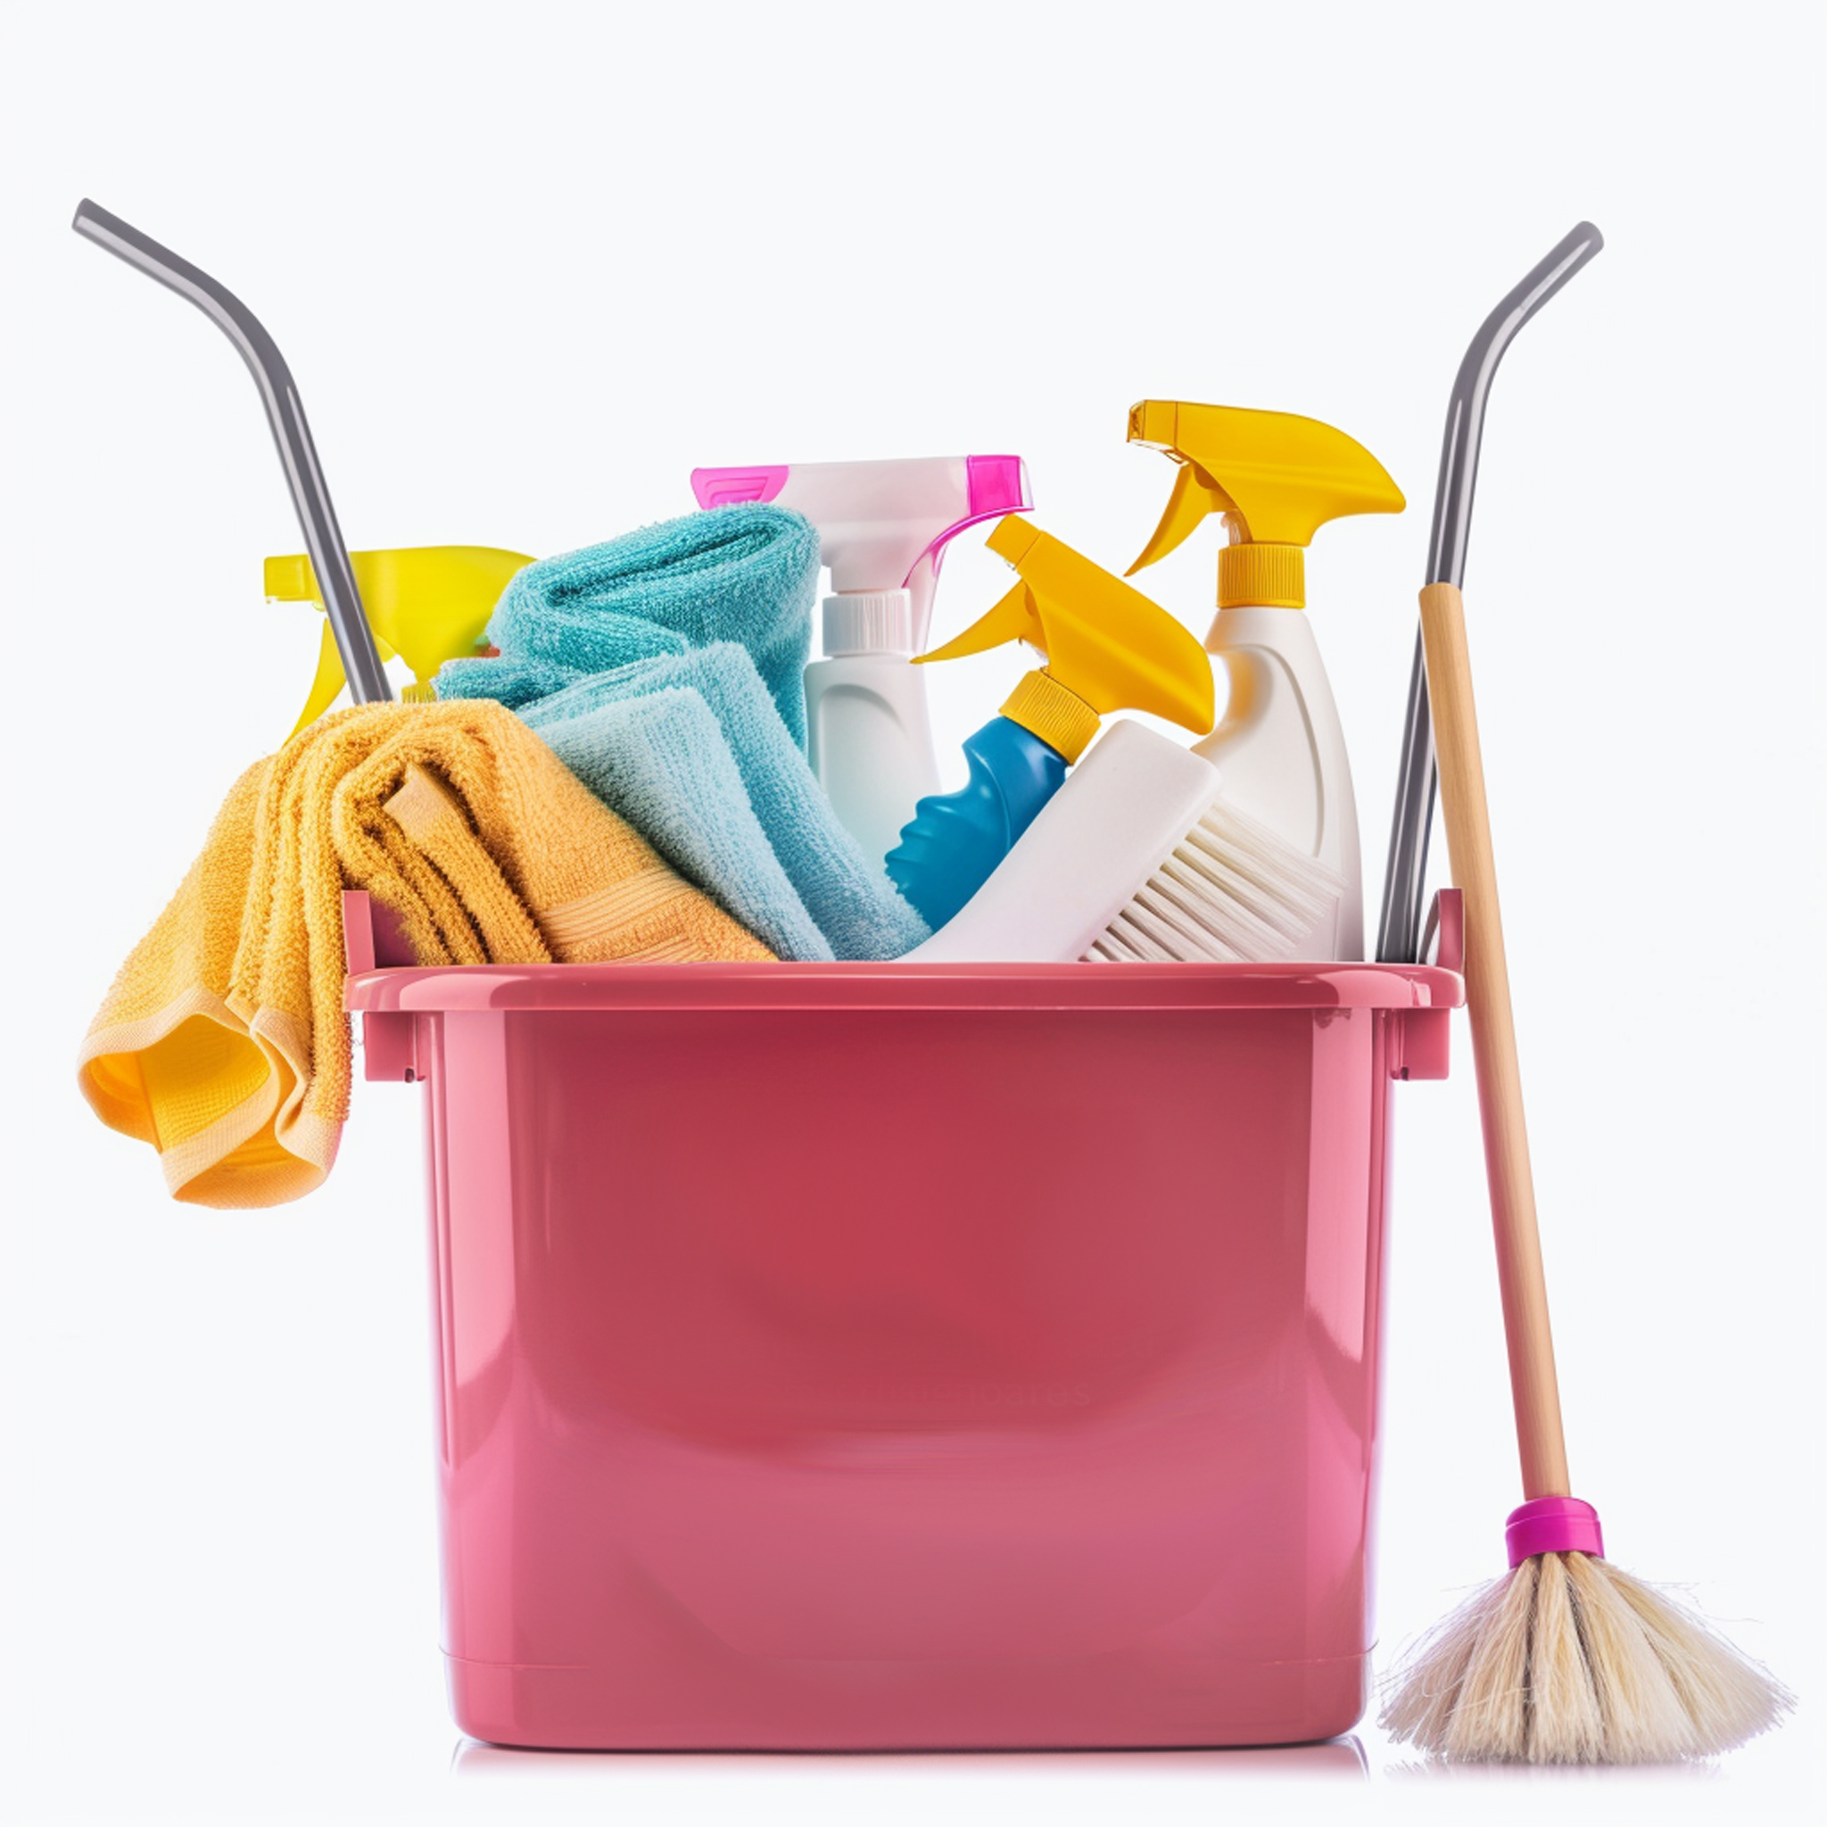
House Cleaning
housecleaning.ltd | +1-012-3456-789 | housecleaning@mail.ltd
Price List
Dusting - $25/$35
Vacuuming - $20/$50
Dusting of furniture surfaces
Dusting of baseboards, window sills
Dusting of ceiling fans and light fixtures
Vacuuming of carpets and rugs
Vacuuming of upholstered furniture
Vacuuming of stairs and under furniture (where accessible)
Bathroom - $50/$100
Kitchen - $20/$50
Cleaning and disinfecting of sinks, countertops, and faucets
Cleaning and disinfecting of toilets, including inside and out
Cleaning and shining of mirrors
Cleaning and polishing of fixtures
Cleaning and sanitizing of countertops and backsplashes
Cleaning of exterior surfaces of appliances
Cleaning and shining of sink and faucet
Wiping down of cabinet exteriors
Additional Services:
Discounts and Promotions:
Inside refrigerator cleaning: $25
Inside oven cleaning: $30
Interior window cleaning: $20 per window
Laundry: $15 per load
Organization services: $25
Pet hair removal: $15
First-Time
Customer Discount
20%

