Slide 1
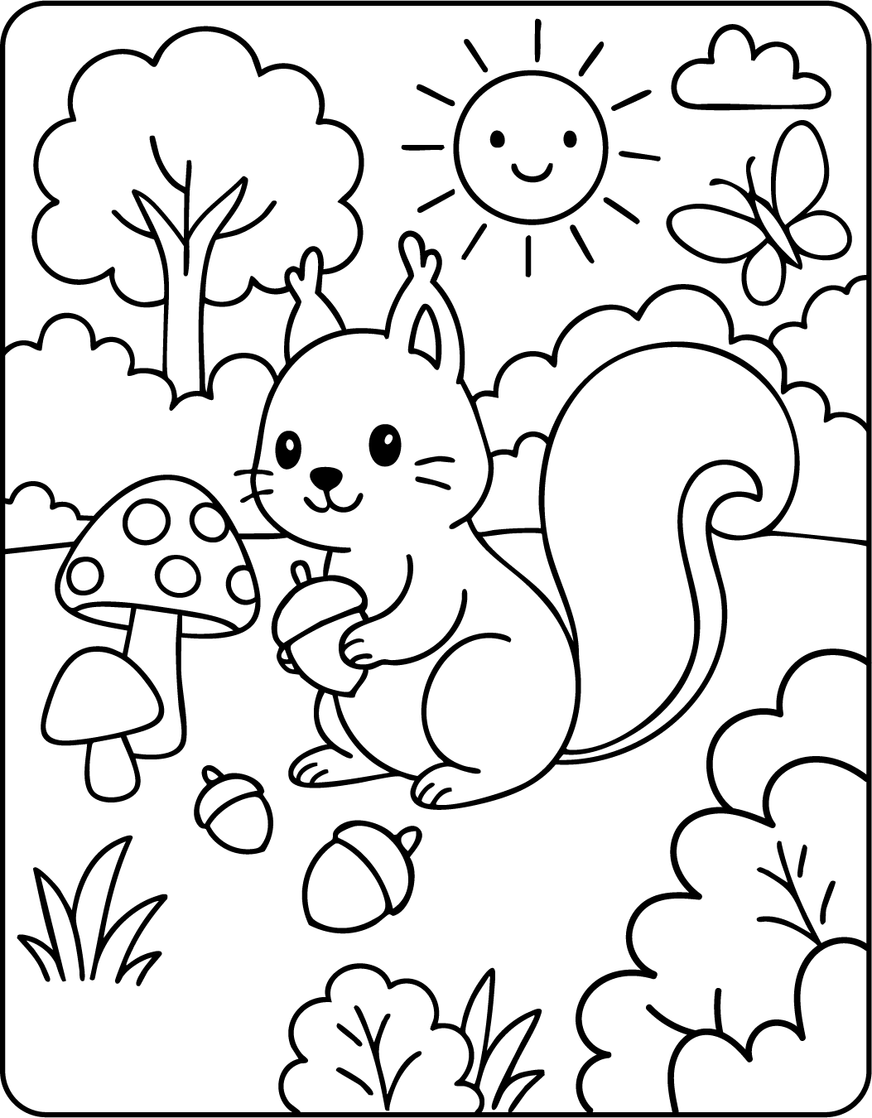
COLOR BY NUMBER - ADDITION
11+3
2+9
9+7
13+6
6+9
1+6
1+10
7+4
3+8
5+6
8+5
10+1
6+5
9+3
15+2
8+1
6+1
7+10
9+4
3+8
2+5
2+5
0+1
8+9
10+1
8+3
7+4
1, 11 Green
6, 16 Yellow
2, 12 Red
7, 17 Brown
3, 13 Orange
8, 18 Purple
4, 14 Blue
9, 19 White
5, 15 Pink
10, 20 Gray

