Slide 1
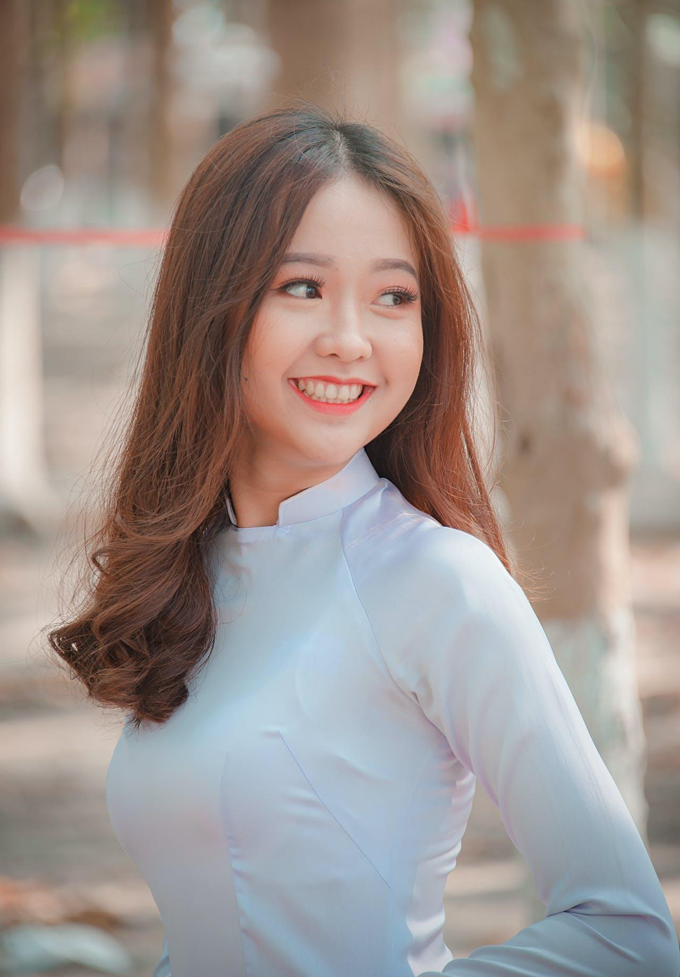
ADALINE SCHMIDT
College Resume
ABOUT ME
The summary section plays a crucial role in your college or job application. It serves as the initial impression for admissions officers or potential employers, providing them with a concise and comprehensive overview of your academic achievements, extracurricular involvement, and personal attributes. Your summary should be a concise paragraph that emphasizes your notable accomplishments and pertinent skills that align with the specific college or institution you are applying to.
EDUCATION
Rexburg High School
CONTACT
Rexburg, Idaho, 282 Oakway Lane
GPA: 3.78
T: 123-4567-8901
ACTIVITIES
M: AdalineSchmidt@mail.com
In: Linkedin.com/in/username
A: 3431 Blane Street, Rexburg
Title
Name of Organization or Club | 2023 - Present
ACHIEVEMENTS
When composing your resume activity section, emphasize the influence you wielded and the proficiencies you honed, rather than solely highlighting your job titles and roles. Employ dynamic verbs and precise instances to present your accomplishments:
David List
•
Orchestrated a prosperous charity function that garnered $700 for a nearby shelter, displaying adept leadership and event coordination abilities.
Autumn 2021
State Science Fair Winner
Spring 2022
Title
Name of Organization or Club | 2021 - 2023
KEY SKILLS
Customize your endeavors to match the proficiencies and background that are most pertinent to the role or educational program you're seeking. Incorporate terms from the job or program details to distinguish your application:
Team Leadership
•
Orchestrated a social media initiative that resulted in a 35% rise in
engagement, highlighting adeptness in communication and digital marketing.
Public Management
Public Speaking
VOLUNTEER WORK
HARD SKILLS
Title
Team Leadership
Name of Organization or Club | 2023 - Present
Public Management
Public Speaking

Slide 2
ADALINE SCHMIDT
College Resume
COVER LETTER
Hiring Manager’s Ezekiel Douglas
CONTACT
Job Position
College Name
T: 123-4567-8901
March 13, 2025
M: AdalineSchmidt@mail.com
In: Linkedin.com/in/username
Dear Mr Ezekiel Douglas
A: 3431 Blane Street, Rexburg
A cover letter introduces yourself to the employer and highlights your relevant qualifications and experiences. Its purpose is to convince the employer that you are the right candidate for the job by demonstrating your enthusiasm and unique skills. While a cover letter is not always required by every employer, it is highly recommended to include one as it can increase your chances of being invited for an interview. Overall, it is a crucial part of a job application that can help you stand out from other candidates.
Begin with an opening paragraph: Introduce yourself and explain why you are interested in the job. Mention how you found out about the job opening and any connections you have to the company.
Highlight your qualifications: Use the body of the letter to explain how your skills and experiences make you a strong candidate for the job. Be specific and give examples of times when you demonstrated these skills.
Show your enthusiasm: In the closing paragraph, express your excitement about the opportunity to join the company and contribute to its success. Thank the employer for considering your application and include your contact information.
Use a professional sign-off like "Sincerely" or "Best regards,” followed by your name.
Before sending your cover letter, make sure to proofread it carefully for spelling and grammar errors. You may also want to have a friend or mentor review it to get feedback and make sure it is clear and concise.
ACHIEVEMENTS
David List
Autumn 2021
State Science Fair Winner
Spring 2022
KEY SKILLS
Team Leadership
Public Management
Public Speaking
HARD SKILLS
Team Leadership
Public Management
Public Speaking
Adaline Schmidt
Sincerely,

Slide 3
ADALINE SCHMIDT
College Resume
REFERENCES
Krystal Franecki
CONTACT
Rexburg High School
Event Coordinator
T: 123-4567-8901
T: 123-4567-890
M: AdalineSchmidt@mail.com
E: name@mail.com
In: Linkedin.com/in/username
Araceli Greenfelder
A: 3431 Blane Street, Rexburg
Rexburg High School
Peer Mentor
ACHIEVEMENTS
T: 123-4567-890
E: name@mail.com
David List
Justice Tremblay
Autumn 2021
Rexburg High School
State Science Fair Winner
Teacher
Spring 2022
T: 123-4567-890
E: name@mail.com
KEY SKILLS
Jevon Heidenreich
Rexburg High School
Team Leadership
Teacher
Public Management
T: 123-4567-890
Public Speaking
E: name@mail.com
Bruce Feeney
HARD SKILLS
Rexburg High School
Teacher
Team Leadership
T: 123-4567-890
Public Management
E: name@mail.com
Public Speaking

