Slide 1
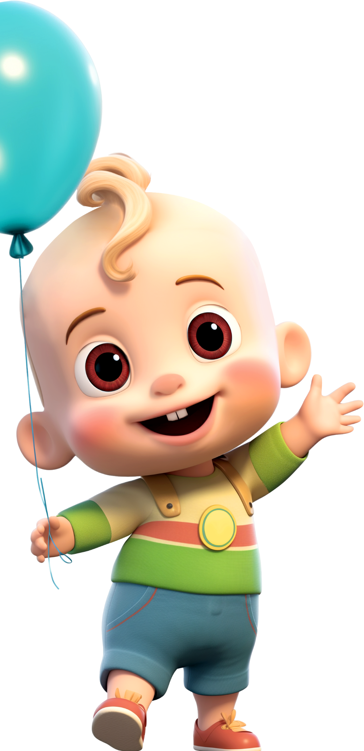
Sophia’s
BIRTHDAY
PARTY
IS TURNING 4
Come and celebrate with us
15 | 12 | 26
RSVP to Monica 777-312-345
by December 15th

