Slide 1
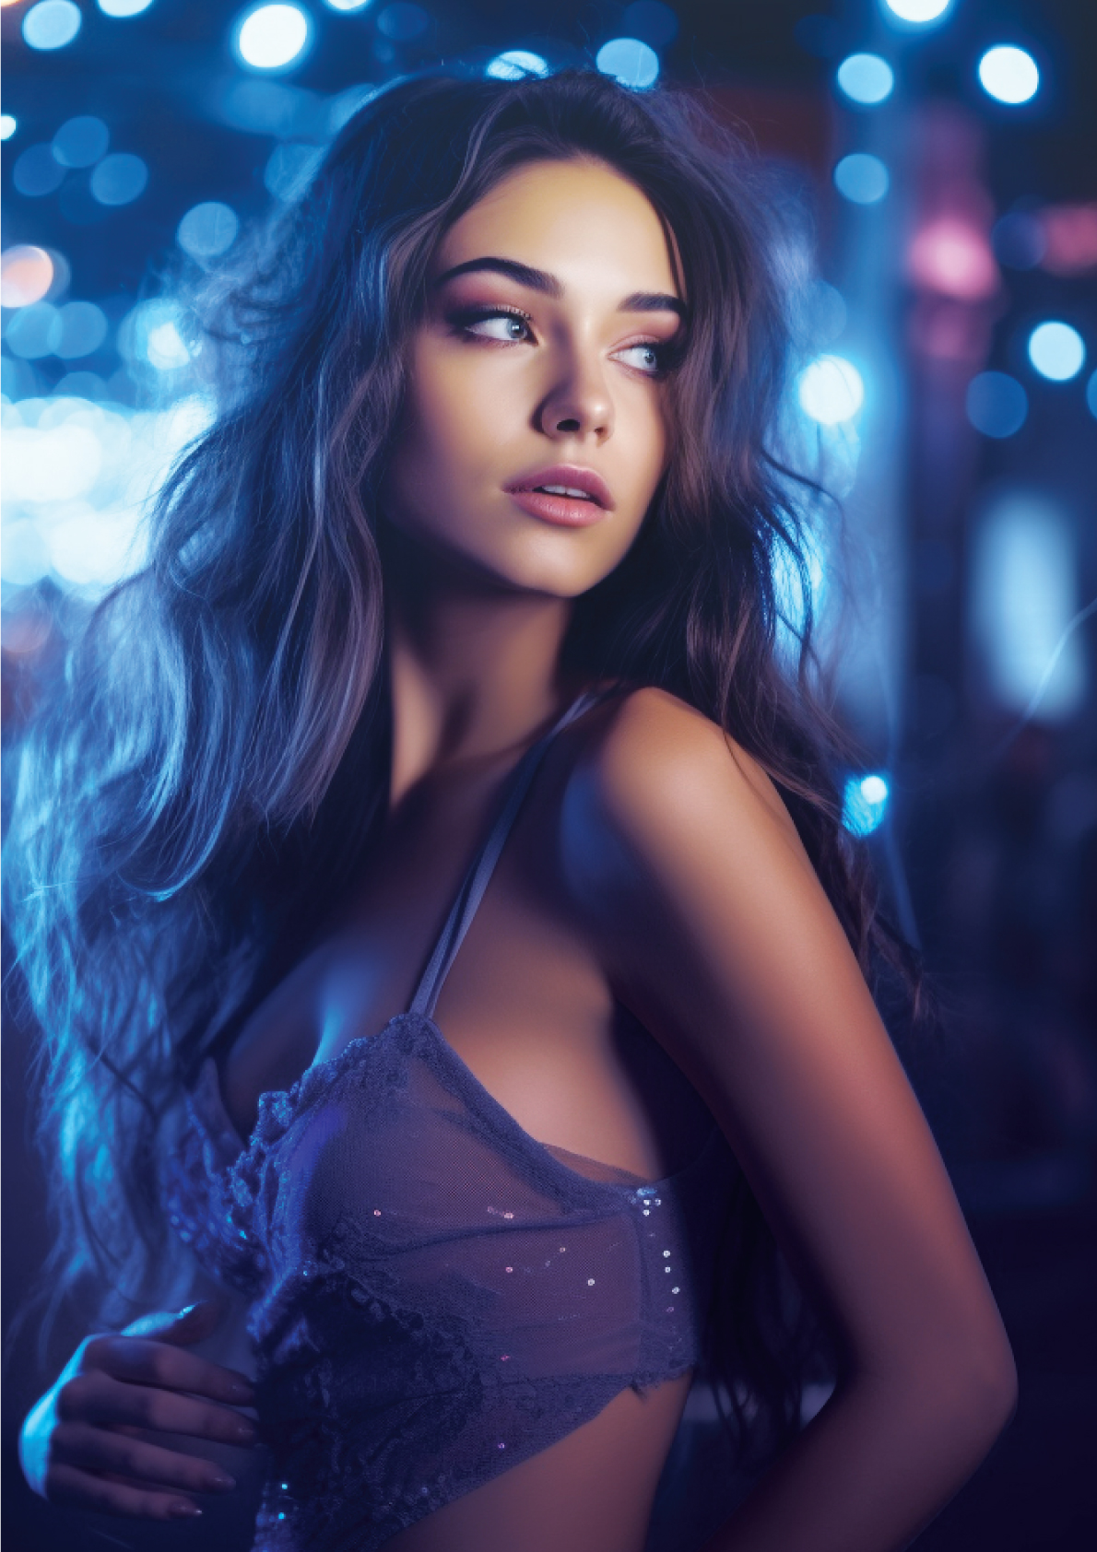
sat
june
21ST
your club presents
CLUB
Party
free entry • Free Parking
Free champagne
DOORS OPEN AT 11PM // ENTER GIRLS // DRESS TO IMPRESS
WWW.CLUBWEBSITE.COM

