Slide 1

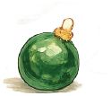
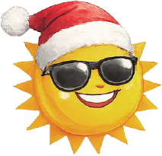
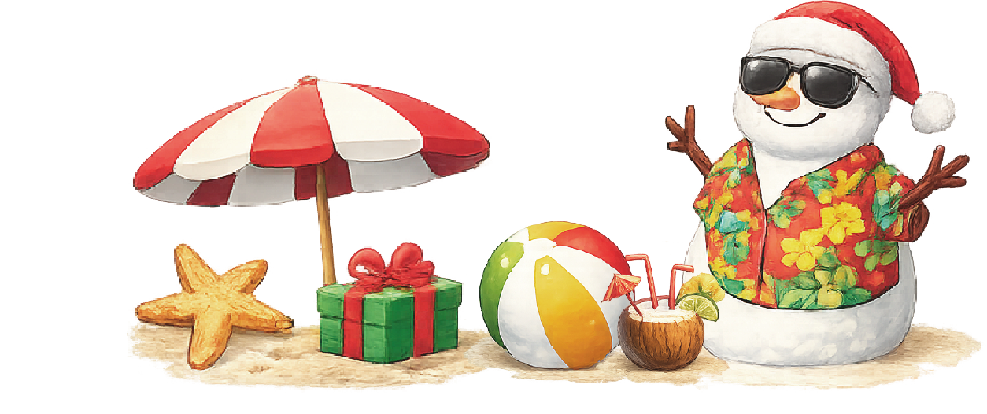
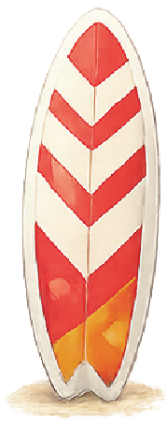
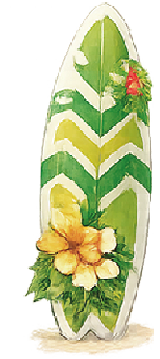


Sun, sand… and Santa?
CHRISTMAS
IN JULY
Hosted by:
the Harrison Family
Saturday, July 25
2:00 PM – 7:00 PM
Tropical drinks • Music • Games
RSVP: (123) 456-7890
458 Palm Grove Avenue, Santa Monica, CA 90402

